Slide 1

Facilitating Investment in SDG Projects
Regional Seminar on Facilitating Investment in SDG-Projects
26-28 November 2019, St. Kitts and Nevis
Natalia Guerra
Senior Capacity - Building Coordinator
Investment Promotion Section
Division on Investment and Enterprise

Slide 2
What is Investment Facilitation (IF)?
Making it easier to invest and do business
Definition:
Examples:
A set of policies and actions aimed at making it easier for investors to establish and expand their investments, as well as to conduct their day-to-day business in host countries; focuses on alleviating ground-level obstacles for investment
transparent and predictable rules
efficient administrative procedures
dispute prevention
effective stakeholder relations
investor services (helping to deal with rules/procedures)

Slide 3
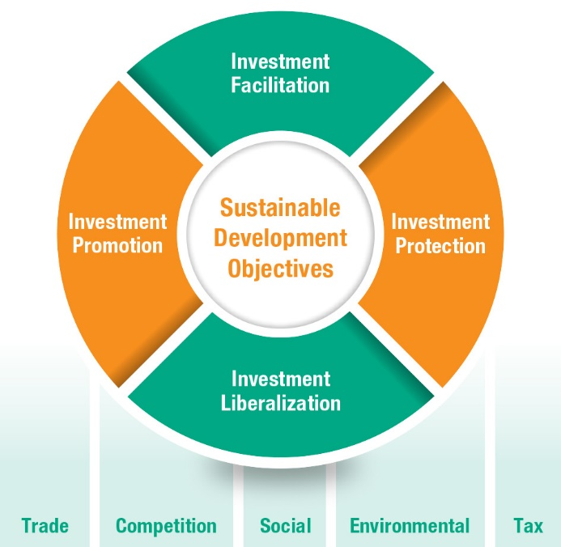
Investment Facilitation and other areas of investment policy making
Issues of delimitation and grey zones
Source: ©UNCTAD

Slide 4

UNCTAD’s Global Action Menu for Investment Facilitation (2016)
Takes a holistic approach
Key characteristics: content
  is in line with sustainable development objectives
  sets out 10 action lines covering a wide range of policy areas
  offers flexibility: countries can adapt and adopt it for their national and international policy needs
Key characteristics: process
  is based on extensive experience and policy analyis
  incorporates multi-stakeholder feedback
  is implemented through technical assistance and advisory services
  is solidly rooted in international mandates

Slide 5

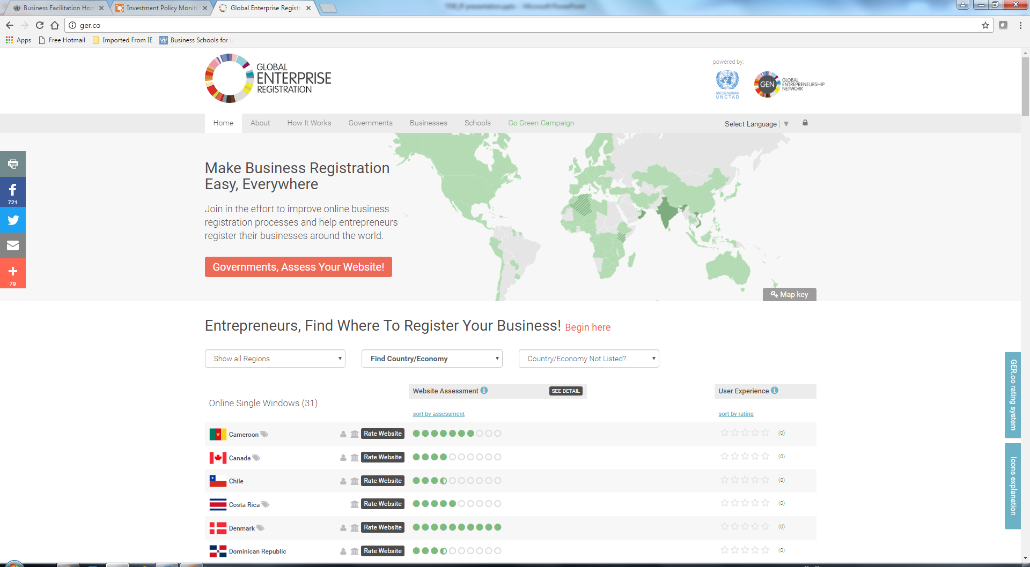
UNCTAD’s Global Action Menu for Investment Facilitation (2016)
Is implemented through technical assistance and advisory services
UNCTAD’s work on International Investment Agreements (IIAs)
UNCTAD Investment Facilitation Compact (iGuides, eRegulations, eRegistrations)
Peer-group learning GER.co (the Global Enterprise Registration Portal)
UNCTAD’s Investment Policy Reviews (IPRs)
UNCTAD’s cooperation with Investment Promoton Agencies

Slide 6
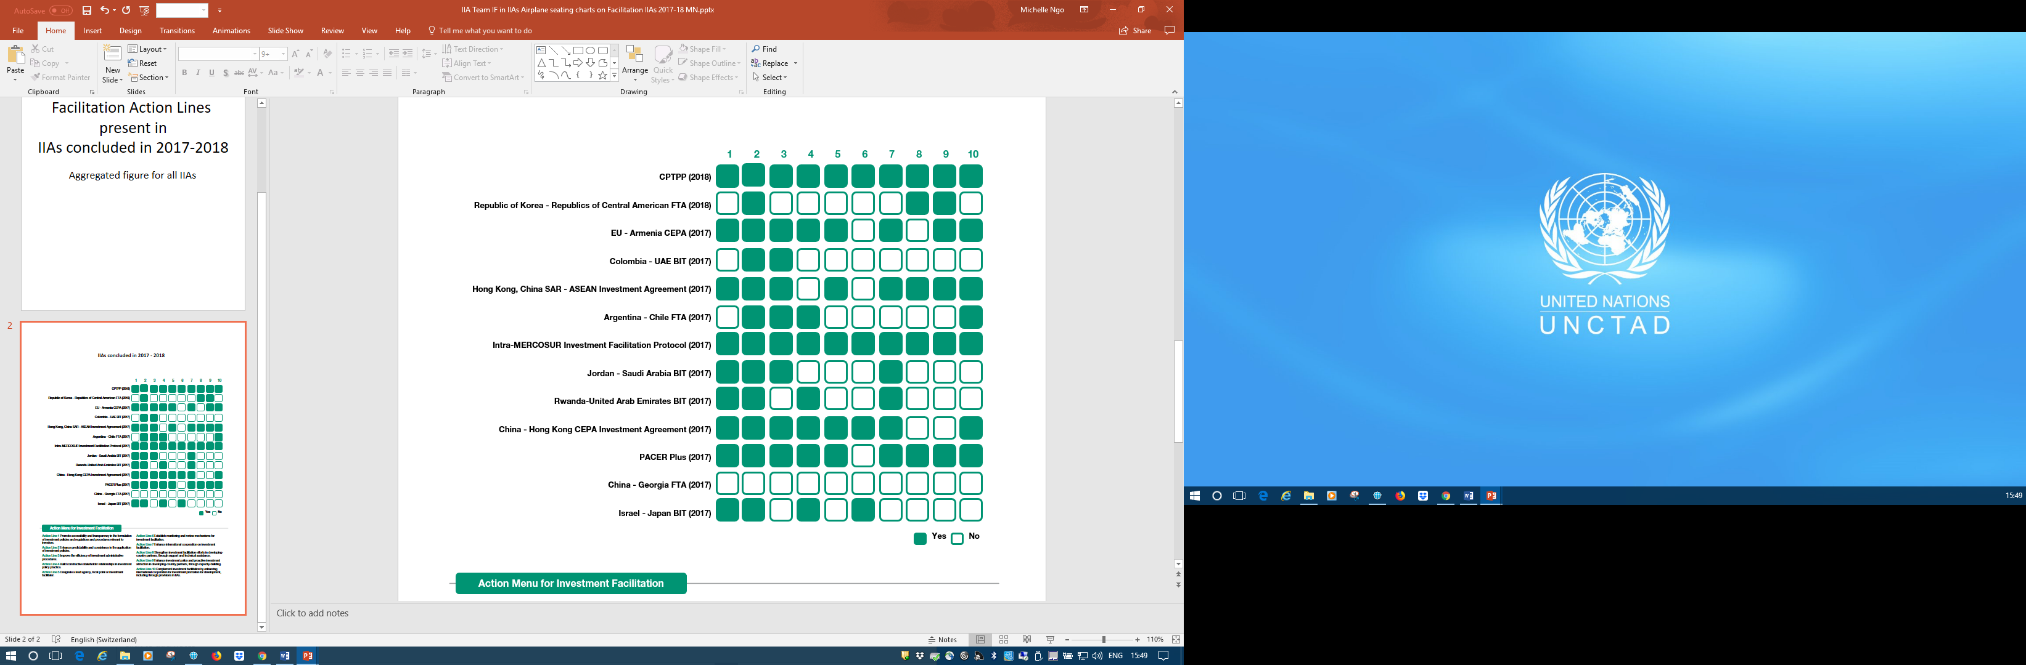

UNCTAD Global Action Menu - Facilitation Action Lines present in
IIAs concluded in 2017-2018
Action Menu for Investment Facilitation
Action Line 1 Promote accessibility and transparency in the formulation of investment policies and regulations and procedures relevant to investors.
Action Line 2 Enhance predictability and consistency in the application of investment policies.
Action Line 3 Improve the efficiency of investment administrative procedures.
Action Line 4 Build constructive stakeholder relationships in investment policy practice.
Action Line 5 Designate a lead agency, focal point or investment facilitator.
Action Line 6 Establish monitoring and review mechanisms for investment facilitation.
Action Line 7 Enhance international cooperation on investment facilitation.
Action Line 8 Strengthen investment facilitation efforts in developing-country partners, through support and technical assistance.
Action Line 9 Enhance investment policy and proactive investment attraction in developing-country partners, through capacity-building.
Action Line 10 Complement investment facilitation by enhancing international cooperation for investment promotion for development, including through provisions in IIAs.
Note: For TIPs, mapping based on full text, where available, and investment chapters only, where not

Slide 7
UNCTAD Global Action Menu and the global IIA regime
BITs clauses on transparency
Share of the current stock of BITs containing a provision on transparency
Share of BITs containing a provision on transparency, 1968−2018 (Per cent)
13
BITs signed per period
>65%
≈30%
5%
Source: UNCTAD IIA Mapping Project.
Note: Slide Presented in April 2018. Based on approximately 2,500 BITs signed between 1968 and 2018. The bars on “transparency” also include “a priori” transparency.

Slide 8
Mainstreaming SDGs in investment promotion and facilitation
1. Identify SDG target sectors
2. Align the IPA structure
3. Select SDG projects
4. Develop an SDG project pipeline
5. Find and secure partners
6. Promote sectors and projects
7. Facilitate and provide aftercare
8. Give stake-holders feedback
Typical Steps
New SDG-related steps
Source: UNCTAD, Investment Advisory Series 8
Notes:
2. Align the IPA structure (IPAs will require the development of specialized expertise on sustainability and Goal-related sectors, and the capacity to assess projects, prepare high-quality proposals and marketing materials, and seek various forms of financing).
4. Develop an SDG project pipeline (IPAs can elaborate Goal-related projects that have been prioritized in the pipeline using a template that meets the requirements of investors).
5. Find and secure partners (IPAs should work closely with the private sector to identify firms that could contribute to the achievement of the Goals. Long-term partnerships with
in-country stakeholders can enhance the development, packaging and promotion of projects and provide insight on objectives and plans. Other possible partners are OIAs that can support IPAs in promoting Goal-related projects in the home countries of investors).

Slide 9
SDG Investment Facilitation project cycle
1
Incorporate SDG projects into IPA aftercare program
Ensure the SDG impacts form the basis of re-investments
2
Advocate policy – promote national development through investment
Support new establishment through improved IF
3
Monitor, evaluate and feedback systematically
1
Ensure the investment regime is SDG friendly
Negotiate and implement agreements with the donors’ community
2
Update information on investment regulations
Made clear and available any guidelines e.g. for screening and investment proposals
3
Pre-empt SDG facilitation issues
Partner locally with experts in the SDG areas
Pre -establishment
Establishment
Post-establishment
1
Develop linkages with SDG engaged organizations
Partner locally to facilitate set-up and establishment
2
Avoid discrimination in laws and regulations
Apply investment regulations consistently
3
Provide for amicable dispute settlement decision making
Combat corruption
Notes:
1. Pre-establishment: - Create a positive environment (e.g. regional agreements that deal with SDGs, BITs)
- Develop key partnerships with international donors/ funders to facilitate co-operation/
- Update information on investment regulations
- Provide clear screening guidelines and definitions for assessing investment proposals
- Pre-empt SDG –specific facilitation issues that might arise
- Partner locally with experts in the SDG areas targeted
2. Establishment: - Drive for centralised start-up support for SDG projects
- Partner locally to facilitate set-up and establishment
- Avoid bureaucratic discrimination in laws and regulations
- Apply consistently investment regulations
- Provide for amicable dispute settlement decision-making
3. Post establishment: - Incorporate SDG projects into IPA aftercare program
- Ensure SDG impacts envisaged that also form the basis of re-investments
- Advocate policy – to promote national development through investment
- Inform and support new establishment through improved IF
- Monitor, evaluate and feedback systematically

Slide 10
Strategic issues for SDG IF
1. IPA’s organization
2. Information access and transparency
3. Partnerships
4. Intra & inter regional cooperation
5. Commitments
6. Support programmes
7. Feedback
Notes:
IPA’s Organization : - provide resources that deal with SDGs priorities
- proactive approach
2. Information access and transparency: - e-regulations portal
- publishing/making available SDG
projects
3. Partnerships: - partner locally
- partner with outward investment agencies (OIAs)
- use of Public-Private-Partnerships (PPPs)
4. Intra & inter regional cooperation Fora: - develop a national Forum on SDG
- a global SDG facilitation centre of excellence for IPA’s
5. Commitments: - IPAs can develop Client Charters for a range of tailored
support services
- Ombudsman support for the Charter commitments not
fulfilled
6. Support programmes: - aftercare
- business linkages
7. Feedback: - policy advocacy
- evaluation and monitoring systems

Slide 11
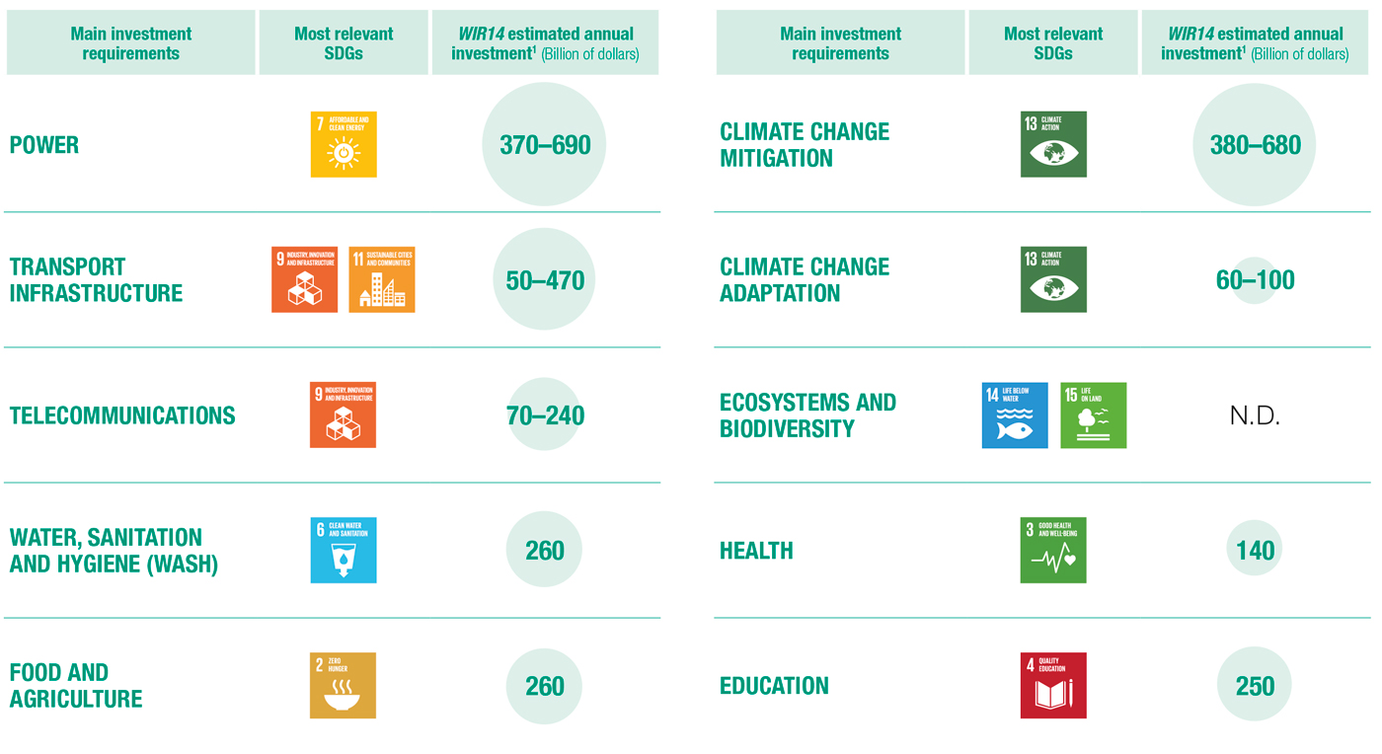
UNCTAD World Investment Report (WIR) 2014
Assessed investment needs and gaps across 10 sectors
Source: UNCTAD, SDG Investment Trends Monitor, 2019, based on WIR 2014.
Notes:
The 10 sectors cut across the 17 SDGs and fall within three pillars of the SDGs: economic growth, social inclusion and environmental stewardship.
Why did we choose these 10? These are the sectors that have significant and identifiable sustainable development financing needs. The SDGs which required institutional change, rather than investment (e.g. SDG 17 – partnerships) were not included.
The SDG investment sectors cover basic infrastructure (roads, rail and ports; power stations; telecommunications; water and sanitation); food security (agriculture and rural development); climate change mitigation and adaption; health and education.
Many of the sectors have cross-cutting links with a number of SDGs. However, we tried as best as possible to separate the sectors in terms of their capital expenditure requirements.
The WIR 14 estimates included Capex only.

Slide 12
Thank you!
Natalia Guerra
Senior Capacity-building Coordinator
Investment Promotion Section UNCTAD
Natalia.guerra@unctad.org

