Slide 1
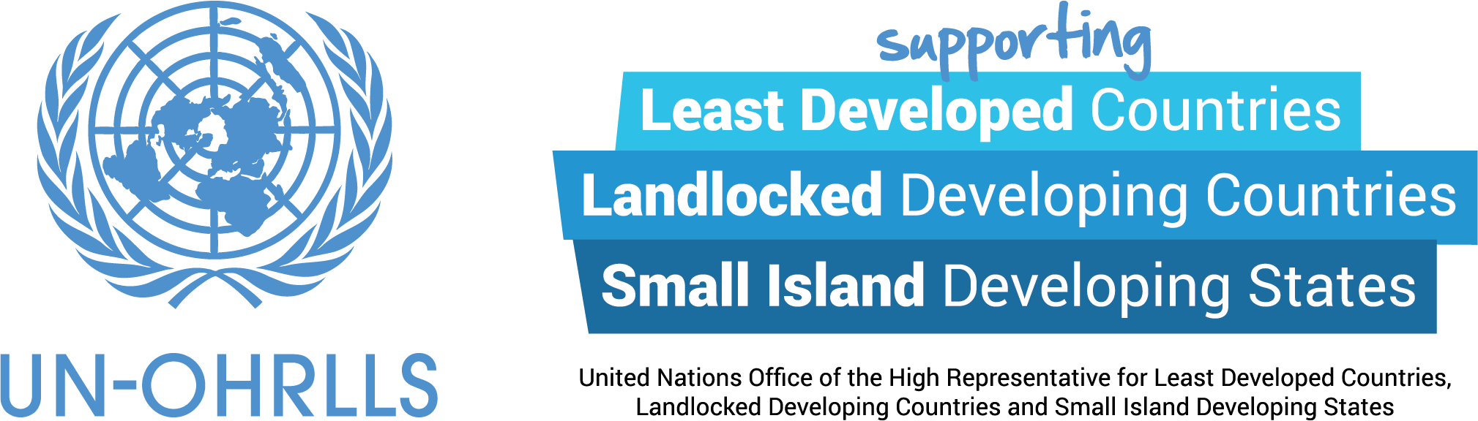
Role of partnerships and the SAMOA Pathway
in advancing the implementation of the SDGs in SIDS
Ms. Tishka Francis, Head of the SIDS Sub-Programme UN-OHRLLS

Slide 2
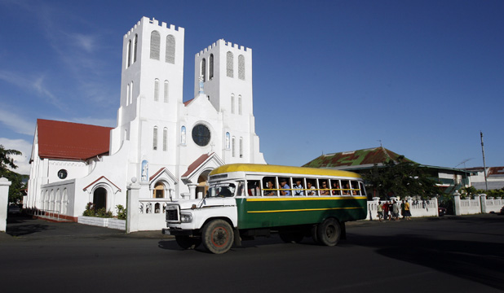

The SAMOA Pathway and the Mid-Term Review
Small Island Developing States Accelerated Modalities of Action (SAMOA)
2014 Adopted at the 3rd International Conference on SIDS in Apia, Samoa.
  Theme of the conference:
  Sustainable development through genuine and durable partnerships
  Resulted in some 300 partnerships
2019 The Mid Term Review of the SAMOA Pathway September New York, USA.
  Renewed commitment to meaningful partnerships with SIDS
  Reiteration of the importance of ocean-based economic growth and diversification

Slide 3
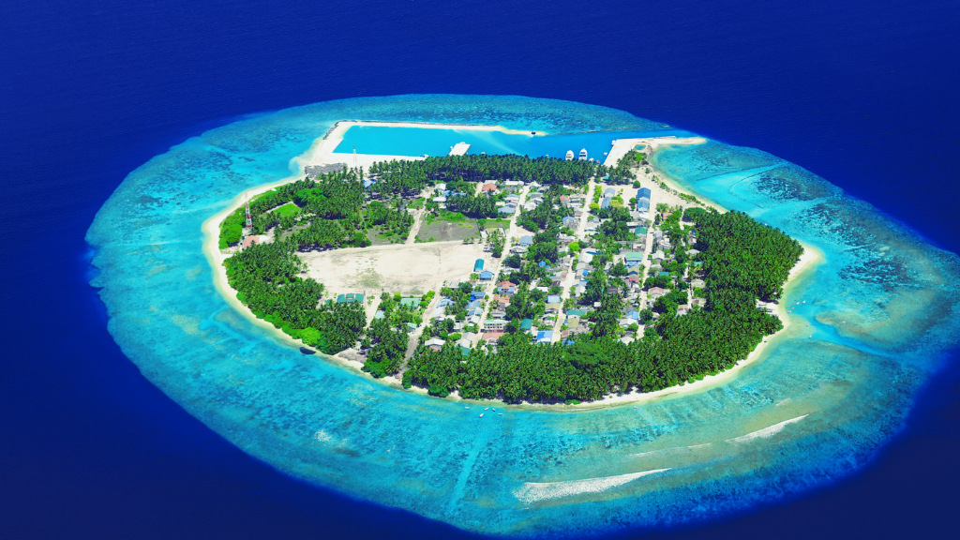
What is the SIDS Partnership Framework?
Consists of:
A Steering Committee
Annual Global Multi-stakeholder SIDS Partnership Dialogue

Slide 4
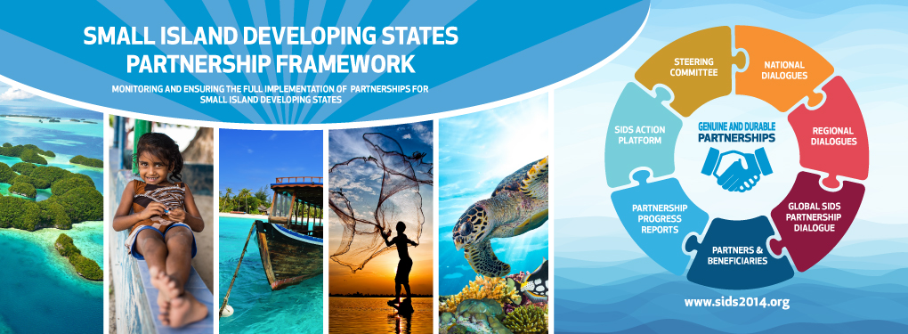
SIDS Partnership Framework: Key outputs in 2018
Partnership Analysis
Regional Partnership Dialogues
Criteria and Norms
Partnership Toolbox
For more information on the Partnership Framework and registering partnerships please visit: https://sustainabledevelopment.un.org/sids/partnershipframework

Slide 5

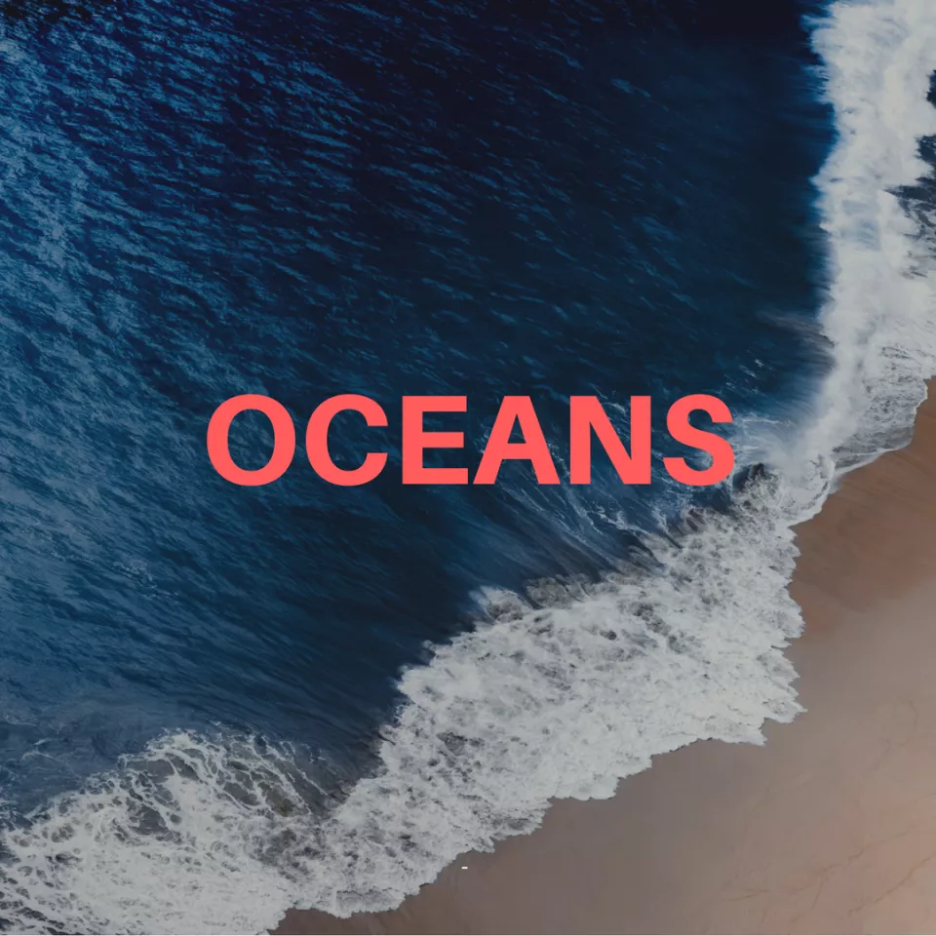
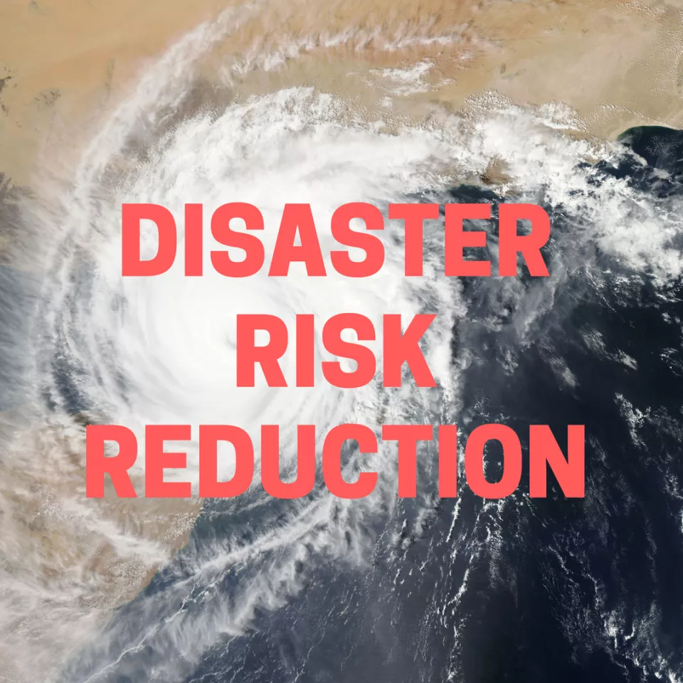



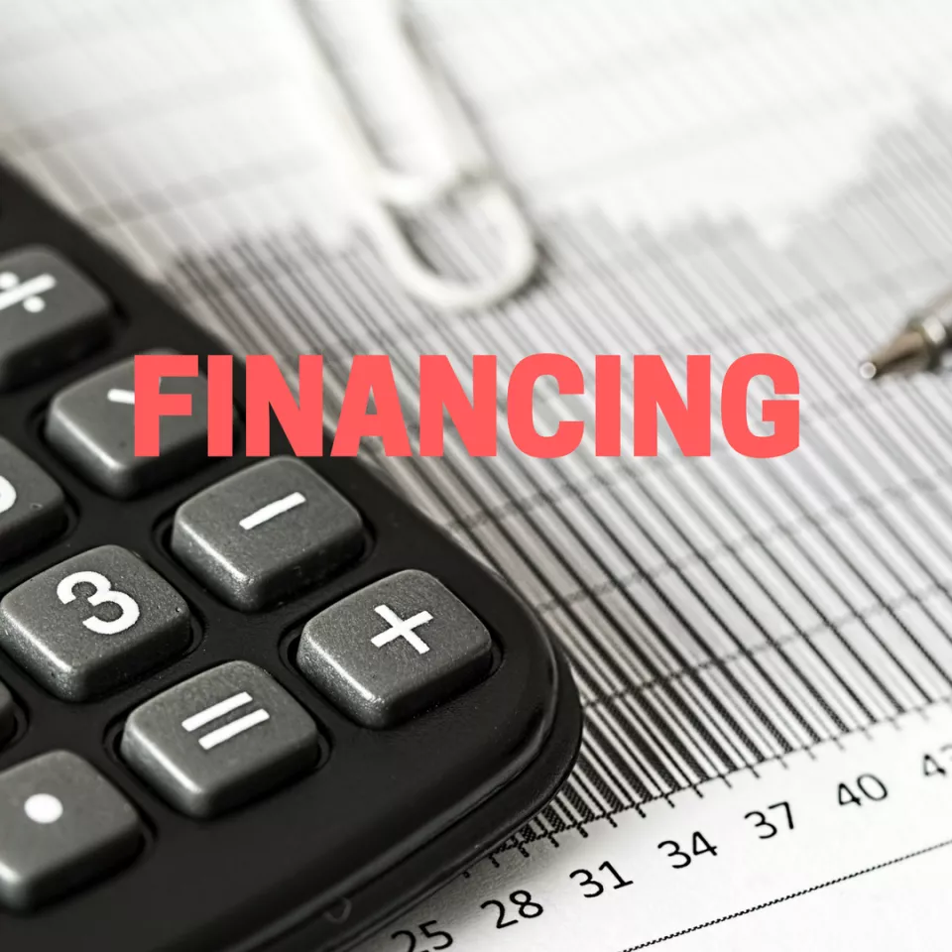

The SIDS Global Business Network (SIDS-GBN) and engagement of the Private Sector
Launched in 2016 to strengthen partnerships with the private sector
Structure of the SIDS-GBN consists of:
  SIDS-GBN Forum – Every 2 years
  SIDS-GBN Online Platform
The SIDS-GBN focuses on seven thematic areas:

Slide 6
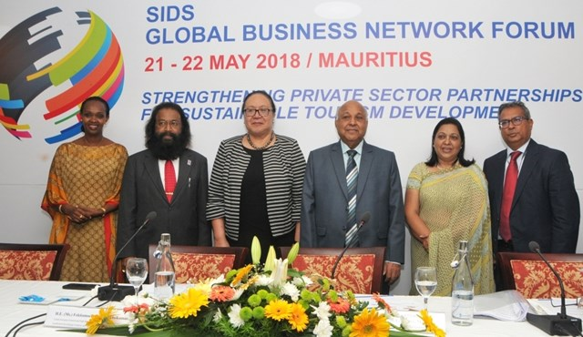
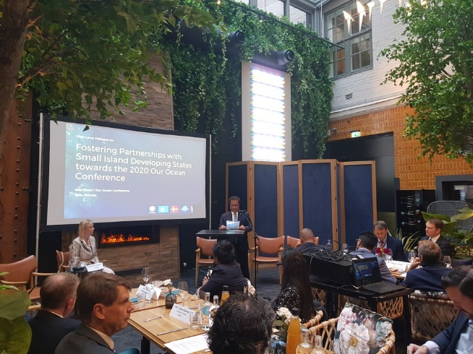
The SIDS Global Business Network (SIDS-GBN) and engagement of the Private Sector
SIDS-GBN Forums
3 SIDS-GBN Forums organized so far, one in each SIDS Region
  Example: 2018 SIDS GBN Forum Mauritius and Partnership established on renewable energy based desalination systems
The Next SIDS GBN Forum in Palau, in the context of the 2020 Our Oceans Conference to be held in the country
  Informed by the recent High Level Dialogue at Our Ocean Conference 2019

Slide 7
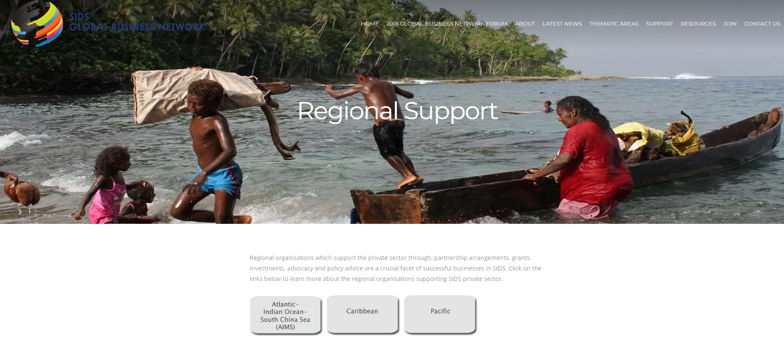
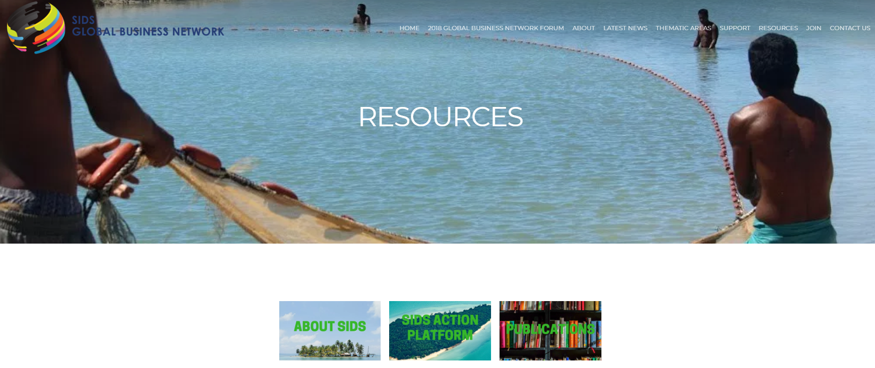
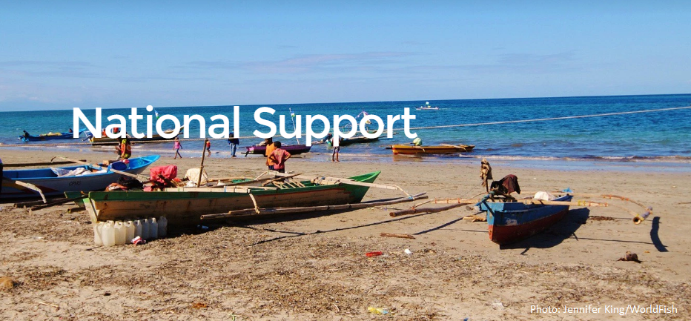
The SIDS Global Business Network (SIDS-GBN) and engagement of the Private Sector
The Online Platform
  News
  Resources
  Support
    Global
    Regional
    National
      E.g. Information on the National Chamber of Commerce
      Key indicators for starting a business per country (WB)

Slide 8

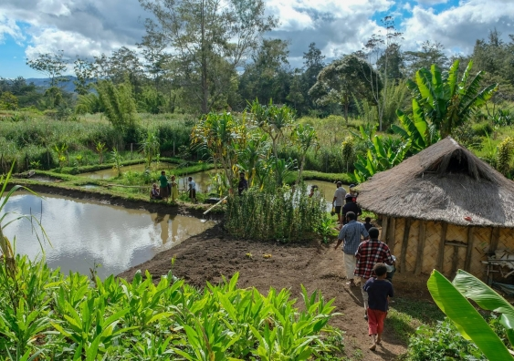
The way forward
OHRLLS Continues to strenghten partnerships to support the SAMOA Pathway
Towards the Second UN Ocean Conference in Lisbon, Portugal
  Opportunities for partnerships in particular on SDG 14 for SIDS and LDCs on ocean based industries
Key areas for future private sector engagement with SIDS and FDI
  Sustainable Tourism
  Sustainable Agriculture
  Infrastructure

