Slide 1

The role of SEZs
Regional Seminar for the Caribbean on Facilitating Investment in SDG Projects: Spotlight on Small Island Developing States
26-28 November 2019
St. Kitts and Nevis
Paul Wessendorp
Chief, Investment Promotion Section
United Nations Conference on Trade and Development

Slide 2
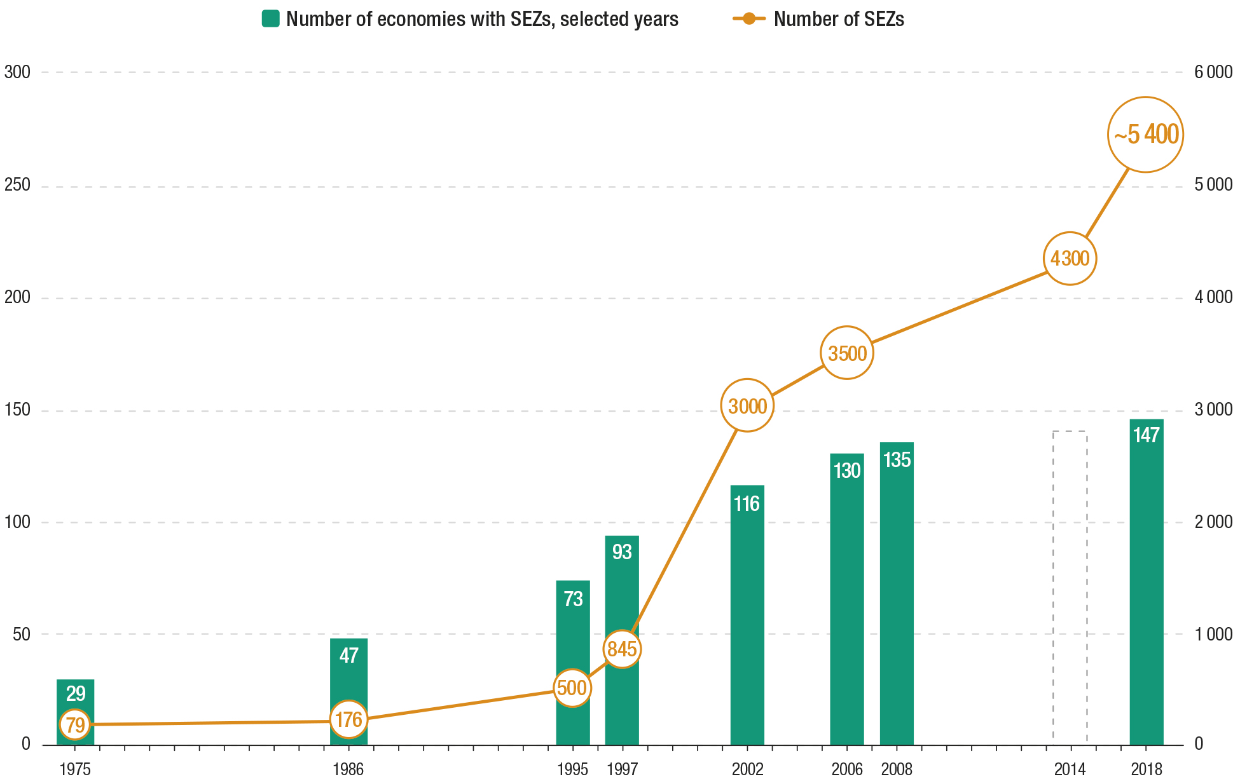
Special economic zones (SEZs) widely used around the world
Historical trend in SEZs
(Numbers of countries and SEZs)
Source: UNCTAD WIR 2019.

Slide 3
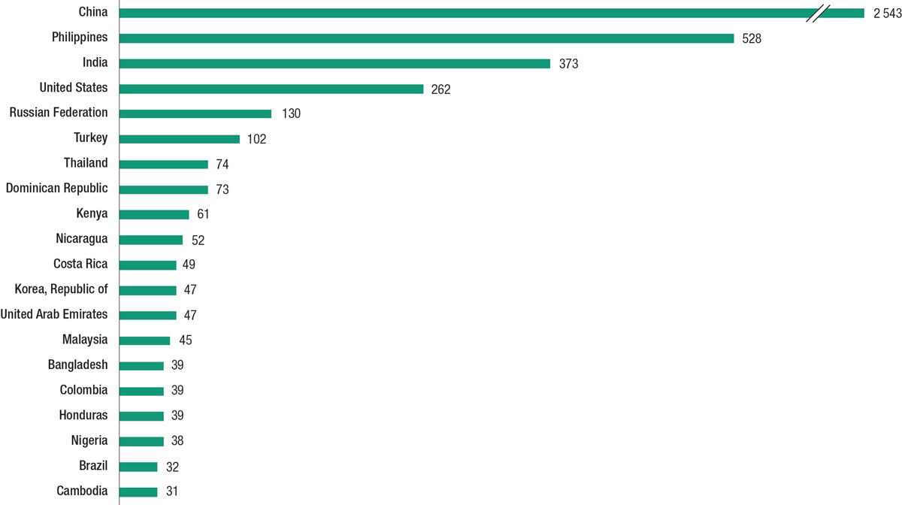
A diverse set of economies embrace SEZs
Economies with the most SEZs, 2019
Source: UNCTAD WIR 2019.

Slide 4
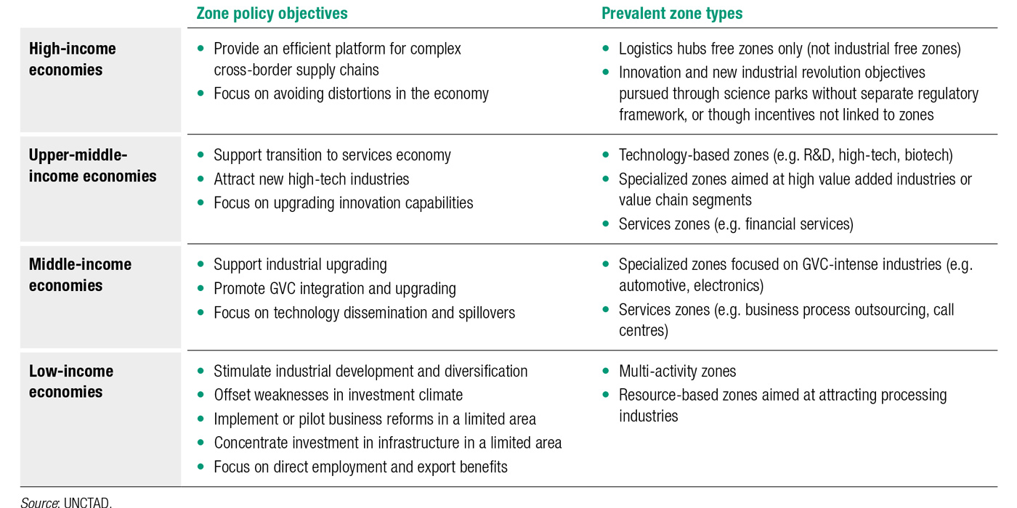
Zone types follow an SEZ development ladder
The SEZ development ladder
Source: UNCTAD WIR 2019.

Slide 5
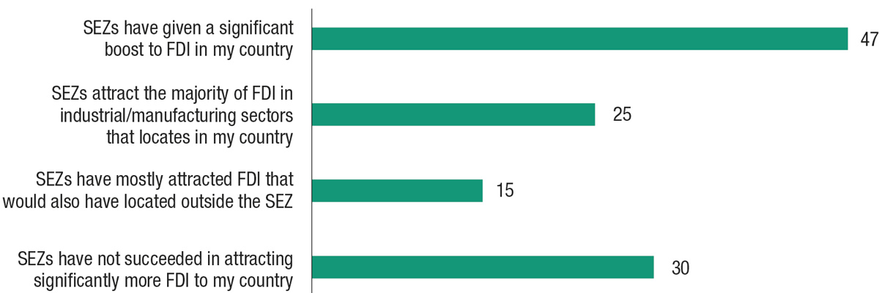
Role of SEZs – Survey of investment promotion agencies
Contribution of SEZs to investment promotion
(Percentage of respondents)
Source: UNCTAD WIR 2019.

Slide 6
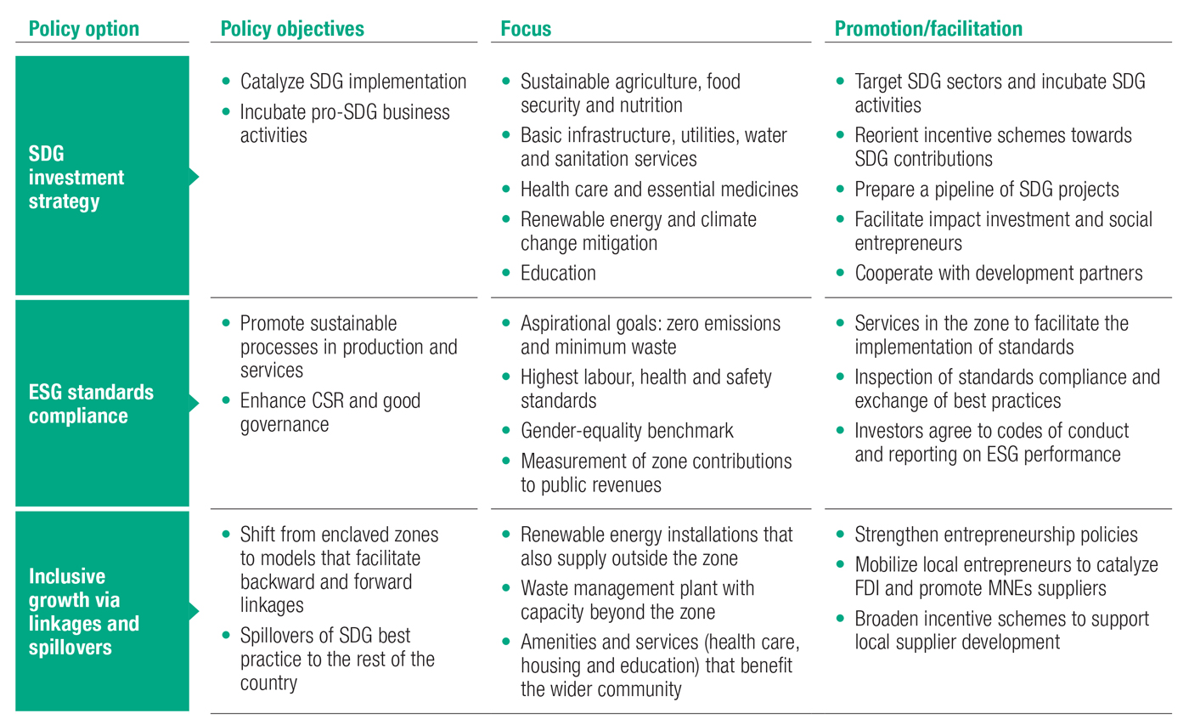
List of policy options for the creation of SDG model zones
Source: UNCTAD WIR 2019.

Slide 7
Thank you!
Paul Wessendorp
Chief, Investment Promotion Section
Division on Investment and Enterprise
UNCTAD
paul.wessendorp@un.org
This presentation will be available on sustainableFDI.org

