Slide 1

FDI trends, investment in SIDS
and the SDGs
Regional Seminar for the Caribbean on Facilitating Investment in SDG Projects: Spotlight on Small Island Developing States
26-28 November 2019
St. Kitts and Nevis
Paul Wessendorp
Chief, Investment Promotion Section
United Nations Conference on Trade and Development

Slide 2
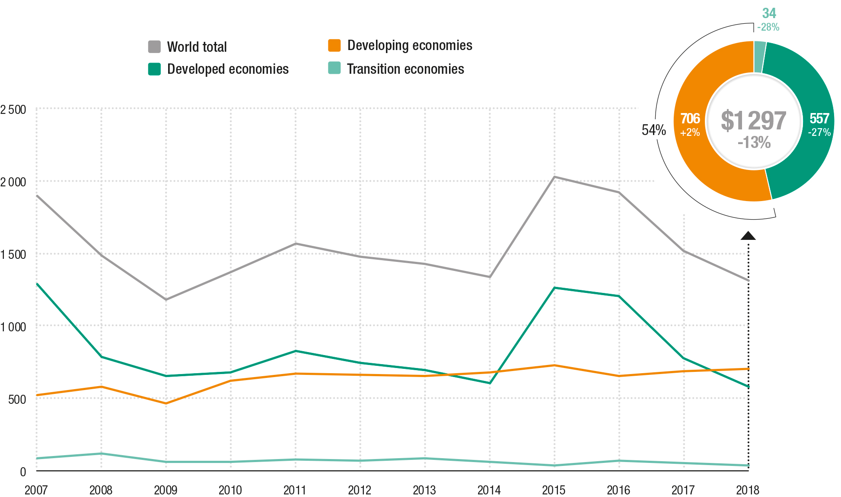
Global FDI down 13% in 2018
Global FDI inflows, global and by economic group, 2007-2018
(Billions of dollars and per cent)
Source: UNCTAD WIR 2019.

Slide 3
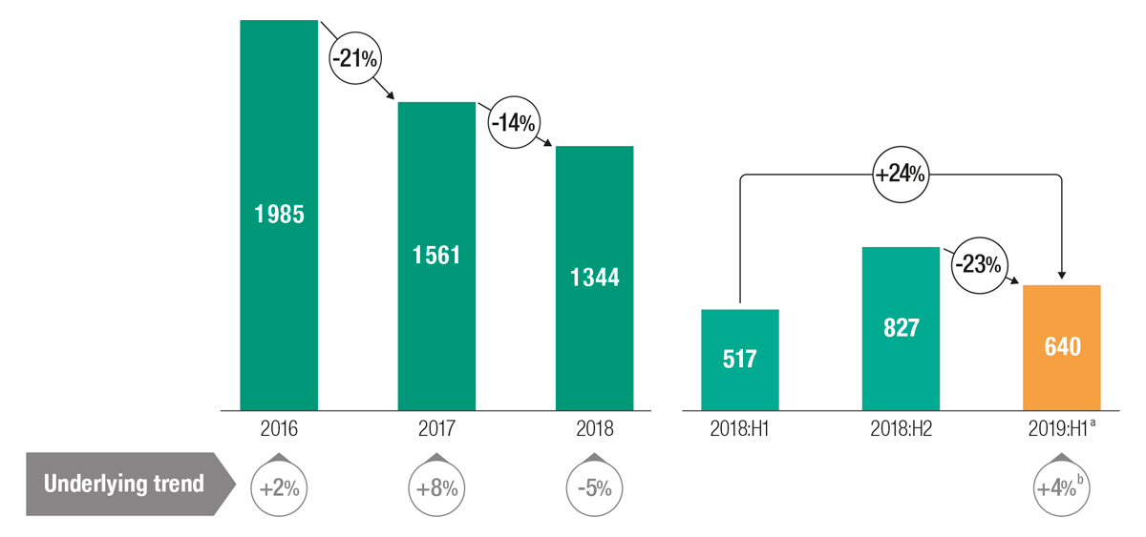
Global FDI reached US$ 640 billion in the first half of 2019, the underlying trend is up to 4%
Global FDI flows and growth rates 2016-2018 and 2018:H1–2019:H1
(Billions of US dollars and per cent)
Source: UNCTAD.
a. Estimates. b.Annualized.
Note: Excluding Caribbean offshore financial centres.

Slide 4
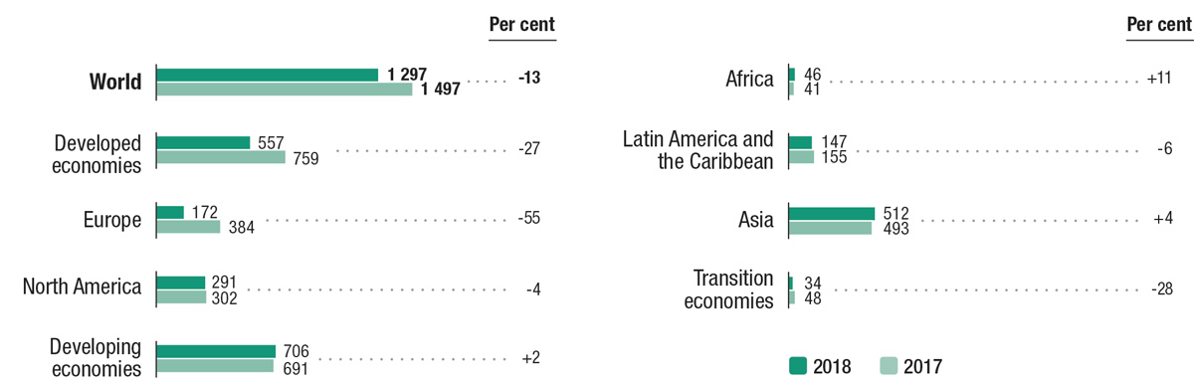
FDI flows to developing economies remain steady
FDI inflows, by region, 2017-2018
(Billions of US dollars and per cent)
Source: UNCTAD WIR 2019.

Slide 5
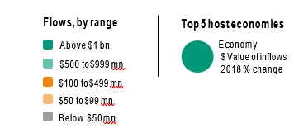
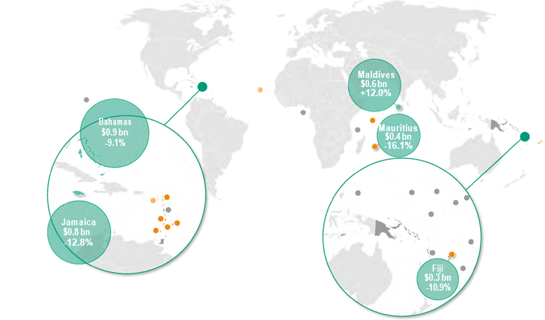
FDI trends – Small Island Developing States (SIDS)
FDI flows, top 5 host economies, 2018 (Value and change)
Source: UNCTAD WIR 2019.

Slide 6
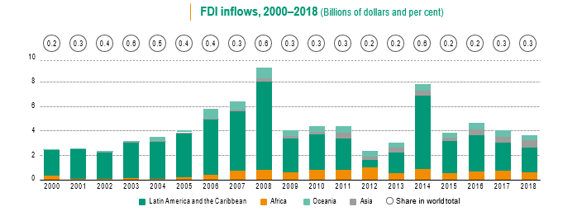
FDI Trends - SIDS
Source: UNCTAD WIR 2019.

Slide 7
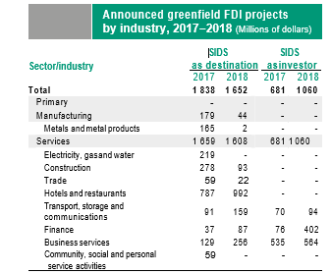
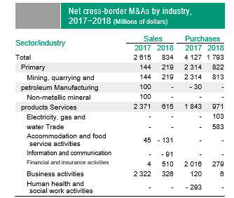
FDI Trends - SIDS
Source: UNCTAD WIR 2019.

Slide 8
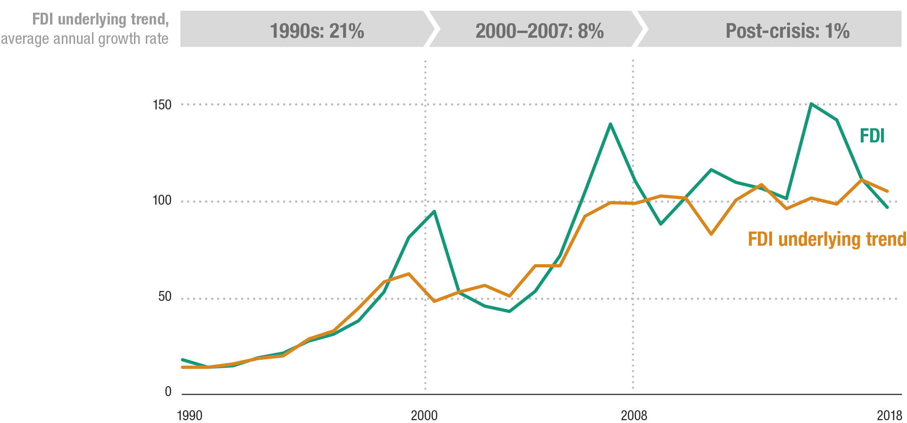
The underlying FDI trend anemic since 2008
FDI flows and the underlying trend, 1990-2018
(Indexed, 2010 = 100)
Source: UNCTAD, WIR 2019.

Slide 9
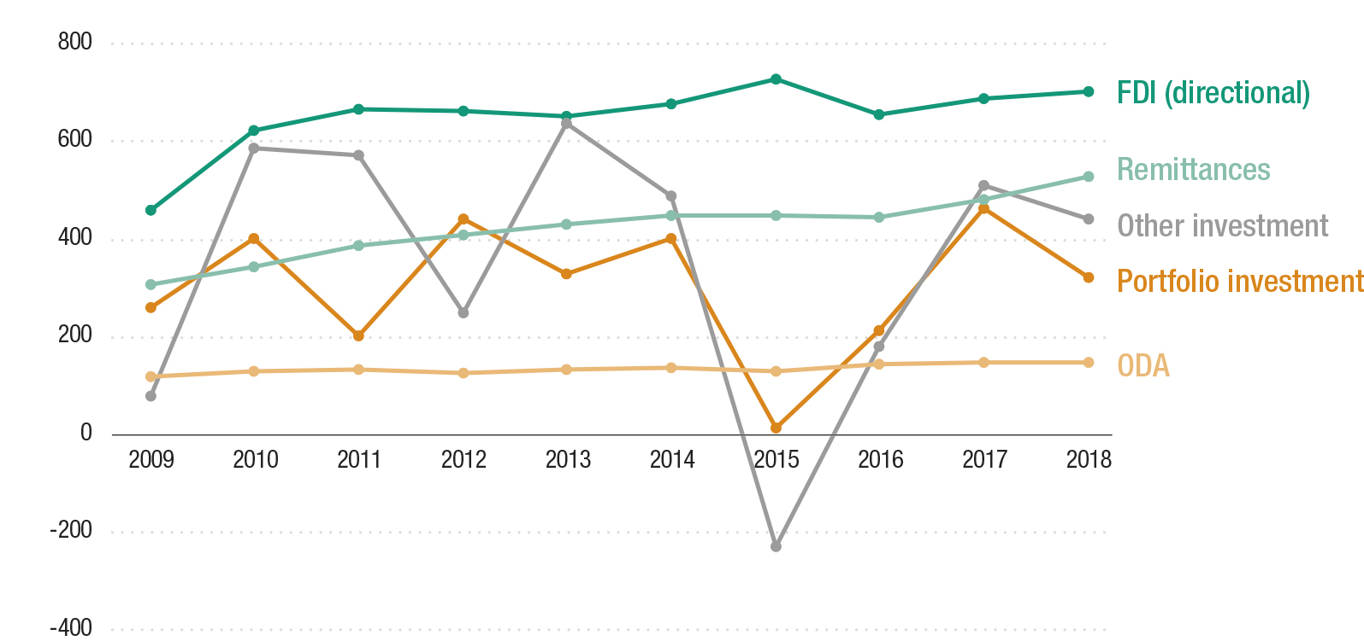
FDI flows prove resilient as a source of external finance
Developing economies: sources of external finance, 2009-2018
(Billions of dollars)
Source: UNCTAD, WIR 2019.

Slide 10

What are the Sustainable Development Goals?
The 2030 Agenda for Sustainable Development includes 17 SDGs and 169 targets addressing economic, social and environmental challenges
Source: United Nations.

Slide 11
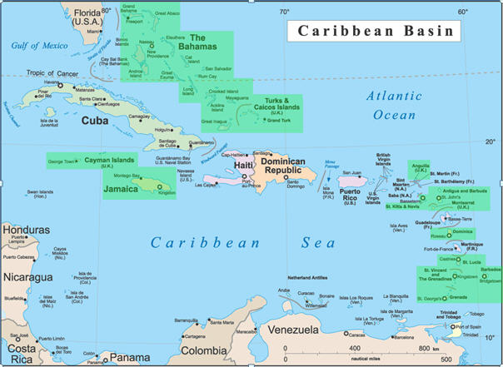
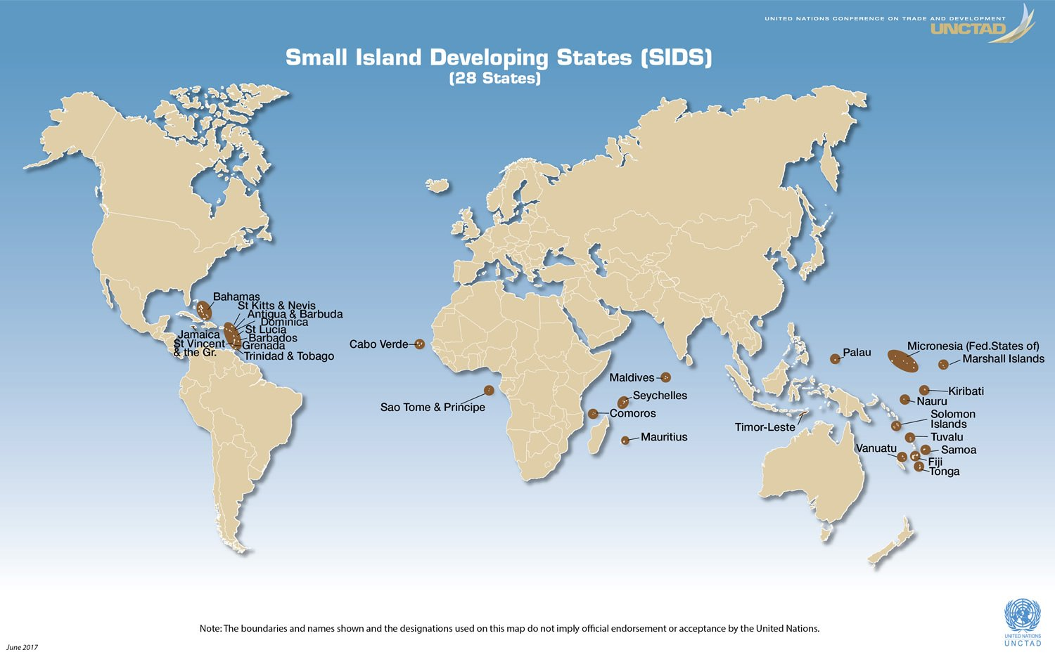
Development Challenges for SIDS
1. Narrow resource base.
2. Small domestic markets.
3. High costs of energy and infrastructure services.
4. Long distances from export and import markets.
5. Low and irregular international traffic volumes.
6. Natural disasters.
7. Growing populations.
8. High volatility of the economic growth.
9. Limited opportunities for the private sector. Large reliance on the public sector.
10. Fragile natural environments.
Source: UN-OHRLLS

Slide 12
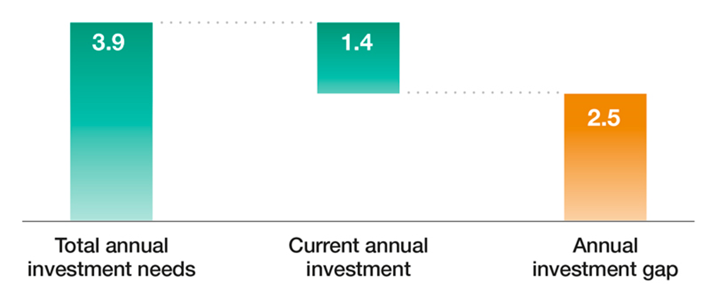
Investment requirements to achieve the SDGs in developing countries
2014 World Investment Report Estimates (Trillions of dollars)
Source: UNCTAD, WIR 2014.

Slide 13
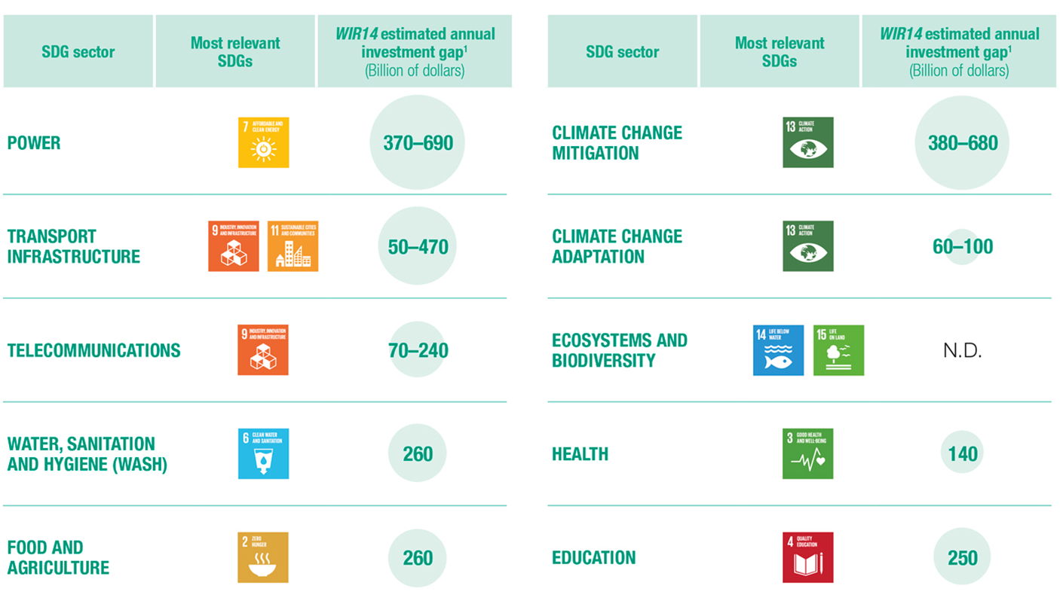
WIR 2014 assessed investment needs/gaps across 10 sectors
Source: UNCTAD, WIR 2019.

Slide 14
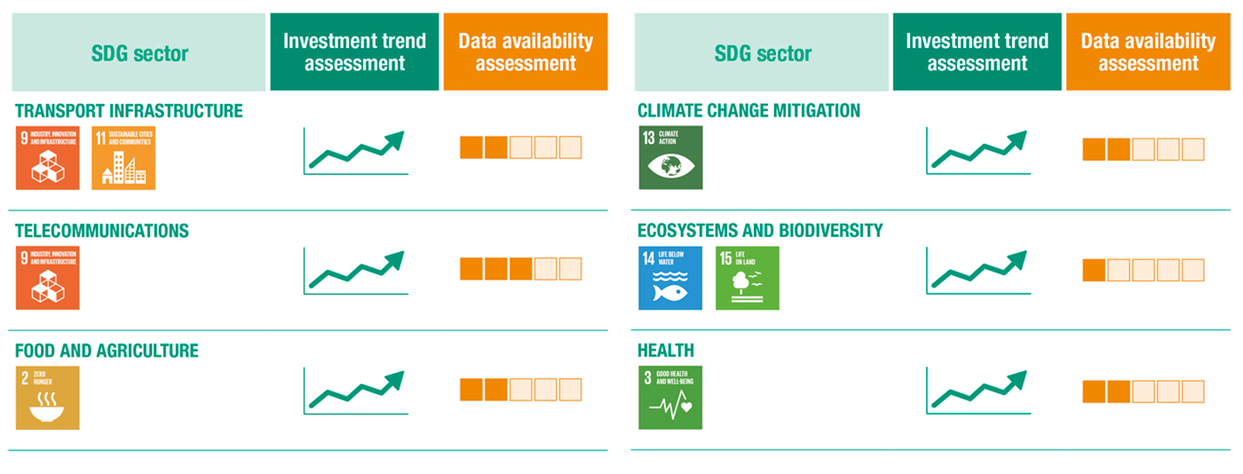
What does the data show?
Overall, the data paints a mixed picture of both investment trends and monitoring capacities. Signs of progress are evident in the following sectors:
Investment growth falls short of estimated investment gaps across the board. The transition towards sustainable-development-oriented investment is not happening at the necessary scale.
Source: UNCTAD, SDG Investment Trends Monitor, 2019.

Slide 15
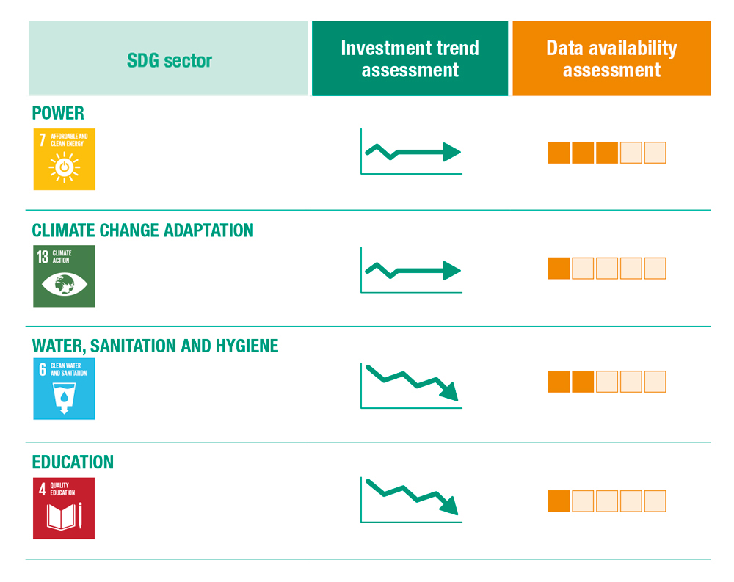
What does the data show? (continued)
Investment in some sectors is either stagnant or declining:
Source: UNCTAD, SDG
Investment Trends Monitor, 2019

Slide 16
So, how do IPAs get involved in promoting and facilitating investment in SDG projects?

Slide 17
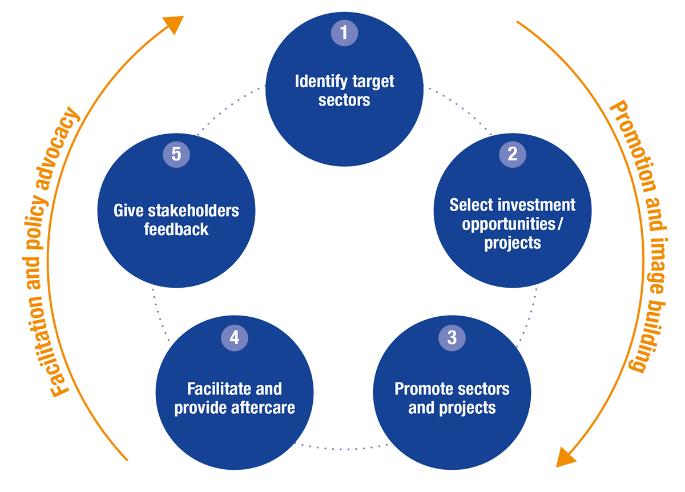
The traditional investment promotion cycle
Source: UNCTAD

Slide 18
Mainstreaming SDGs in investment promotion and facilitation
1. Identify SDG target sectors
2. Align the IPA structure
3. Select SDG projects
4. Develop an SDG project pipeline
5. Find and secure partners
6. Promote sectors and projects
7. Facilitate and provide aftercare
8. Give stake-holders feedback
Typical Steps
New SDG-related steps
Source: UNCTAD, Investment Advisory Series 8

Slide 19
Why more attention by IPAs for investment facilitation?
Investment promotion measures outpace investment facilitation measures 4 to 1.
Investment in the SDGs requires enhanced facilitation.
Furthermore, investment facilitation measures:
Dramatically improve a location’s offer.
Often do not require changes in policies and regulations.
Fall within the realm of IPAs.
Do not incur much extra costs (unlike investment promotion campaigns and incentives).
Incorporate many activities and give IPAs flexibilities to develop an offering that can be adapted to circumstances and available resources.

Slide 20
Thank you!
Paul Wessendorp
Chief, Investment Promotion Section
Division on Investment and Enterprise
UNCTAD
paul.wessendorp@un.org
This presentation will be available on sustainableFDI.org

