Slide 1


Supporting sustainability aspects in the implementation of EU EPAs in the context of the SDGs
Global Project “NEW”
Ms. Sanya Alleyne
Technical Trade Adviser
GIZ
© GIZ / Jose Diaz

Slide 2
Outline
Overview
Background: The EPAs
Investment Provision of the EPA
Areas of Activity
Stakeholders and Partners
The Team
Other GIZ Projects of interest

Slide 3
Outline
Overview
Background: The EPAs
Areas of Activity
Stakeholders and Partners
The Team

Slide 4
Outline
Overview
Background: The EPAs
Areas of Activity
Stakeholders and Partners
The Team

Slide 5
Economic Partnership Agreements (EPAs)
Economic Partnership Agreements (EPAs) are bilateral Free Trade Agreements between the EU and African, Caribbean and Pacific (ACP) states
Background
1975 – 2000
Lomé Convention
2002
Start of EPA negotiations
2008
Signing of the CARIFORUM EPA
2016 Singing of the SADC EPA
2000 – 2020
Cotonou Agreement
Notes:
Hintergrund:
Lomé-Abkommen: Das Lomé-Abkommen gewährte den AKP-Staaten seit 1975 unilaterale Handelspräferenzen. Es wurde insgesamt drei Mal verlängert und seine Kernpunkte waren die Einfuhr von Produkten aus den AKP-Staaten in die EU, die Einrichtung von Fonds, mit denen bei sinkenden Weltmarktpreisen oder Ernteausfällen die Exporteinnahmen der AKP-Staaten stabilisiert werden konnten sowie eine enge industrielle und landwirtschaftliche Zusammenarbeit. Da die Handelsvorteile nicht im Einklang mit den Prinzipien der WTO waren, wurde eine Reform der Zusammenarbeit notwendig. Eine Ausnahmegenehmigung der WTO wurde letztmalig bis Ende 2007 verlängert.
Cotonou-Abkommen: Im Jahr 2000 wurde das Lomé-Abkommen durch das Abkommen von Cotonou abgelöst. Ziele des Cotonou-Abkommens: Armutsreduzierung; Wirtschaftspolitische, handelspolitische und finanzielle Zusammenarbeit; Förderung von Good Governance; Stärkere Einbeziehung von Organisationen der Zivilgesellschaft und Privatwirtschaft in die EZ. Im Cotonou-Abkommen ist außerdem vorgesehen, dass die einseitigen Präferenzen durch regionale Wirtschaftspartnerschaftsabkommen ersetzt werden. Seit 2002 verhandelt die EU-Kommission mit Mandat der Mitgliedsstaaten mit den AKP-Staaten über die Wirtschaftspartnerschaftsabkommen.
Zielsetzung:
Ziel der Abkommen ist es, regionale Integration und nachhaltige Entwicklung zu fördern und die bisherigen Handelsbeziehungen auf eine WTO-konforme Grundlage zu stellen. Hintergrund ist auch, dass die EU aufgrund des Vertrags von Lissabon dazu verpflichtet ist, im Rahmen ihres außenpolitischen Handelns die Leitprinzipien der europäischen Entwicklungszusammenarbeit einzuhalten.
WTO-Konformität: das Prinzip der Reziprozität/ Gegenseitigkeit ist eines der drei Hauptprinzipien der WTO. Konkret bedeutet es, dass Staaten, denen von anderen Vertragspartnern handelspolitische Vergünstigungen gegen das Prinzip der Meistbegünstigung eingeräumt werden, gleichwertige Gegenleistungen erbringen sollen. Im Kontext der AKP-Staaten bedeutet dies die stufenweise Aufhebung aller seit 1975 von der EU einseitig eingeräumten Handelsvorteile.
Nachhaltige Entwicklung:
a) Anwendung der EPAs unter der Beachtung und Wahrung von wirtschaftlichen, sozialen und ökologischen Prinzipien.
b) Auch teilweise Verpflichtung zur Einführung und Einhaltung von Sozial- und Umweltstandards, wie z.B. der ILO-Kernarbeitsnormen.
c) Asymmetrische Marktöffnung mit Übergangsfristen von bis zu 20 Jahren.
d) Einseitige und flexible Schutzklauseln.
Regionale Integration: Entsprechend dem Cotonou-Grundsatz der Differenzierung und Regionalisierung sollen die Entwicklungsländer dazu befähigt werden, innerhalb der WPA in Regionalgruppen zu agieren, die regionale Integration voranzubringen und den Handel innerhalb der Regionen zu fördern. Insgesamt haben die AKP-Staaten 7 Regionalgruppen gebildet, die als Verhandlungspartner der EU auftreten.

Slide 6
Part 1: TRADE PARTNERSHIP FOR SUSTAINABLE DEVELOPMENT
Art. 1 ( c): Promoting regional integration, economic cooperation and
good governance thus establishing and implementing an
effective, predictable and transparent regulatory framework
for trade and investment between the Parties and in the
CARIFORUM region;
Art. 1 (e): Supporting the conditions for increasing investment and
private sector initiative and enhancing supply capacity
competitiveness and economic growth in the CARIFORUM
region;

Slide 7
Art. 1 (f): Strengthening the existing relations between the Parties on the basis of solidarity and mutual interest. To this end, taking into account their respective levels of development and consistent with WTO obligations, the Agreement shall enhance commercial and economic relations, support a new trading dynamic between the Parties by means of the progressive, asymmetrical liberalisation of trade between them and reinforce, broaden and deepen cooperation in all areas relevant to trade and investment.

Slide 8
Title II: Investment, Services & e- Commerce:
Chapter 2 Commercial Presence
Art. 67 – National Treatment Art. (no less favourable than
that they accord to their own like commercial presences and
Investors).
68 - Market Access
Limitations on the number of operators or total quantity of output;
Limits on the total value of transactions or assets in the form of numerical quotas;
maximum percentage limits on shareholding or the value of aggregate or total investment;
measures restricting specific types of commercial presences or joint venture)

Slide 9
Title II: Investment, Services & e- Commerce:
Chapter 2 Commercial Presence
Art. 69 – List of Commitments
Art. 70- Most Favoured Nation Treatment ( no less favourable to the most favourable treatment applicable to like commercial presences and investors)
Art. 73 – Maintenance of Standards
Art 74- Behaviour of Investors ( retention of standards for labour, environment and occupational health and safety).
Art 74- Review

Slide 10
Dispute Settlement: Nature of the DSM in the CARIFORUM- EU Economic Partnership Agreement
State to State Dispute Resolution unlike Investor – State Dispute Resolution usually found in BITs.
PART III: Dispute Avoidance and Settlement
    Consultation
    Mediation
    Arbitration
    Review and Compliance

Slide 11
Dispute Settlement: Nature of the DSM in the CARIFORUM- EU Economic Partnership Agreement
Institutional Provisions
Joint CARIFORUM-EC Council
CARIFORUM-EC Trade and Development Committee
CARIFORUM-EC Parliamentary Committee
CARIFORUM-EC Consultative Committee *organisations of civil society, including the academic community, and social and economic partners.

Slide 12
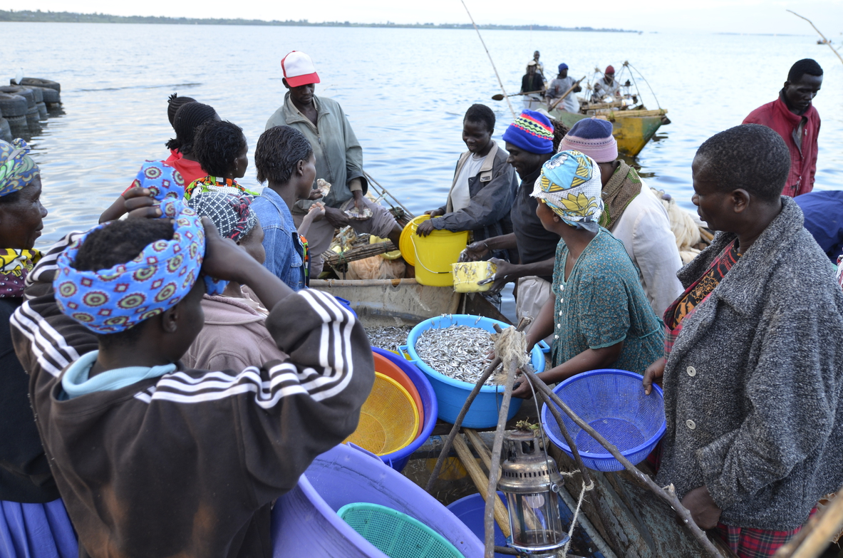
Relevance of the EPAs
Supports Implementation of the 17 SDGs.
WTO Compliance.
Sustainable Development & the Environment. (Art. 3 & 183 of the EPA)
Sustainable Development & Social Aspects (Art. 5)
Regional Integration.
Incorporation of sustainable trade practices within the ACP States into Global Value Chains.
© GIZ / Dirk Ostermeier

Slide 13


Slide 14

Sustainable Development & the Environment
Cooperation on eco-innovation ( energy efficiency) and renewable energy ( Art. 138)
Projects related to-
Energy efficiency and renewable energy
Promotion of eco –innovation networks and clusters, incl. of PPPs
Knowledge exchange ( expertise)
Preparation of studies and provision of Technical Assistance
Collaboration in research and development
Pilot and demonstration of projects.
Environmentally- friendly products, technologies, production processes, services, management & business methods incl. water-saving and Clean Development Mechanism applications

Slide 15

Sustainable Development & Social Aspects
Art. 191- Objectives and Multi-Lateral commitments ( affirmation of the ILO Conventions-
      freedom of associaiton;
      abolition of forced labour;
      elimination of child labour and
      discriminatory practices in labour.
Art. 192- Levels of Social Protection & Right to Regulate
Art. 193- Upholding Levels of Protection ( prevention of lowering the standards of level of protection provided by domestic social and labour legislation & derogating from, or failing to apply such legislation and standards).

Slide 16
Sustainable Development & Social Aspects
Art. 194 – Regional Integration( support to social cohesion policies & measures to promote decent work at the regional level)
Art. 195 – Consultation& Monitoring ( right of States to monitor & assess the operation of the Agreement to decent work & Sustainable Development)
Art. 196- Cooperation ( exchange of information on labour & social legislation & Education programmes)

Slide 17






















Pillars of the NEW Project
To foster EPA implementation by regional organisations and their member states, civil society, private sector in a way that supports sustainable development.
To facilitate participatory the establishment of Monitoring Systems.
To support knowledge exchange platforms for relevant stakeholders on EPA topics.
Regional Focus
Southern Africa (SADC EPA)
Caribbean (CARIFORUM EPA)
Sustainability Aspects in the Implementation of the EU-EPAs
Global Project
Commissioned by the BMZ
05/2017 – 04/2020
Volume: 3.5 Mio. €

Slide 18

Outcomes of this project
  Increase exporting capacity of CARIFORUM and SADC member states.
  Support access to EU markets.
  Suppory integration into regional & global value chains.
© GIZ / Ursula Meissner

Slide 19
Potentialities and Challenges of GIZ support to EPA Implementation
Potential positive effects | Risks and challenges
Implementation of the Regional preferential treatment | Non- implementation of the Regional Preferential treatment?
Reduction of barriers to trade | Possibilities of negative impacts on all affected actors
Support of common negotiation positions & implementation strategies | Fragmented negotation positions and implementation strategies
Enhanced knowledge on EPA Rules of Origin in order to foster greater integration of RVCs | Fragmented market access regulations, liberalisation plans, transition periods, RoOs and classification of goods within RECs
Enhanced institutional strengthening
EPAs

Slide 20
Outline
Overview
Background: The EPAs
Areas of Activity
Stakeholders and Partners
The Team

Slide 21
Areas of Activity
Global Project NEW
Pillar 1
Pillar 2
Develop cross-regional knowledge exchange platforms on EPAs
Pillar 3
Raise awareness and strengthen the capacity of the private sector and civil society with regard to the potential and the challenges of EPAs
Facilitate the establishment of a participatory EPA monitoring system

Slide 22
Pillar 1: Awareness Raising
Supporting initiatives that facilitate access to market intelligence (eg. Online portals, linkages to European import promotion agencies)
Market Intelligence
Capacity Building
Workshops and training programs on EPA flexibilities and safeguards, on regulations and requirements (RoOs, cumulation, certification and export documentation etc.), and on export readiness (incl. Branding, packaging and marketing strategies)
B2B Promotion
Regional and cross-regional Business-to-Business matchmaking, support for trade fair participation, facilitation of linkages for joint ventures co-productions
RVCs and Value Added Exports
Defining, identifying and positioning in product value chains
And develop market entry strategies, support in regional linkages, support for regional integration initiatives

Slide 23
Planned Activities
Pillar 2: Monitoring Systems
Feasibility Studies
Commissioning of studies to analyse existing M&E systems, capacities and needs of the member states and their stakeholders
Building Consensus
Bringing together key stakeholders to present and discuss the results and recommendations of this report and attempt to build consensus on key questions such as financing, structure and timetable
Piloting
Piloting of a systems building on stakeholder consensus
Operationalisation
Scaling and operationalisation of the system

Slide 24
Planned Activities
Pillar 3: Cross-regional Exchange
Establishing Contacts
Organise sharing conferences (e.g. on EPA monitoring) at the ACP level to facilitate cross-regional exchange between Southern Africa and the Caribbean
Interregional Connections
Support sharing networks among IPOs to facilitate exchange on strengthening the public-private dialogue on EPAs and improve evidence-based policy making

Slide 25
Outline
Overview
Background: The EPAs
Areas of Activity
Stakeholders and Partners
The Team

Slide 26



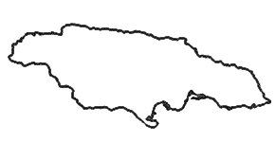
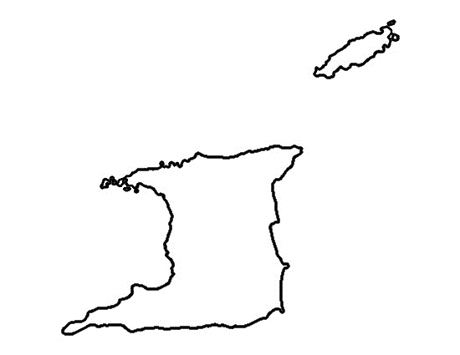


Partners
Jamaica:
EPA Implementation Unit
JAMPRO
Guyana:
CARIFORUM Directorate
Trinidad & Tobago:
EPA Implementation Unit
Ministry of Trade and Industry
TTCSI
Export TT
Barbados:MF&FT
  BIDC
  EU Delgation
  CEDA
  CROSQ
  CDB

Slide 27



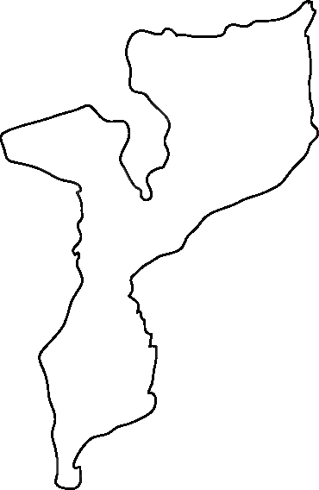

Partners
Botswana:
National Trade Institutions
Namibia:
National Trade Institutions
Mozambique
National Trade Institutions
South Africa:
National
Trade Institutions

Slide 28
Outline
Overview
Background: The EPAs
Areas of Activity
Stakeholders and Partners
The Team

Slide 29



Leonor v. Limburg
Project Manager, Eschborn
Tel.: +49 6196 79 1383
Mobil: +49 172-5452660
leonor.limburg@giz.de
Sanya Alleyne
Regional Advisor & Coordinator,
Barbados
Petros Shayanowako
Regional Advisor & Coordinator, Gaborone, Botswana
sanya.alleyne@giz.de
1-246-436-0578 ext 237
petros.shayanowako@giz.de

Slide 30
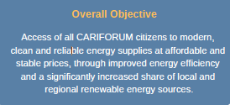
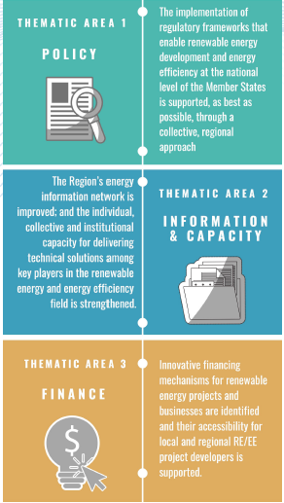
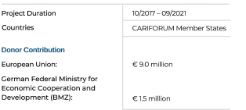
Other Possible Partners & Activities
GIZ Technical Assistance Programme (TAPSEC):
Source: TAPSEC Factsheet

Slide 31
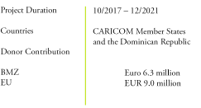
GIZ Climate Resilient & Sustainable Energy Supply
Support to Policy development ( development of country specific action plans).
Information and Capacity building.
Development of a regional strategy to promote financing of SME in the RE sector.
Resilience planning through the establishment of a regional mechanism to support the preparation and implementation of Integrated Resource and Resilience Plans.
Development of pilot projects for a climate- resilient energy system.

Slide 32
Financing Energy for Low carbon Investment – Cities Advisory Facility (FELICITY)
Project objective: Cities and municipalities in the project regions have the capacities to develop and implement bankable, low-carbon infrastructure projects.
Cooperation project between GIZ and the European Investment Bank (EIB), focuses on measures in the energy, water, transport and waste sectors. The project supports the implementation of mitigation measures in cities and municipalities through:
Demand-oriented advisory to cities on applying for and using financing, as well as support in the preparation of concrete low carbon projects, subsequently to be financed by the EIB.
Development of capacities and resources in the local administration.

Slide 33
Economic Policy Advise to the Moldovan Government
Enhance opportunities for inclusive growth through investment.
Outputs:
Support the creation of an Enabling Framework ( provision of policy advise for sustainable economic development) ;
2. Investment Promotion ( provision of information for potential investors and strengthening of after care services);
3. Linkages ( supporting local SMEs to become suppliers for foreign investors capacities thereby supporting access to GVCs); and
4. Disadvantaged Groups ( Supporting integration into the labour market).

Slide 34
Thank you for your time and attention
Ms. Sanya Alleyne
Technical Trade Adviser
Contact : sanya.alleyne@giz.de

