Slide 1

Reform of the International Investment Agreements (IIAs) Regime
Diana Rosert
Economic Affairs Officer
Investment and Enterprise Division, UNCTAD
Regional Seminar for the Caribbean
28 November 2019
https://investmentpolicy.unctad.org/

Slide 2
Outline
Trends in IIAs and ISDS cases
UNCTAD policy tools for IIA reform
Taking stock of IIA reform progress

Slide 3
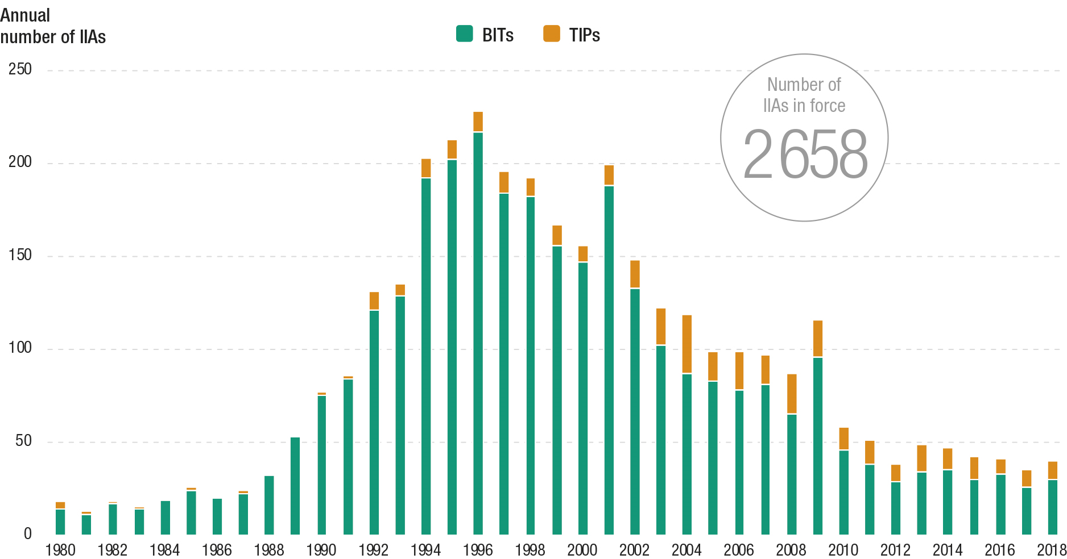
40+ international investment treaties signed in 2018
Trends in number of IIAs signed, 1980–2018
Source: UNCTAD, IIA Navigator.

Slide 4
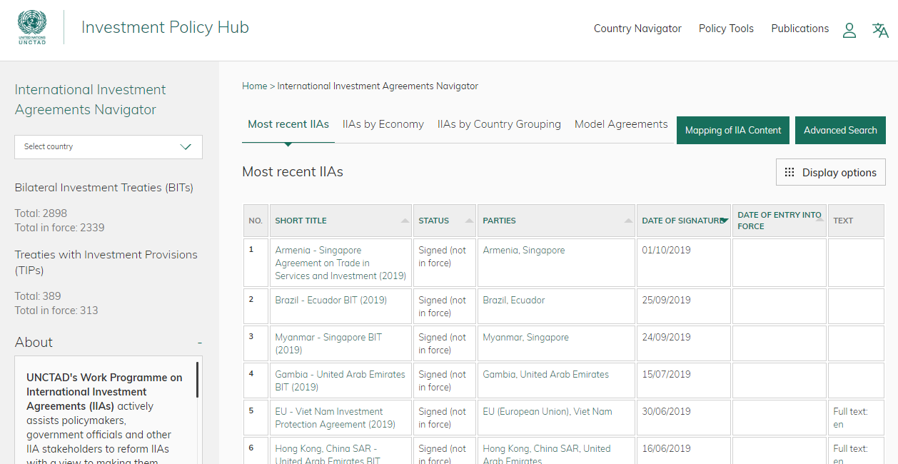
International Investment Agreements Navigator: 3,300+ treaties
https://investmentpolicy.unctad.org/

Slide 5
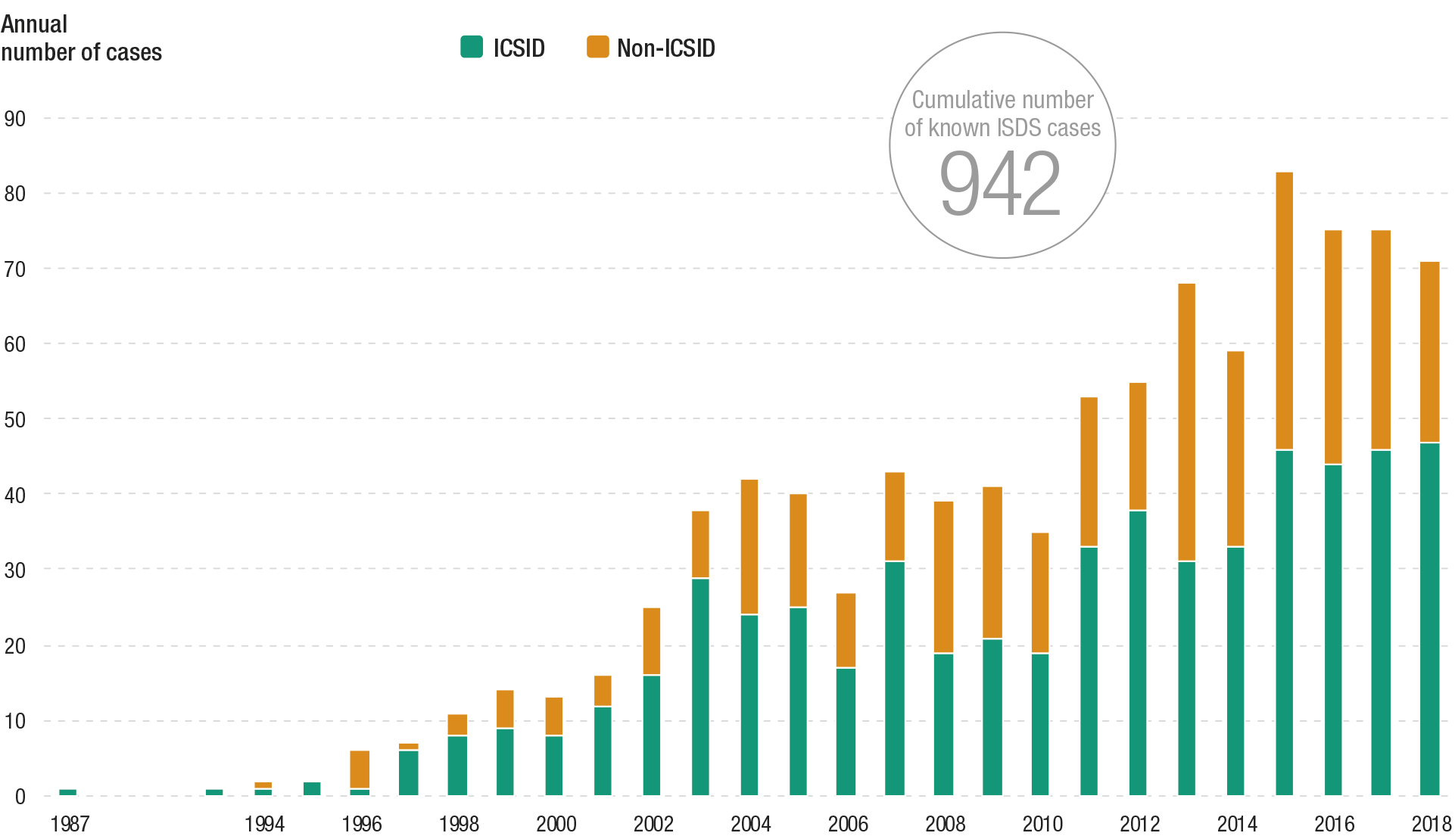
70+ investor-State arbitrations initiated in 2018 based on IIAs
Trends in known treaty-based ISDS cases, 1987–2018
Source: UNCTAD, ISDS Navigator.

Slide 6
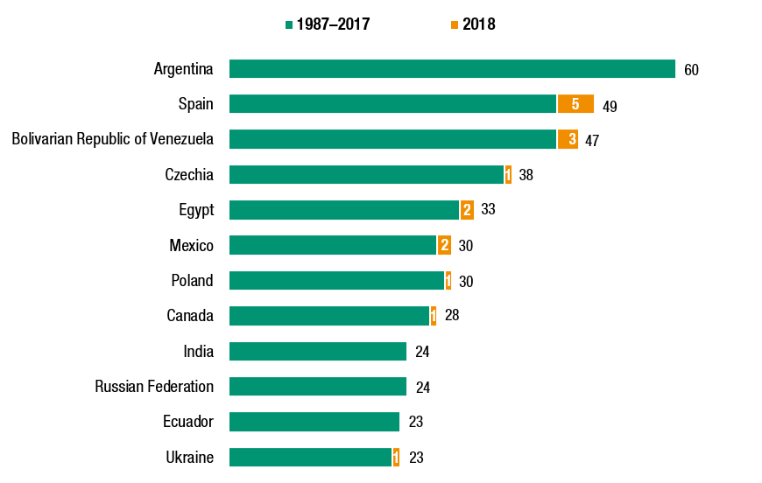
Argentina, Spain and Venezuela have received the largest share of claims over the years
Most frequent respondent States, 1987–2018 (Number of known cases)
Source: UNCTAD, ISDS Navigator.

Slide 7
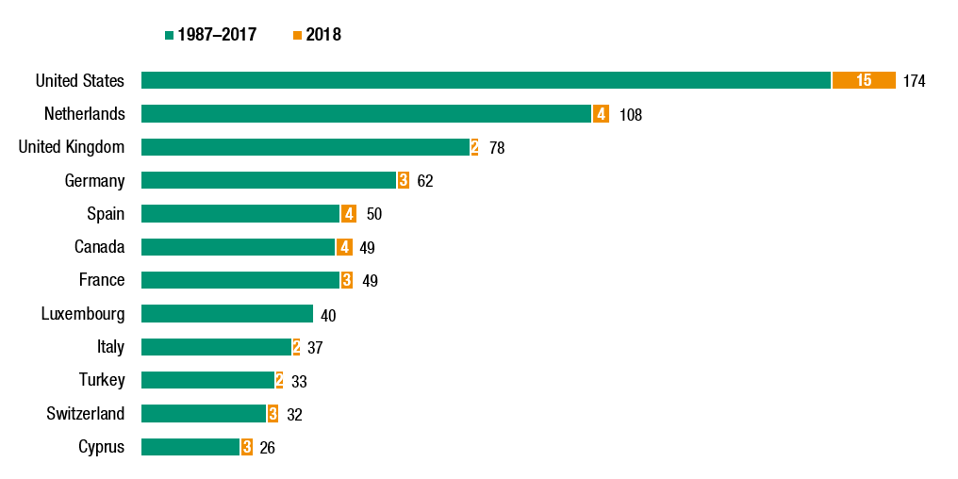
Overall, investors from the United States, the Netherlands and the United Kingdom have filed the largest shares
Most frequent home States of claimants, 1987–2018 (Number of known cases)
Source: UNCTAD, ISDS Navigator.

Slide 8
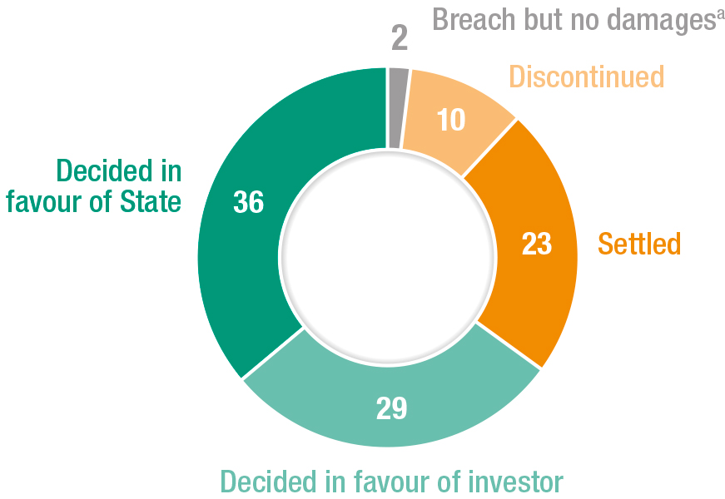
Outcomes of ISDS cases
Results of concluded cases, 1987–2018 (Per cent)
Source: UNCTAD, ISDS Navigator.

Slide 9
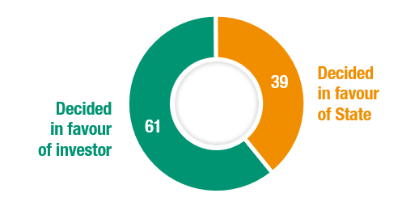
On the merits, 60 per cent were decided in favour of the investor
Results of decisions on the merits, 1987–2018 (Per cent)
Source: UNCTAD, ISDS Navigator.

Slide 10
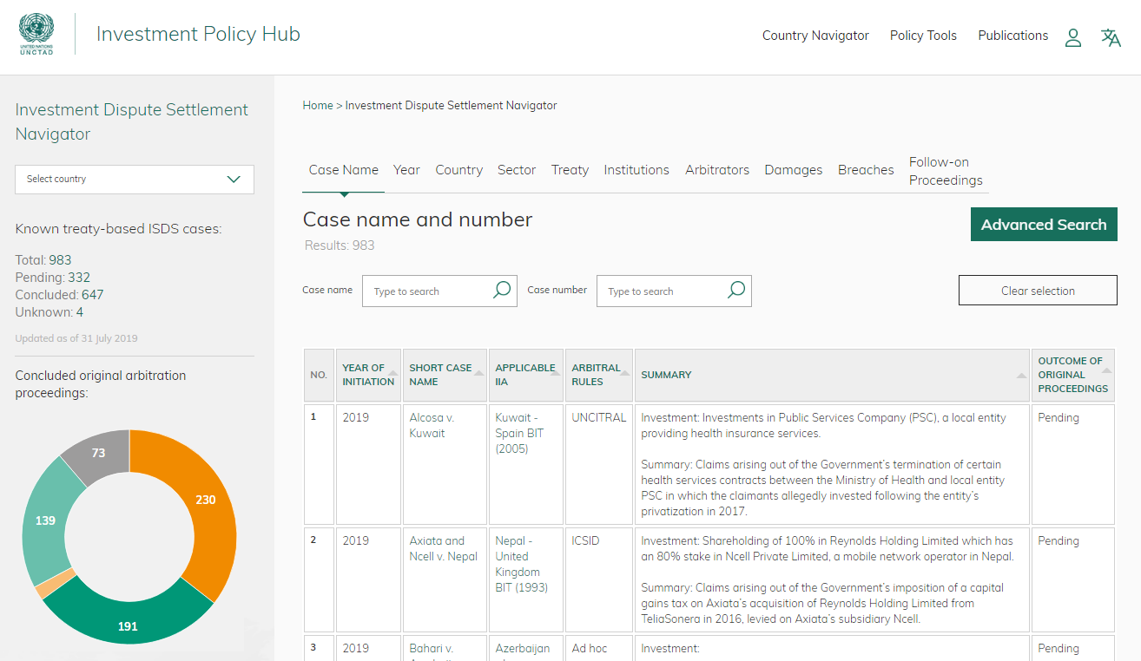
Investment Dispute Settlement Navigator: 983 known cases
https://investmentpolicy.unctad.org/

Slide 11
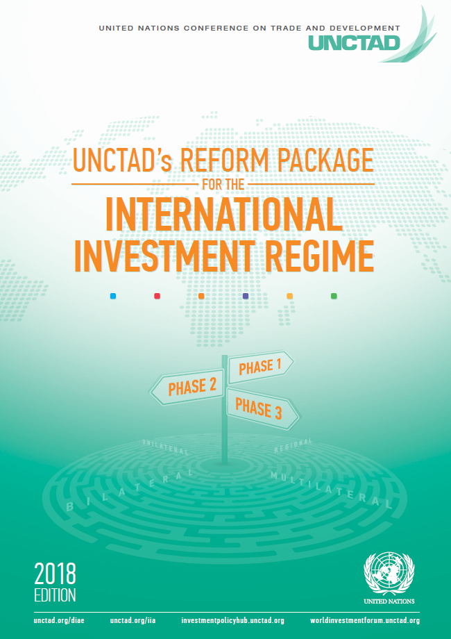
UNCTAD’s Reform Package for the Int'l Investment Regime
Phase 1
More than 100 policy options for treaty clauses addressing the five priority areas for sustainable development-oriented treaty making
Phase 2
10 reform mechanisms that countries can use to modernize existing old-generation treaties
Phase 3
Policy guidance for 3 prongs of action towards ensuring overall investment policy coherence for sustainable development

Slide 12
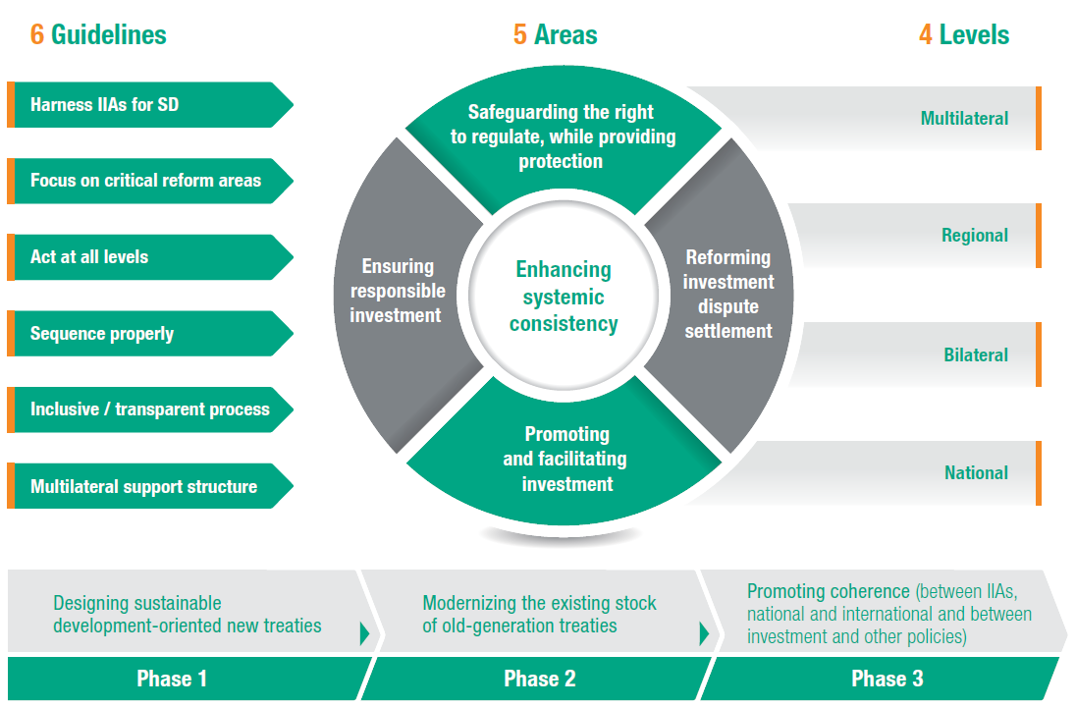
UNCTAD's Road Map for IIA Reform
Reform Package for the International Investment Regime (2018 edition)
Source: UNCTAD 2018.

Slide 13
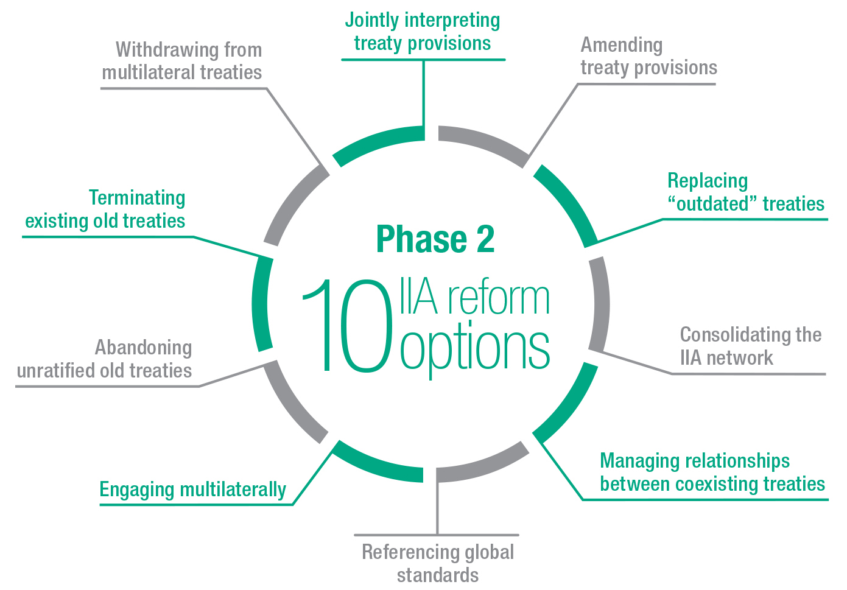
Ten options for modernizing the existing stock of old-generation IIAs
Source: UNCTAD WIR 2017.

Slide 14
Reform–oriented provisions in IIAs concluded in 2018
Number of treaties
Selected aspects of IIAs
1 | Refined treaty preamble
2 | Refined definition of investment
3 | Circumscribed fair and equitable treatment (FET), or FET omitted
4 | Clarification of indirect expropriation, or indirect expropriation omitted
5 | Detailed exceptions from the free-transfer-of-funds obligation
6 | Omission of the so-called “umbrella” clause
7 | General exceptions
8 | Not lowering of standards clause
9 | Promotion of corporate and social responsibility standards
10 | Limiting access to ISDS, or omitting the ISDS mechanism
11 | Specific proactive provisions on investment promotion and/or investment facilitation
Based on 29 IIAs concluded in 2018 for which texts were available
Source: Based on UNCTAD WIR 2019.

Slide 15
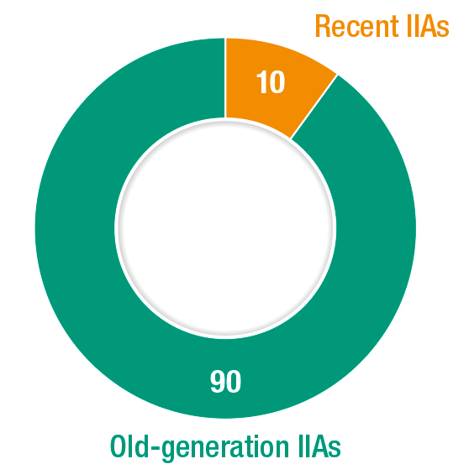
Stock of old-generation (1959–2011) and recent (2012–2018) IIAs
(Per cent)
Source: UNCTAD WIR 2019.

Slide 16
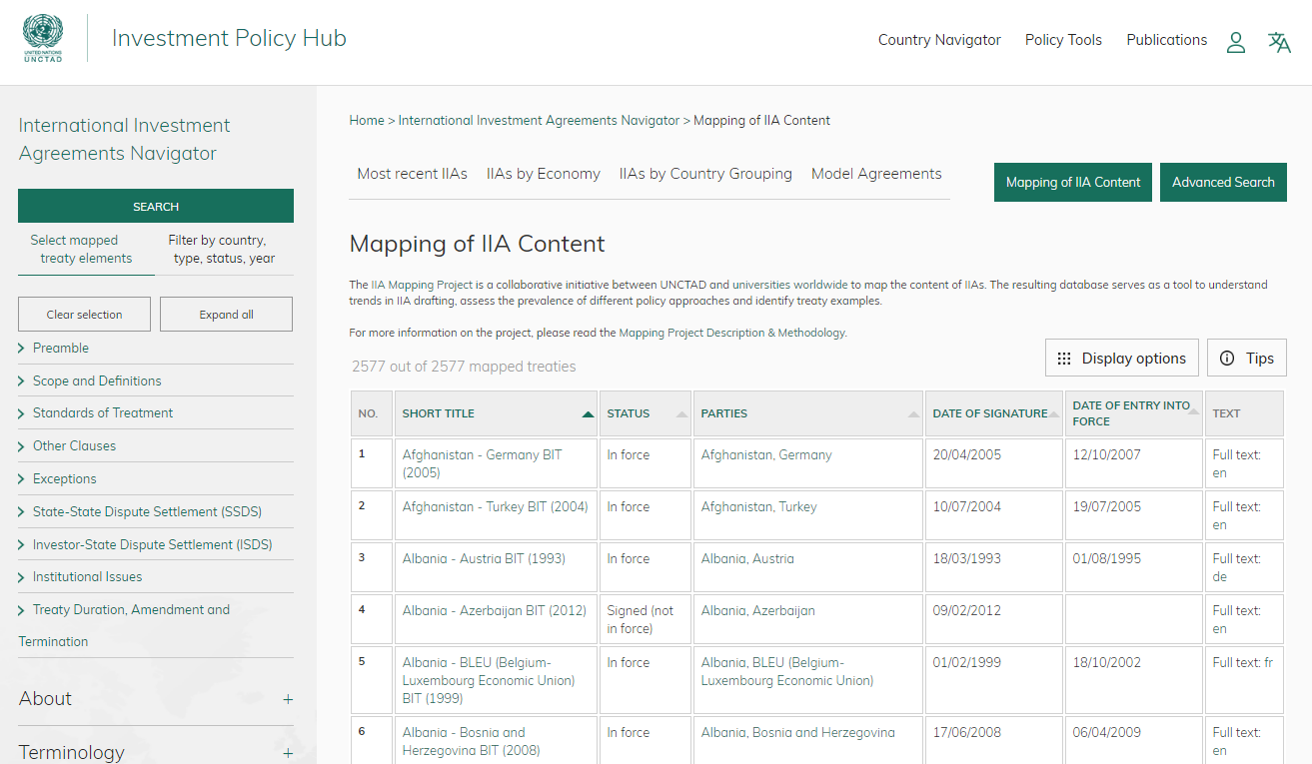
Mapping of IIA Content: 2,500 mapped treaties
https://investmentpolicy.unctad.org/

Slide 17
Pre-reform or traditional ISDS mechanism
Pre-reform ISDS system: prevailing model is to give "advance consent" to ISDS arbitration in the investment treaty & let investor choose the arbitral forum (e.g. after 3-months waiting period)
Ad hoc arbitration: usually three arbitrators (rarely sole arbitrator)
  two arbitrators appointed by the disputing parties (i.e. one by the investor claimant, one by the respondent State)
  third arbitrator appointed either by co-arbitrators or jointly by disputing parties (depending on the applicable arbitration rules & treaty provisions)

Slide 18
Reforming investment dispute settlement: a stocktaking
As part of broader IIA reform, countries have implemented many ISDS reform elements in recent IIAs
Five principal approaches have emerged:
No ISDS
Standing ISDS tribunal
Limited ISDS
Improved ISDS procedures
Unreformed ISDS mechanism

Slide 19
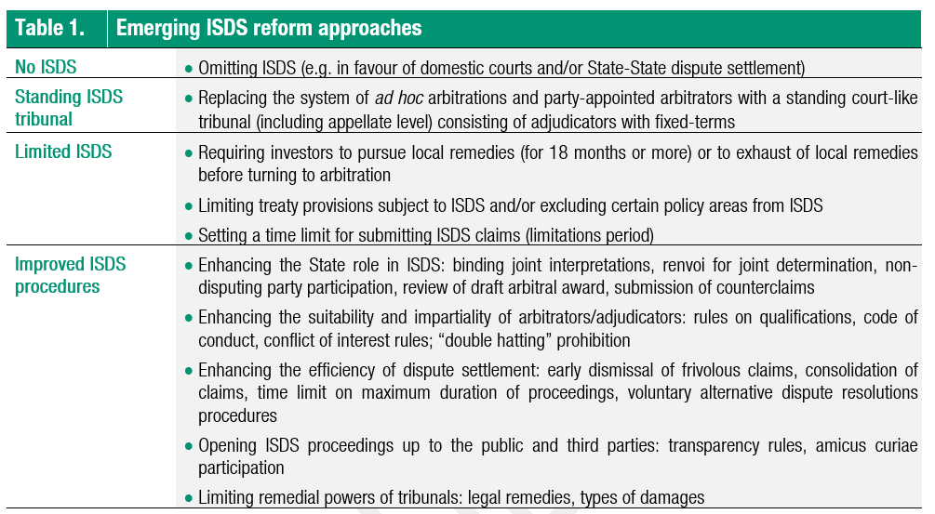
Emerging ISDS approaches
Source: UNCTAD.

Slide 20
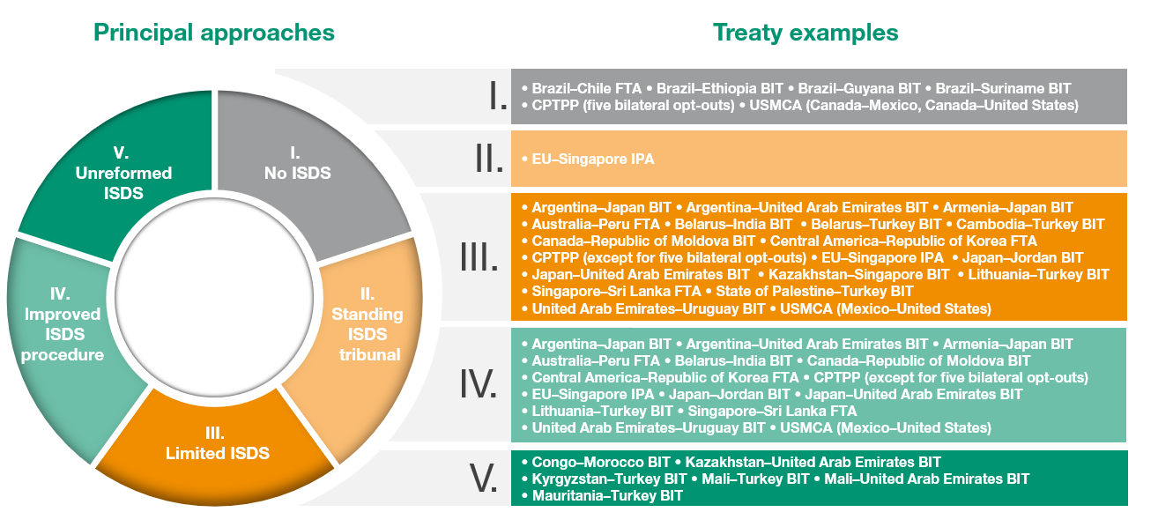
Five principal approaches to ISDS reform
Based on 29 IIAs signed in 2018
Source: UNCTAD.

Slide 21
Examples of ISDS reform approaches
Brazil's Cooperation and Investment Facilitation (CIFA) model: dispute prevention (e.g. including ombudsperson mechanism) and State-State dispute settlement mechanism
European Union's investment court initiative: first instance tribunal and an appeal tribunal; party-appointed arbitrators (selected by the disputing parties) are replaced by tribunal members appointed by State Parties, assigned to specific cases on a rotational basis
India's model BIT revision & new approach to ISDS: requirement to exhaust local remedies and strict time limits for the submission of claims
United States-Mexico-Canada Agreement (USMCA) (2018): Mexico-US ISDS claims will be restricted to NT & MFN (excl. pre-establishment) + direct expropriation (excl. indirect expropriation); 30-months local remedies requirement; no ISDS in relation to Canada

Slide 22
Examples of ISDS reform approaches
Comprehensive and Progressive Agreement for Trans-Pacific Partnership (CPTPP) (2018): procedural improvements; side letters signed by several countries on a bilateral basis emoved or modified ISDS provisions between these specific countries

Slide 23
Multilateral developments: UNCITRAL Working Group III
UNCITRAL Working Group III discussions on the possible reform of ISDS
Three-phase mandate provided by the UNCITRAL Commission in July 2017
WG III is tasked i) to identify and consider concerns regarding ISDS; ii) to consider whether ISDS reform was desirable; and iii) if it were to conclude that reform was desirable, to develop any relevant solutions to be recommended to the Commission

Slide 24
Multilateral developments: ICSID amendment of rules
The ICSID Secretariat published proposed amended arbitration rules (under the ICSID Convention and the Additional Facility) in August 2018
The current process to amend the rules was commenced by the Secretariat in 2016 with a particular focus on the time and cost of ICSID arbitration proceedings
Aiming at comprehensive changes to modernize the rules, the proposed amendments address a number of issues, including arbitration, conciliation, mediation and fact-finding
Amendments to the ICSID rules require the approval of two-thirds of ICSID member States

Slide 25
Rebalancing investment dispute settlement: sustainable development and human rights
Pursuit of the SDGs and the 2030 agenda also implies changes to international investment policymaking, including IIAs
Both substantive rules and rules on dispute settlement need to be oriented towards today’s sustainable development imperative, which is the overarching objective of IIA reform
In the context of investment dispute settlement, SDG 16 (Peaceful and inclusive societies for sustainable development) is particularly important as it calls on States to “promote the rule of law at the national and international levels and ensure equal access to justice for all”
Developments in related fields, e.g. UN Guiding Principles on Business and Human Rights; work on a legally binding instrument to regulate – in international human rights law – the activities of TNCs
(UN Working Group on Business and Human Rights)

Slide 26
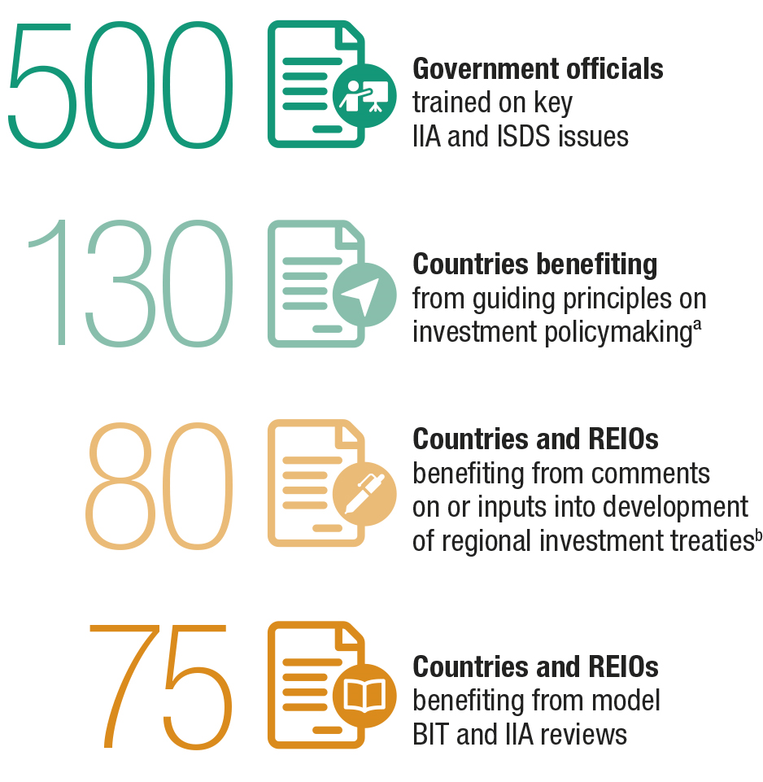
UNCTAD's policy tools spurred initial action to modernize old-generation treaties
UNCTAD’s technical assistance on IIA-related issues since 2012
Source: UNCTAD, World Investment Report 2019.

Slide 27
The way forward: IIA reform should be …
Holistic, looking at IIAs in their entirety
Covering procedural aspects, but also substantive standards of protection
Extending not only to future, but also to existing treaties, and beyond IIAs
Inclusive, ensuring an inclusive and transparent process
Addressing the "development challenge" (rule-takers) and involving other stakeholders
Sustainable, not losing sight of the bigger picture
Shaping the process so that it effectively pursues the overarching objective of sustainable development

Slide 28
UNCTAD Annual High-Level IIA Conference
Taking Stock of Phase 2 Reform Actions, 13 November 2019, Geneva
80 speakers (governments, regional and international organizations, business, civil society and academia)
Sessions on core areas of IIA reform and reform processes by region
IIA reform on course, but challenges persist and hold back Phase 2 of IIA reform (old-generation treaties)
To scale up and accelerate Phase 2 of IIA reform, new methods and mechanisms may be needed
UNCTAD will develop a new pilot project: a Navigator for IIA Reform Actions per Country and Region (IIA Reform Navigator)
Further work will be undertaken, as a joint project with others, on lessons learned for IIA reform from global tax treaty reform

Slide 29
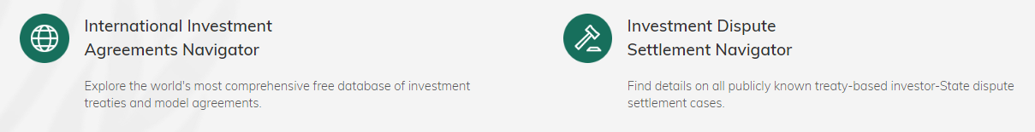
Contact
Diana Rosert
diana.rosert@un.org
Division on Investment and Enterprise
UNCTAD
investmentpolicy.unctad.org
Twitter @unctadwif

