Slide 1
Fostering Business Linkages for the Sustainable Development Goals
Dr. Denise Chevannes, National Private Sector Specialist, Win-Win Programme Jamaica, UN Women, Mobile: 876 564 1656; Email: d.chevannes-vogel@unwomen.org

Slide 2
WIN-WIN
GENDER EQUALITY MEANS
GOOD BUSINESS

Slide 3
A UN Women programme implemented in partnership
with the European Union and ILO to promote
gender equality through the private sector

Slide 4

Agenda 2030
The private sector is a key partner in the advancement of the Agenda 2030 and the achievement of the Sustainable Development Goals (SDG), enabling women’s full and equal participation in society.
GENDER EQUALITY IS THE SILVER BULLET FOR THE ACHIEVEMENT OF THE AGENDA 2030

Slide 5

SDG 5
Achieve gender equality and empower all women and girls
INDICATORS
End discrimination
Eliminate violence
Recognize and value unpaid care and domestic work
Promotion of shared responsibility within the household
Full participation and equal opportunities for leadership at all levels of decision making
Equal rights to economic resources

Slide 6

SDG 8
Promote inclusive and sustainable development, decent work and employment for all
INDICATORS
Full and productive employment and decent work
Equal pay for work of equal value
Labour rights and safe and secure working environments

Slide 7

SDG 17
Revitalize the global partnership for sustainable development
INDICATORS
Resources for developing countries
Capacity-building through North-South, South-South and triangular cooperation
Multi-stakeholder partnerships
High-quality, timely, reliable data disaggregated by gender, age, race, ethnicity, income etc.

Slide 8

OBJECTIVE
Contribute to the economic empowerment of women
by recognizing women as beneficiaries and partners of growth and development
increasing private sector’s commitment to gender equality and women’s empowerment
strengthening its capacities to implement these commitments

Slide 9
OUTCOME 1
OUTPUT 1.1
Women-led businesses in Europe and LAC increase cooperation to expand opportunities
Networking platforms support expanded opportunities for women-led businesses from Europe and Latin America and the Caribbean
Map networks and associations of women in business sector
Strengthen procurement capacities
Strengthen networks and associations to increase number of women in leadership and skills of women entrepreneurs
Strengthen national women’s machineries

Slide 10
OUTCOME 2
OUTPUT 2.1
Sustainable model
of gender sensitive private sector engagement to support SDG achievement developed and adopted
Improved capacities of companies to develop and implement gender equality practices and to genuinely integrate them into their corporate policy and practice
Engage new WEPs signatories

Slide 11
OUTPUT 3.1
OUTCOME 3
Impact investment facility established as innovative and sustainable financing model to attract additional private sector investments for gender equality, linked to SDG5 achievement
Bi-regional women- led innovation and business ventures
Establish an impact investment facility infrastructure as innovative financing model
Attract relevant partners, expertise and resources
Financial and technical assistance to women-led innovation

Slide 12
Main Challenges to Ensure Positive Impact of Investment though Business Linkages

Slide 13
GENDER DETERMINES …
“MASCULINITY” AND “FEMININITY”
(GENDER ROLES)
Roles, status,
norms, values
Responsibilities, needs, expectations
Sexuality and Sexual behaviour
GENDER
THE DIVISION OF LABOUR, POWER AND RESPONSIBILITIES
THE DISTRIBUTION OF RESOURCES AND REWARDS

Slide 14
Definitions
Gender Equality:
  The state or condition that affords women and men equal enjoyment of human rights, socially valued goods, opportunities, and resources. Genuine equality means more than parity in numbers or laws on the books; it means expanded freedoms and improved overall quality of life for all people.
Gender Equity:
  The process of being fair to women and men. To ensure fairness, measures should be taken to compensate for cumulative economic, social, and political disadvantages that prevent women and men from operating on a level playing field.

Slide 15

Some Gains in Gender Equality in Jamaica:
High tertiary education enrolment:
  70% women: 30% men at the largest educational institution, University of the West Indies
Almost 60 % of managers are women
Notes:
–

Slide 16
But gender inequalities for women persist!
Gender stereotyping persists - women segregated educationally, occupationally (under-representation of women in STEM careers, at executive and Board management levels).
Gender digital divide
Higher unemployment in women (Female unemployment rate in July 2019 was 10.2% and the rate for males was 5.8%) – STATIN
Gender pay gap – approx. 60%
Women’s enterprises - low-growth sectors and constraints in access to productive resources.
Notes:
–

Slide 17

Limited Knowledge of Legal & Regulatory Framework
In spite of a number of laws and policies:
  Many women have little knowledge of laws, regulations , procedures
  Business registration barriers: in informal sector
  Property rights: male gender bias in inheritance
Notes:
Evidence of enabling environment :
National Policy for Gender Equality (NPGE); CEDAW Ratification; SDG5; Vision 2030 Gender sector Plan; Bureau of Gender Affairs
Small and Medium-Sized Enterprise (MSME) and Entrepreneurship Policy
Employment (Equal Pay for Men and Women) Act
Fundamental Rights (Additional Provisions) (Interim) Act
Human Employment and Resource Training Act
Labour Relations and Industrial Disputes Act
Married Women's Property Act
Maternity Leave Act
Women (Employment of) Act
Rights to Property Act

Slide 18

Gendered and Cultural Biases
Men naturally form networks such as sports, bar, old boys school club
Women less likely to belong to formal business networks.
Social norms, barriers, burden of work
Many women find it challenging to identify/seize market opportunities.
Market access and growth can be particularly daunting.
Notes:
Cultural biases
Women in business are less likely than men to belong to formal business networks.
Business networks offer formal training, information, advice, access to markets, partnerships and policy advocacy, as well as encouragement and support.
However, social norms and barriers may keep women from joining business networks.
Men naturally form networks such as golfing, bar, lodger, old boys network where business deals are struck – women don’t appear to form these networks as a result of their burden of work including child care and domestic responsibilities
Women producers find it challenging to identify and seize market opportunities. Market access and growth can be particularly daunting for women in the informal economy.
For example, a majority of Canadian women SME exporters perceive that gender plays a role in the operation and internationalization of their firms.
A survey finds that 75% of them believe that gender plays a role, including ‘perceived lack of respect by male business owners, bravado, chauvinism, not being taken seriously, businessmen who refuse to do business with a woman, and verification of decisions through male employees’.
Women-owned companies are therefore less likely to expand or internationalize.

Slide 19

Limited Access to gender-sensitive financial services
Major barriers due to lack of collateral, land titles
High financial institution interest rates
Limited access to financing programmes
Limited financial literacy
Notes:
Limited access to land and finance pose more constraints to women than to men. Women have less access to finance because they have less physical and reputational collateral. This may explain why they are concentrated in less capital-intensive firms.
Jamaican women in international trade, for example, find it difficult to attract the
necessary capital from local financial institutions. ‘This is a strong constraint on their
internationalization ambitions and a handbrake on future growth of the MSME sector in Jamaica and its wider economy
Finance- major barrier for women owned businesses
Major barriers due to-no collateral, High Interest rates; limited business skills &documentation.
Limited financial literacy
Services NOT gender friendly Few if any of this funding, targets WOEs
Lending policies & practices of FIs, NOT viewed as women-friendly

Slide 20

Limited skills and access to Information, Communication and Technology
Gender digital divide
Under-representation of women in high-tech sectors and business development.
Low female participation in these sectors hinders equitable distribution of gains in these sectors.
Notes:
Following gender norms, women are inclined to study education, health and welfare, humanities and arts. These educational specializations in turn limit the job opportunities available to educated women to predominantly public sector positions in education, health, and administration. It also limits their use of ICT to help them scale up their exports
High-tech sectors, such as chemicals, electrical, electronic machinery and applications, industrial machinery and transport equipment, have a high indirect impact of services exports. These are sectors that use specialized services and there is lower participation of women.
Low female participation in these sectors hinders equitable distribution of gains in these sectors.

Slide 21

Non-tariff measures hit women harder
Modern barriers to trade often take the form of non-tariff measures (NTMs)
Female owned firms tend to be smaller than male owned firms, and suffer disproportionally from NTMs.
Limited expertise to efficiently overcome relevant trade costs.
Notes:
Modern barriers to trade often take the form of non-tariff measures (NTMs), such as standards or regulations. They can also take the form of lengthy port-handling or custom procedures. One characteristic of NTMs is that they often lead to fixed costs for exporters – costs that do not change with the number or amount of products exported. Women SMEs tend to be disproportionally affected by such trade costs (ITC and WTO, 2014).
Given that female owned firms tend to be smaller than male owned firms, female owned firms tend to suffer disproportionally from NTMs.
Unlike large companies, most SMEs do not possess in-house trade or international departments with experts who know how to efficiently overcome relevant trade costs.
Women SMEs tend to have limited resources and a lower threshold to absorbing risks, especially when operating in intensely competitive markets (OECD, 2006).
In addition, the fact that SMEs tend to trade smaller quantities implies that fixed trade costs often make up a larger share of the unit cost of their goods when compared to rivals exporting larger volumes.

Slide 22
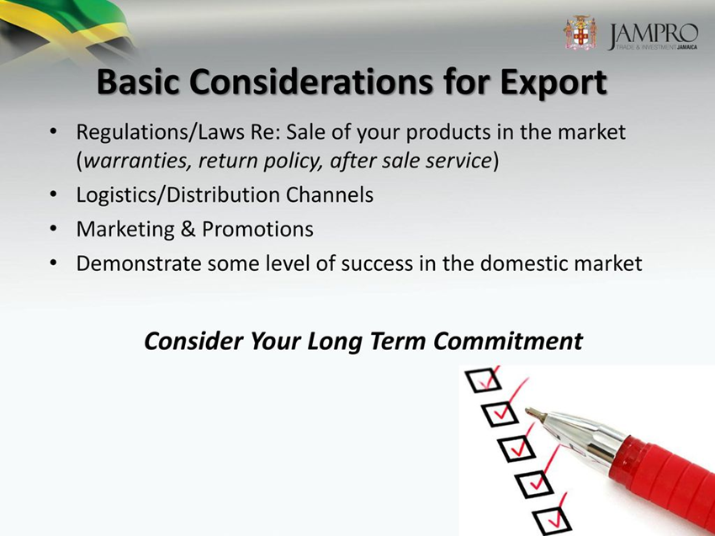
Limited access to gender-sensitive export development services
Limited women’s access to export development services
Limited export development services respond to needs of women entrepreneurs
Knowledge of standards critical – environmental, CARICOM, EU
Notes:
Build capacity of export development services to integrate gender sensitivity in design, access and delivery of export development services to women owned businesses of different sizes, stages of development, across key sectors & in rural and urban areas.
Knowledge of environmental standards, phytosanitary standards, CARICOM and EU standards critical
Establish model of women-focused export development that reflects and responds to their roles and needs
Increase access to these services in rural areas , on line and through women friendly mechanisms

Slide 23
How to Empower Women to Foster Gender Equality and Inclusion

Slide 24
Facilitation of Jamaica chapter of the International Women’s Coffee Alliance
Men dominate the coffee value chain from ownership of the land to processing and export.
Limited information about women in coffee in Jamaica so IWCA Jamaica conducted a pilot survey
Among the lessons learned is that almost 25% of the 4100 registered farmers are women. Cross referencing against the altitudes of the coffee communities has yielded mapping of women producing coffee in the best climatic conditions for specialty coffee.
The definition of Blue Mountain coffee is coffee grown above 3000 ft in 3 specific parishes: St. Andrew, St. Thomas & Portland. Unfortunately, many companies from Jamaica export coffee that is not technically Blue Mountain while labeling it as such. Already knowing this information has allowed IWCA Jamaica to reach out to women regarding quality assurance and are actively seeking training for Q-grader certification.
To date, they have completed small meetings with women in St. Andrew & St. Thomas and the findings include the following:
  Most women do not feel they are being paid enough for their coffee cherries and would like another option for processing their coffee.
  Some women face discrimination from their workers and are charged higher rates for labour than their male counterparts.
  The women have seen a decline in their income over the past 5 years partially due to climate change and decreased production, specifically drought conditions.
  100% of the women grow cash crops to support their income.

Slide 25
PLATFORM TO ACHIEVE GENDER EQUALITY
- Women’s Empowerment Principles (WEPs)
Developed by UN Women and Un Global Compact in 2011
WEPs in Brief:
Establish high-level corporate leadership for gender equality.
2. Treat all women and men fairly at work – respect and support human rights and nondiscrimination.
3. Ensure the health, safety and well-being of all women and men workers.
4. Promote education, training and professional development for women.
5. Implement enterprise development, supply chain and marketing practices that empower women.
6. Promote equality through community initiatives and advocacy.
7. Measure and publicly report on progress to achieve gender equality.

Slide 26
Principle 1. Leadership Promotes Gender Equality:
Sign CEO Statement of Support
Affirm high-level support and direct top-level policies for gender equality and human rights.
Establish company-wide goals and targets for gender equality and include progress as a factor in managers’ performance reviews.
Engage and actively include internal and external stakeholders
Ensure that all policies are gender-sensitive

Slide 27
Principle 2. Equal Opportunity, Inclusion and Non-Discrimination:
Treat different categories of women and men equitably at work - respect and support human rights and non-discrimination.
  Pay equal remuneration for work of equal value
  Ensure that workplace policies and practices are free from gender-based discrimination.
  Implement gender-sensitive recruitment and retention practices
  Assure sufficient participation of women – 30% or greater
  Offer flexible work options, leave and re-entry opportunities to positions of equal pay and status.
  Support access to child and dependent care

Slide 28
Principle 3. Health, Safety and Freedom from Gender-Based Violence:
Ensure the health, safety and well-being of all categories of women and men workers.
  Prevent sexual harassment and establish a zero-tolerance policy
  Respect women and men workers’ rights to time off for medical care
  In consultation with employees, identify and address security issues, including the safety of women traveling to and from work and on company-related business.
  Train security staff and managers to recognize signs of violence against women

Slide 29
Principle 4. Education and Training:
Promote education, training and professional development.
  Build a pipeline of qualified women for senior level and executive positions
  Invest in workplace policies and programmes that open avenues for advancement of women
  Ensure equal access to all company-supported education and training programmes
  Provide equal opportunities for formal and informal networking and mentoring.
  Articulate the company’s business case for the positive impact of inclusion for women as well as men.

Slide 30
Principle 5. Enterprise Development, Supply Chain and Marketing Practices :
Implement enterprise development, supply chain and marketing practices that empower women.
  Expand business relationships with women-owned enterprises across the company value chain.
  Develop gender sensitive procurement policy
  Train women to complete formal bid processes, provide mentorship opportunities
  Market products made by women entrepreneurs
  Support gender-sensitive solutions to credit and lending barriers.
  Ensure that company products, services and facilities are not used for sexual exploitation.

Slide 31
Principle 6. Community Leadership and Engagement:
Promote equality through community initiatives and advocacy:
  Lead by example – showcase company commitment to gender equality
  Leverage influence to advocate for gender equality
  Work with community stakeholders, officials and others to eliminate discrimination and exploitation and open opportunities for women and girls.
  Promote and recognize women’s and ensure sufficient representation
  Use philanthropy and corporate social responsibility programmes to support inclusion, equality and human rights.

Slide 32
Principle 7. Transparency, Measuring and Reporting:
Measure and publicly report on progress to achieve gender equality and women’s economic empowerment.
  Make public the company policies and implementation plan for promoting women’s empowerment and gender equality.
  Establish benchmarks that quantify inclusion of women at all levels.
  Measure and report on progress, both internally and externally, using data disaggregated by sex.
  Incorporate gender markers into ongoing reporting obligations.

Slide 33
The Business Case for Investing in Gender Equality
There is a growing business case for gender equality and the private sector. Women are becoming more significant consumers of goods and services including purchasing decisions of the household.
  A 2011 Deloitte report urged the public and private sectors to reap this benefit by investing in women and bringing them into leadership positions. The report highlighted the growing power of women consumers – already controlling roughly US$20 trillion of total consumer spending globally and influencing up to 80% of buying decisions.
Women are more likely than men to invest a larger proportion of their household income to the education and health of their children.
The combined impact of growing gender equality, the emerging middle class and women’s spending priorities is expected to lead to rising household savings rates

Slide 34
The Business Case for Investing in Gender Equality (contd.)
By aligning gender equality initiatives with company goals, businesses may achieve greater success in corporate social responsibility, sustainability and talent management.
Studies have proven that an integrated and sustainable approach to empowering women across the business value chain yields a high return on investment (ROI).
Empowering women to participate fully in economic life across all sectors and throughout all levels of economic activity is essential to:
  Build strong economies; Establish more stable and just societies;
  Propel businesses’ operations and goals.

Slide 35
Signing the Women’s Empowerment Principles: https://www.empowerwomen.org/en/weps/signtheweps

Slide 36

Gender Equality and the Sustainable Development Goals

