Slide 1
Special Economic Zones
The Jamaica Experience
Presented by Kelli-Dawn Hamilton
Manager – Policy and Business Advocacy, JAMPRO
November 2019

Slide 2
Contents
SEZ Regime
Objectives
Vision & Strategic Rationale
Potential SEZ Locations
Regulatory and Fiscal Regime
Market Demand Drivers
Potential Industries
SEZs and SDGs
Next Steps

Slide 3
Experience Timeline
1976 - 2015
Free zone regime
Jamaica Export Free Zone Act
2015 - 2017
Implementation & Operationalisation
SEZ enacted on Feb. 15, 2016
2019 onwards
Integrating into the global value chain
December 31, 2019 deadline for transition
Entered into force Aug 1, 2016 resulting in the repeal of the Free Zone Act
Government led initiative
Focus on manufacturing
Export-led focus
Regulations passed Sep 2017
Free zone operators grandfathered
Identifying anchor companies
Buildout of townships
Economic clusters
World class zone development
Creation of SEZ policy

Slide 4

Objectives of the SEZ Regime
Support growth-inducing activities
Stimulate sustainable economic growth
Supported by efficient and cost-effective regulatory procedures
Stimulate wide-scale economic activities, especially in new and emerging sectors
Adhere to international obligations

Slide 5
Regulatory Authority
Jamaica Special Economic Zone Authority:
- Agency of the GOJ
Responsible for the regulation of SEZs
Provide a policy direction for the economy through SEZs
Establish new and diverse investments in SEZs
Create access to one stop shop services
Countrywide Zone development
Facilitate two-way trade in Zones
Mitigate any negative impact on investors, the environment and revenue leakage
Efficient conduct of business in Zones to enhance competitiveness
Develop human capital to support businesses in the SEZs
:

Slide 6

Vision
Backward linkages into the economy
Development of industry cluster
Standard driven SEZs
Integration into the global value chain
MSME Development
Safety & security at the forefront of planning

Slide 7
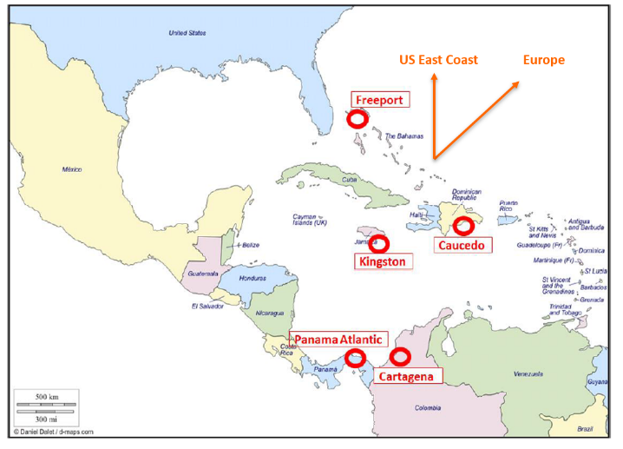
Strategic Rationale—Growth in Transshipment
PORT OF KINGSTON
A strategic location with thriving activities
32 nautical miles off the sea linking Asia to the US East Coast and Europe
11 East/West through Caribbean services w/total nominal capacity of 71,000 TEUs/week transit through Panama Canal from Asia to US East Coast
Potential consumer market of over +800 million people
Throughput: 1.65 million TEU/annum

Slide 8
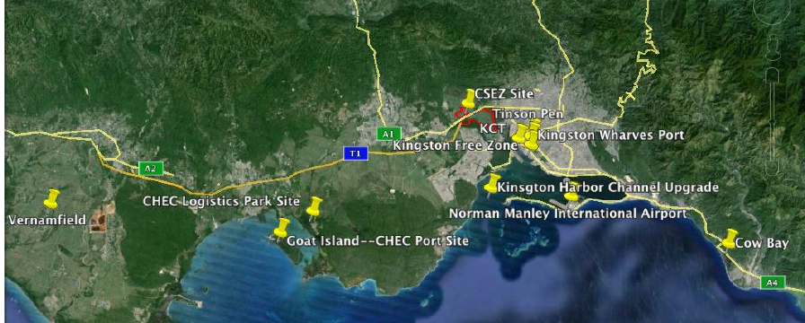
Strategic Rationale—Integrated Infrastructure
Global Logistics Hub Initiative: establishing Jamaica as one of four global leaders in cargo transshipment and logistics
CSEZ
Caymanas New Town
Tinson Pen
Expansion of Kingston Wharves Limited Terminal
Proposed: Development of Vernamfield Airport and Cargo Hub
Privatization & Expansion of Kingston Container Terminal
Modernization and Expansion of Norman Manley International Airport
Commodity Port in Cow Bay, St. Thomas

Slide 9
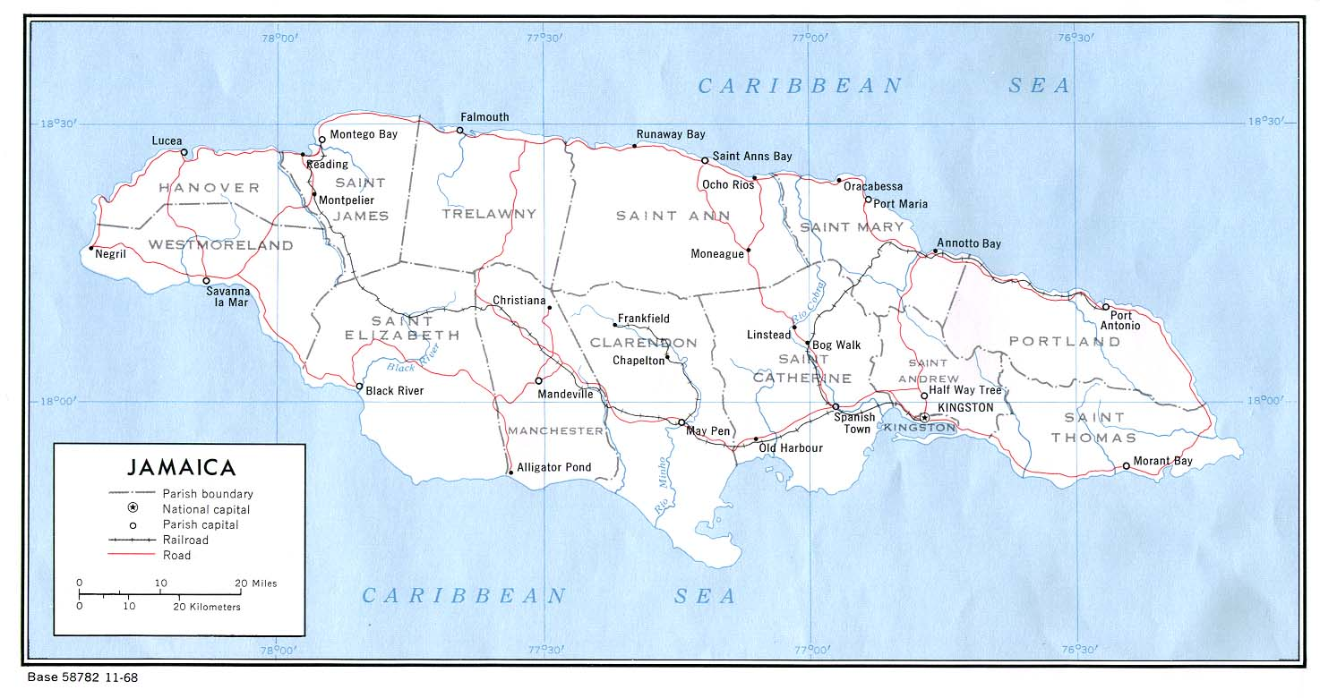


Potential SEZ Locations
Montego Bay
Frankfield
Ewarton
Port Antonio
JAMAICA
Parish boundary
National capital
Proposed SEZs
Existing Free Zones
Stand - Alone Free Zones
Parish capital
Major railway stops
Railway
North Coast Highway
Highway 2000 Toll Road
Highway Dev. Underway
Kingston
Vernamfield
Port Esquivel

Slide 10

Regulatory and Fiscal Regime - SEZ Regime
Trade Facilitation
Special Customs Regime for Zones
National Single Electronic Window
Business Facilitation
One Stop Shop for SEZ investors
Modern SEZ regime
Business-friendly environment

Slide 11
Regulatory and Fiscal Regime - SEZ Regime
 | Developers | Occupants
Fiscal Incentives | Corporate income tax of 12.5 percent Exemption from customs duties, income tax, general consumption tax, stamp duties, transfer tax Promotional tax credit up to a maximum of 10 percent of income tax | Corporate income tax of 12.5 percent Exemption from assets tax, customs duties, general consumption tax
Permitted Business Activities | All except: Extractive industries, tourism services, telecommunications services, public utilities*, financial services, construction services (unless as part of manufacturing process within a Zone), real estate, health services (excluding R&D), catering services, and retail trade.
Minimum Eligibility Requirements | Be a company incorporated under the Companies Act of Jamaica Have issued and paid up share capital, not less than US$1.5 million Have a minimum of three occupants** | Be a company incorporated under the Companies Act of Jamaica Have issued and paid up share capital, not less than US$25,000 Minimum US$50,000 investments in zone-related buildings, machines, etc. in first year of subconcession
Contract Awarded | License-agreements or Master Concessions | Subconcession
Applicable Law | Normal environmental permitting, labor, and utility regulation laws; British common-law business law | Normal environmental permitting, labor, and utility regulation laws; British common-law business law
*Excluding generation of electricity by a developer or an occupant solely for its own use
**Except if in receipt of special approval of a single-entity specialized zone

Slide 12
Market Demand Drivers for SEZ
Transforming economy
From tourism and agriculture to export-oriented sectors
Positive momentum from GLHI
Increasing # of shipping lines, destinations served, and volumes of container traffic at Port of Kingston
Filling an urgent need
Turnkey building solutions for manufacturing, logistics and services sectors
Regionally competitive offering
Competitive land and facility prices, attractive fiscal regime

Slide 13










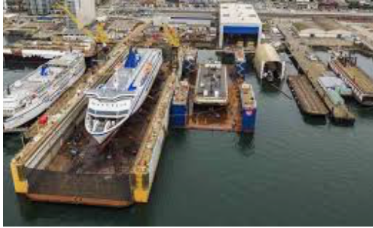
Potential Industries
Furniture: Traditional wood, mattresses, etc.
Creative: Fashion and Jewelry, Advertising, etc.
Pharmaceuticals: Health and beauty, specialty oils
Global Services: Professional services, KPOs, Digital services etc.
Food and beverage: Canned goods, confectionery, etc.
Warehousing: Open storage, containers, logistics and distribution
Paper: Paper products, packaging and labeling, etc.
Metal fabrication: Building materials, fences, etc.
Textiles: Apparel, uniforms
Repairs: Motor vehicles and parts, appliances, etc.
Dry dock: Ship repair
Notes:
Integrated SEZs – Kingston Wharves

Slide 14










SEZs and SDGs
Notes:
-Quality education
Energy
Economic growth

Slide 15
Next Steps and Timelines
Refine legislation and regulations
Tweak administrative processes
Assess landscape against projections
Evaluate
Targeted marketing campaign
Identify anchor companies
Attract largescale developers
Industry consultation
Actively Incorporate SDGs
3. Monitoring and Evaluation
1. Operationalisation
2. Attract investors
Public Awareness Campaign
Transition Free zones
Market engagement
Monitor stakeholders
Convert Leads
Assess admin processes
Train resources
Actively Incorporate SDGs

Slide 16

Thank You!!!

