Slide 1
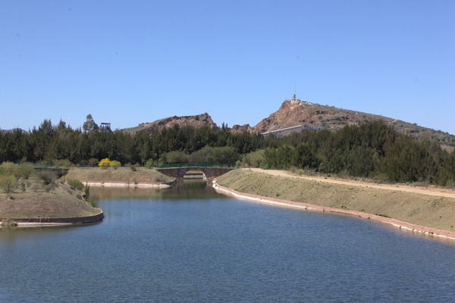




Fresnillo plc
Sustainability Strategy aligned with the UN Sustainable Development Goals (SDG´s)
November 8th, 2017

Slide 2
Agenda
Fresnillo at a glance
SDG alignment
Social Strategy and SDG’s
Environmental Strategy and SDG’s

Slide 3
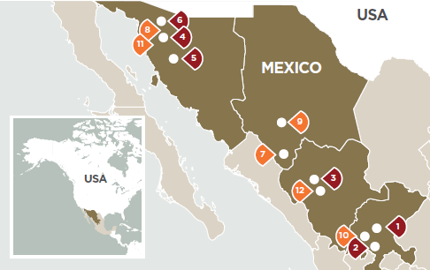



Fresnillo at a Glance
6 mining operations in Mexico
World’s largest silver producer (50.3 moz en 2016)
Mexico’s largest gold producer (935.5 Koz en 2016)
  Market cap of US$12.4 billion
Silver resources of 2.2 billion ounces and gold resources of 38.4 million ounces
Mining concessions of 1.8 million hectares in Mexico and 350 thousand hectares in Peru

Slide 4
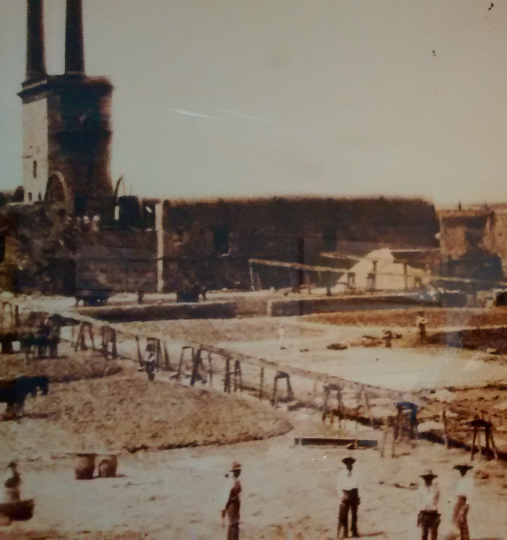
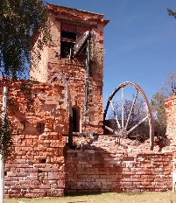
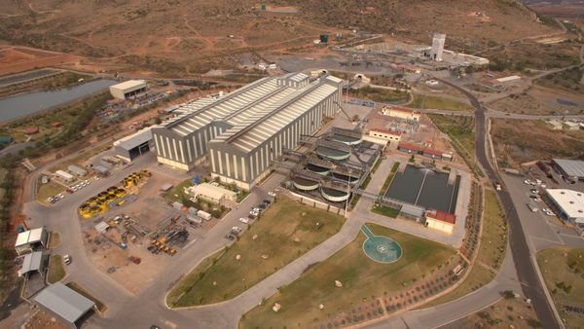
Fresnillo at a Glance
Mining heritage
Ancient building hosting the Mine Dewatering Pumps
Proaño Mine
Photo: Beneficiation hacienda and the building hosting the Mine Dewatering Pumps
Discovered in 1554 by the Spanish Capitain Diego Fernández de Proaño
Modern beneficiation Plant
“El Saucito Mine”

Slide 5
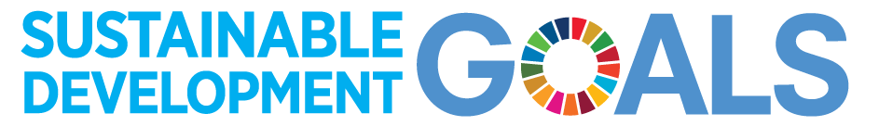
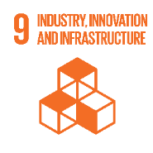
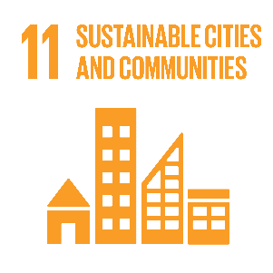
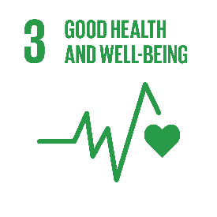
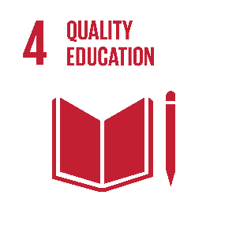
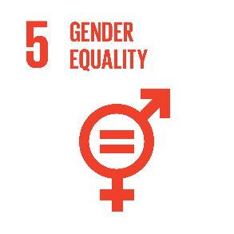
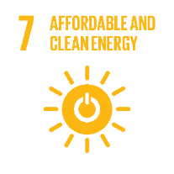
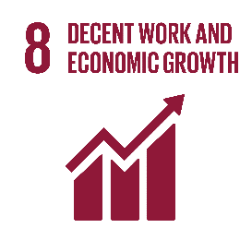

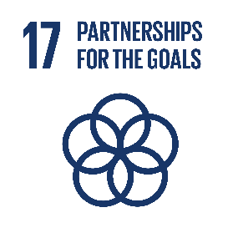
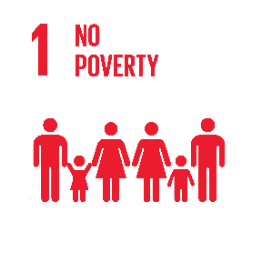
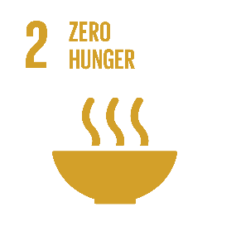
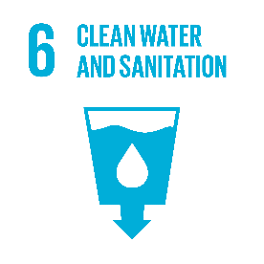
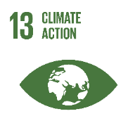
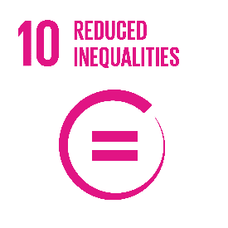
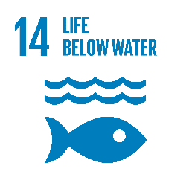
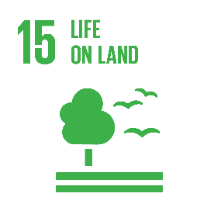
 | Leverage and collaboration | Core Business
Enhance
Mitigate

Slide 6



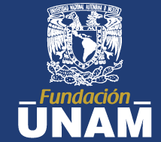


Purposeful and aspirational engagement with our communities
Create long term value, aligned with the UN Global Goals for sustainable development
Education
Enjoy reading and making the learning of a science a rewarding experience
Water
Partner with communities to increase safe water access
Build capacities
Develop entrepreneurs to diversify local economies making them more resilient and less dependent on mining
Health
Partner with communities to improve their health

Slide 7
Reading – A proposeful story, we stand for
Picando Letras: Bringing books and children together.
66 schools, benefiting 8,186 children
Fresnillo district, Guanajuato, Penmont, San Julian and La Ciénega.
"We seek to create a space where teachers, parents, youngsters and children interact, raise awareness and reflect as a result of reading; in an enjoyable, free and meaningful manner. By doing this we strengthen our community bonds, educate people so they can self-reflect, express their feelings and thoughts and really listen to others in a tolerant and respectful environment."
Benefits to our social acceptability :
Develops the competences of teachers, hence supporting the education reform
Direct engagement with parents, teachers and students with a purposeful story
Communication skills, dialogue and science support community development in the long term

Slide 8
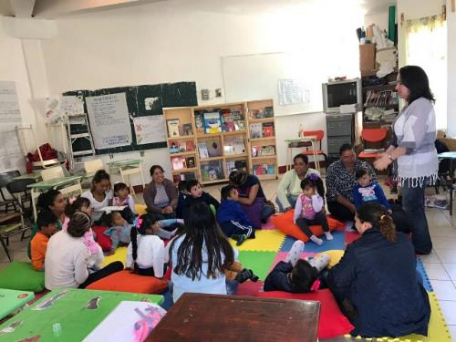
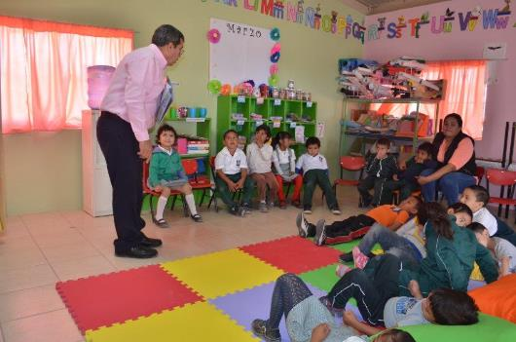
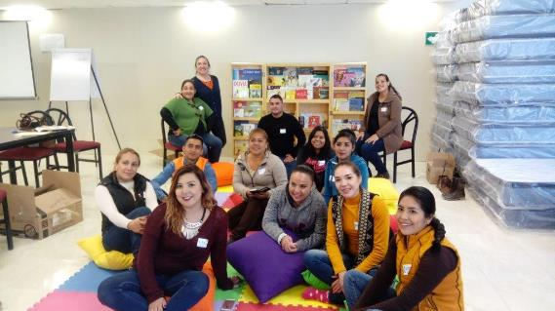
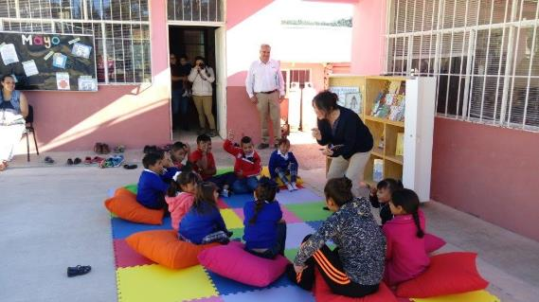
Picando Letras “IBBY”
Reading session with parent and their children in the Guanajuato district
Reading session in the Penmont district
Training session for teachers of San Julian
Reading session in San Julian

Slide 9
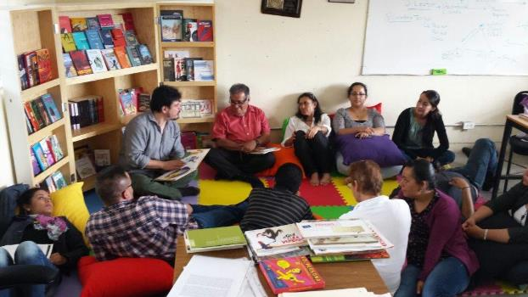
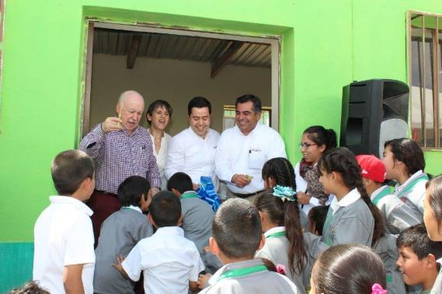
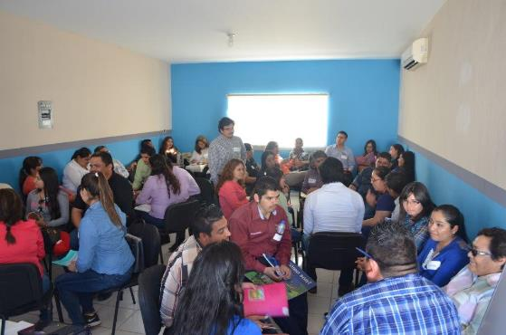
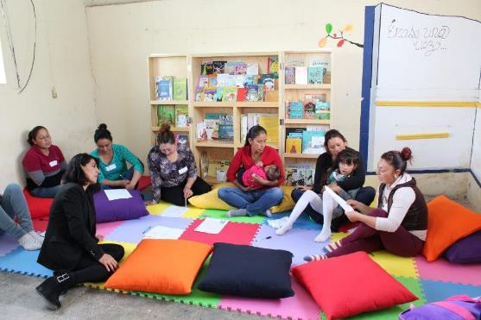
Picando Letras “IBBY”
Training session for teachers of Penmont
Cutting ribbon ceremony in el Saucito
Training session for parents in Penmont
Reading session with parents in el Saucito

Slide 10
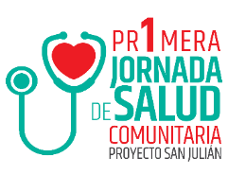

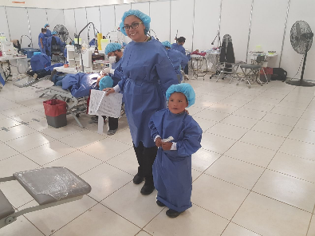
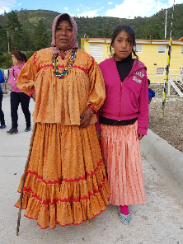
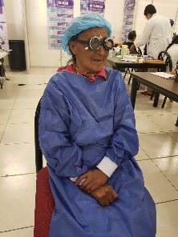
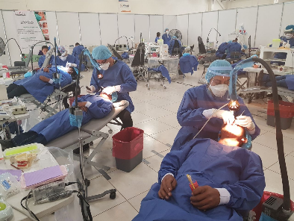
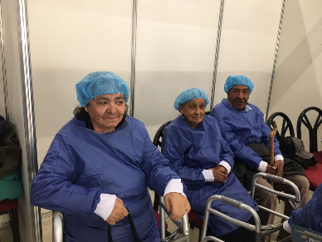
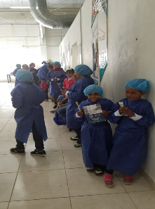
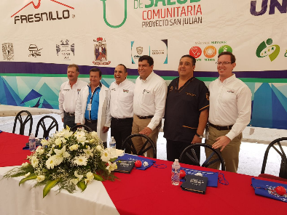
Health Week
The program benefited 1,144 persons from 27 communities
Eye care, dental care, vaccination, diabetes detection, eating habits and raising awareness

Slide 11

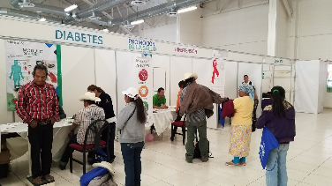
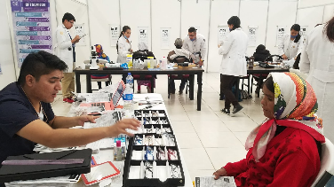
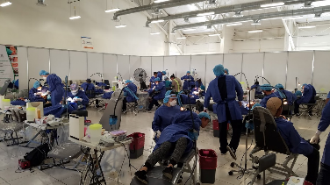
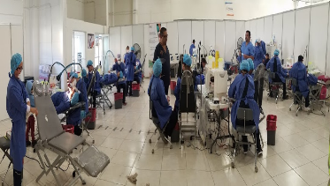
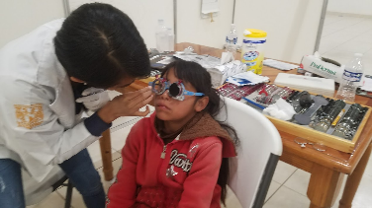
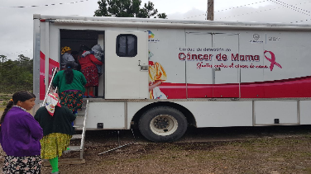
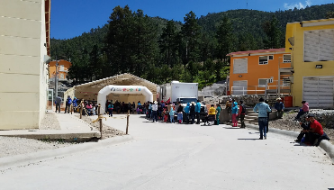
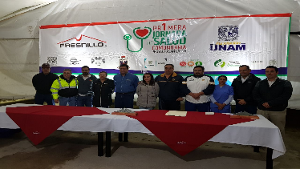
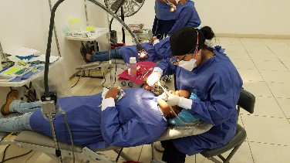
Health Week

Slide 12
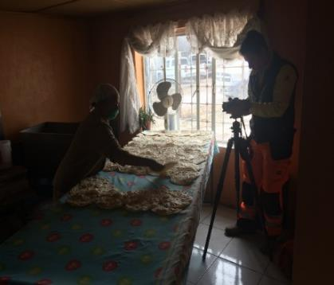
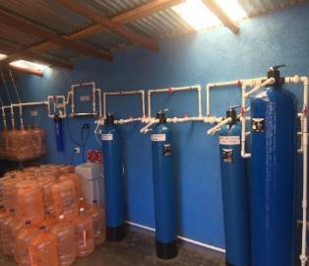
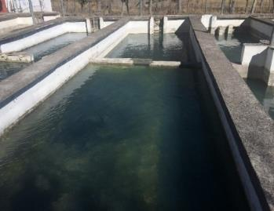

Local procurement – Capacity building
Tortilla bakery in “Las Papas”.
Tortilla bakery in “San Julián”.
Bottled water “El Chorrito” in San Julián.
Trout farm in “Chinatu”.
Water tank truck service in “San Julian”.
AC maintenance in “La Catedral”.
Grocery supplier “ServiAval” in “El Vergel”.
Tortilla bakery
Bottled water “El Chorrito”
Trout farm in Chinatu

Slide 13


Clean Water Access through Silver
Use silver to remove bacteria and enhance safe water access as part of our commitment with the United Nations Sustainable Development Goals.

Slide 14







Water – Rainwater harvest
Increase access to safe water through rainwater harvesting. In partnership with the NGO Captar AC. This NGO has great experience working with Raramuri communities.
1
2
3
4
5
6

Slide 15




Water – Rainwater harvest

Slide 16





Water stewardship - Technology
Reduction of the water footprint with High density thickeners
Reuse of municipal wastewater
Protection of groundwater
Reclaimed tailings converted in parks

Slide 17





Climate Action
Reduction of the carbon footprint of mining operations through energy efficiency and renewables
Transparency and strong commitment with the Paris agreement

