Slide 1
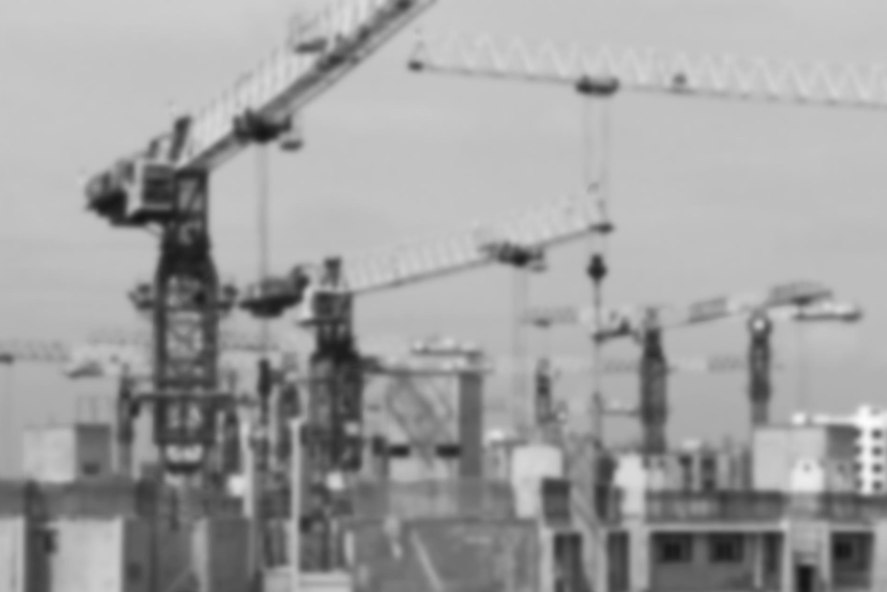
Building an IPA pipeline of SDG project proposals
Regional Seminar on the Promotion of
Bankable Sustainable Development Goal Projects
7-8 November 2017, Mexico City
Carlos Griffin
UNCTAD consultant

Slide 2
Examples of real projects
Moldova: Plant to hull, clean, & sort sunflower seeds, w/ GAP training to farmers
Background
  Seeds exported for processing into oil. Intermediate steps of hulling, cleaning, and sorting done in Netherlands before re-export to oil producers.
  Existing plants in Moldova could not meet quality and/or volume requirements of 3,000 tons per year at 99.9% purity.
  Local processor sought investment, skills, technology, and better raw seeds
SDGs served: 8 (growth), 1 (poverty), 2 (hunger)
  120 farmers given better seed varieties and trained in GAP
  More revenue to farmers and local processor
  Higher industrial skills & technology, better agricultural practices in Moldova
  Increased export value
Investment needed: €1.5 million
Financial partners:
  Local firm willing and able to be responsible for 50% through equity and debt
  Netherlands Enterprise Agency willing to lend half to companies meeting financial and CSR requirements
  Two Dutch firms found to each take a 25% share
2
Global and Regional Investment Trends

Slide 3
Examples of real projects
Lesotho: Construction and operation of a public hospital
Background
  Min. of Health determined that quality was falling, prices were rising, and facilities at Queen Elizabeth II Hospital needed to be replaced or extensively refurbished.
  Government enlisted World Bank Group (IFC) to advise. An open-bid PPP was chosen as the best vehicle.
  Hospital to have 425 public beds, 35 private beds, 3 off-site filter clinics, and 1 gateway clinic. To be managed under an 18-year contract.
SDGs served: #3 (health and wellbeing), as assessed by a Boston University study…
  Maternal and infant mortality
  Post-surgical mortality
  Clinical management of HIV/AIDS
  PLUS, an increase in demand for services
Financial partners:
  Govt. paid $58 million up front to reduce risk and committed to $30 million per year starting when construction completed
  $500,000 equity from winning bidder
  $95 million financed by Development Bank of South Africa
  Period from start of construction to start of operations bridged by $6.25 million grant from World Bank’s Global Partnership for Output-Based Aid
3
Global and Regional Investment Trends

Slide 4
A process for mainstreaming SDGs at IPAs
1. Consider SDGs at the strategy-setting level, along with other development plans
2. Identify and select SDG target sectors
3. Select and rank SDG projects
UNCTAD’s SDG project profile template is a tool for these steps
4. Develop a pipeline of project proposals
5. Promote the projects and identify OIA partners
6. Follow-up, facilitate and provide aftercare
7. Feedback to SDG stakeholders
4
Global and Regional Investment Trends

Slide 5
UNCTAD’s SDG project profile template–Data
Kind of project data included
General: Sector/subsector/product, SDGs served, status, scale, location, investment needed, investment already made available (by whom w/ what requirement)
Project specifics: Business case, detailed project requirements (inputs, infrastructure, legal/regulatory framework)
Government requirements and monitoring: Need, procedures, and status of regulatory clearances (environmental, social, etc.); compliance monitoring
Government support and monitoring: Incentives, facilitation, public programs offering worker training and other potentially useful services
Project partners and contacts
Moldova | Lesotho
Product, volume, local firm’s history/ financial strength | Location, market characteristics, govt funding
Export vols./value, value chain, quality stds/challenges, timeframe | Mkt, service demand, revenue sources, competition, costs of construc./operation
Pre-clearance in hand. NEA to do CSR audit. Plant needs to be HACCP certified | Regulatory pre-clearance and EIA in hand. No other statutory requ.
Export facilitation | Govt funding, feasibility study in hand, training
NEA | LNDC
5
Global and Regional Investment Trends

Slide 6
UNCTAD’s SDG project profile template–USE
Systematically collecting, storing, and presenting data on each project allows IPAs to understand, compare, aggregate, and quickly analyze projects for the purposes of:
Organizing their “pipeline” of highly diverse projects with SDG benefits
Assessing competitiveness and, therefore, promotability
  At least, within your pipeline. Still needs to be compared against competitors
Prioritizing your pipeline
Marketing projects by presenting crucial information to potential investors succinctly and persuasively
Two-factor prioritization
Desirable | High
 | Low
 |  | Low | High
 |  | Promotable
6
Global and Regional Investment Trends

Slide 7
UNCTAD’s SDG project profile template–USE
The completed template can take the forms of:
Individual project profiles, for example, in the form of a prospectus or brochure
An entry in an IPA database (as simple as an Excel spreadsheet), which represents the SDG project “pipeline”
Through you CRM or even the MS suite of software (with some help from your IT dept.) this can even be turned into a powerful tool for strategy-setting or into project-specific marketing materials and pipeline performance reports.
7
Global and Regional Investment Trends

Slide 8
Exercise: Group discussion and presentation
Break into four groups
Share the promotable SDG project you selected from your country (2-3 minutes each)
Select the most promotable project among your groupmates
Select 1 person to report on the group’s work
Do three things for the selected project (45 minutes):
  Fill out the template, to the extent possible using your knowledge and online research
  Highlight the template information fields where you have the most trouble finding information. Why? What partners can help?
  Brainstorm investors and institutions that you might want to pitch the project to
In plenary, report on the results of your group’s work (5 minutes per group)
8
Global and Regional Investment Trends

Slide 9


UNCTAD’s
Investment Promotion Programme
Thank you!
Paul Wessendorp
Chief, Investment Promotion Section
UNCTAD
Jan SMIT
Partner, CSES
8 December 2015, Geneva
jsmit@cses.co.uk

