Slide 1

CAF – Development Bank of Latin America
In Front of Sustainable Development Goals
Emilio Uquillas Freire - Director Representative in México
Notes:
Good morning everyone. It is a pleasure for me to be representing CAF Development Bank of Latin America in this gathering to discuss the importance of the Sustainable Development Goals and our role as a development bank committed with sustainable development in the region.

Slide 2
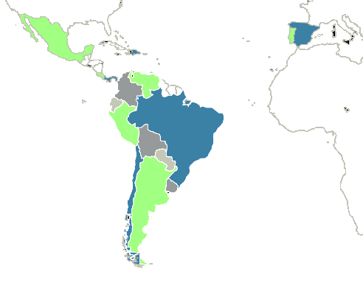
About CAF
Latin American multilateral financial institution.
Mission:
    Sustainable development
    Regional integration
Provides multiple types of banking services to clients in the public and private sectors of its member countries.
It is versatile, agile and competitive at both regional and global levels.
2
Notes:
Since its constitution, CAF’s objectives have been strictly aligned with sustainable development and regional integration. We are a multilateral financial institution with a Latina American identity and an Ibero American projection that promotes an efficient mobilization of resources for a timely provision of multiple financial services, with high value added, to clients in the public and private sectors of the shareholder countries. Our goal is to maintain a competitive organization, client-oriented, sensitive to the social needs, and supported by a highly specialized staff.

Slide 3
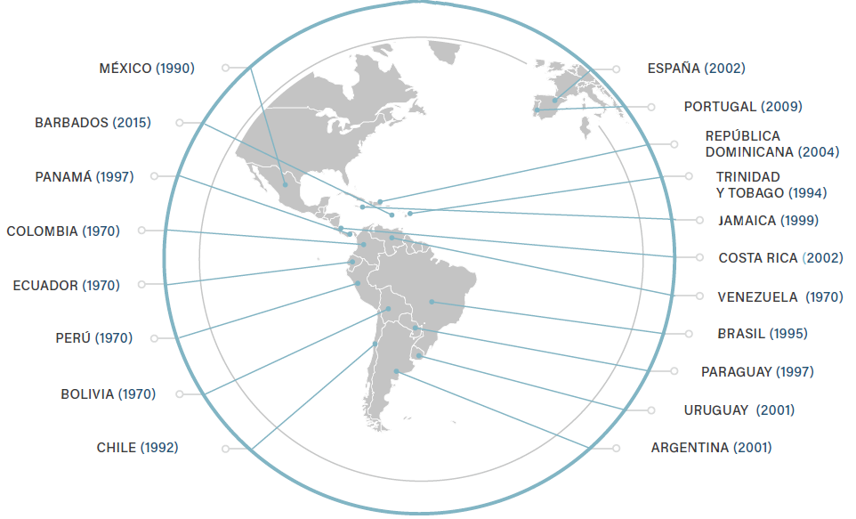
CAF: from Andean Institution to Latin American Development Bank
3
Notes:
Starting as an Andean bank with 5 member countries, CAF became a 19 member regional institution, including Spain and Portugal, having Mexico as the first non-Andean country to subscribe in 1990.

Slide 4
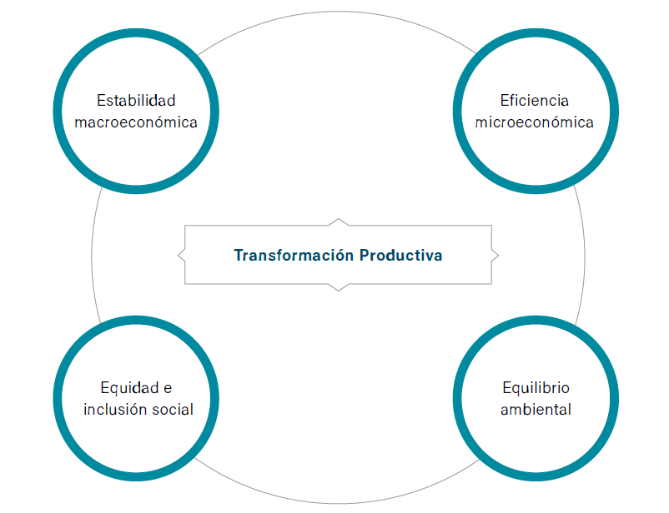
CAF’s Vision of Sustainable Development
Comprehensive Development Agenda to attain a Sustainable Growth
4
Notes:
CAF’s vision of sustainable development includes a comprehensive agenda that aims to achieve a high quality, sustained, efficient and sustainable growth in Latin America. However, to fulfill these objectives it is necessary to preserve and strengthen most of our countries’ increasing macroeconomic stability, as a platform in which the desired growth must be supported. Moreover, a solid institutional framework must be reinforced in order to establish the necessary public policies to promote sustainable development.
Nonetheless, these efforts must be accompanied with considerable microeconomic efficiency upgrades along with a productive transformation that lead to productivity increases, support a regional and international competitive integration, and contribute to generate new formal employment. Consequently, new middle classes should emerge, reducing poverty and promoting social inclusion and equality.
Furthermore, sustainable growth must come hand in hand with a responsible use of the environmental capital that helps develop new regional comparative and competitive advantages, whilst ensuring it’s availability throughout generations.

Slide 5
Products and services
Loans: short, medium and long term
Project financing
Structured financing
Co-financing and A / B loans
Capital investments / Investment Funds
Investment banking and financial advice
Guarantees
Treasury services
Technical cooperation
Special programs and knowledge services
5
Notes:
To tackle these challenges, CAF possesses multiple tools with high quality financial and technical products and services tailor-made for our countries’ needs, which gather up more than 50 years of lessons learned from financing development in Latin America. Products and services that mainly focus on programs and investment projects, but also respond to demands for budgetary resources.

Slide 6
CAF, more than a bank…
Programs and projects financing
  Catalytic and resource intermediation role
  Anti-cyclical role in financing development
  Innovative products and services
Mitigation of market failures
Support for the region’s pragmatic integration
Support for the comprehensive development agenda through special programs
Generation and dissemination of knowledge in favor of public policies in the region
Construction of bridges between Latin America and the world
6
Notes:
Nevertheless, CAF is more than just a bank. It catalyzes and intermediates public, private and international financial organisms resources. Additionally, the bank stands out for its counter-cyclical role in financing development, mitigating market failures, promoting the region’s pragmatic integration, generating and spreading knowledge and good practices.

Slide 7
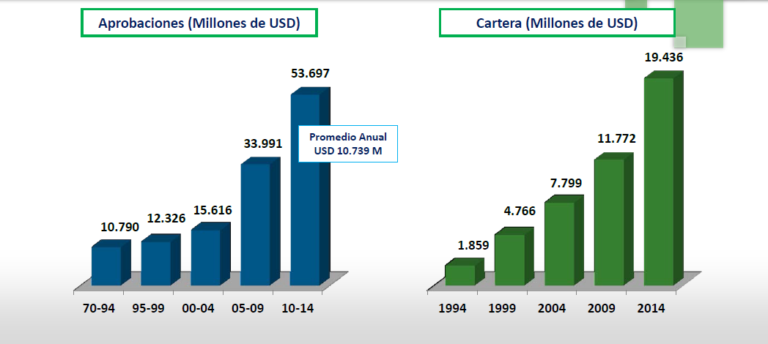

Accelerated growth
USD 12,412 Aprobados en 2016
Promedio Anual
USD 11.074 M
7
Notes:
Convinced and motivated by our mission, we have earned a steady and rapid growth of our approvals demand and projects portfolio, with USD 12.4 billion in approved projects in 2016 for a 4-year 39% growth, and reaching USD 22.6 billion in CAF’s projects portfolio for the same years’ end.

Slide 8
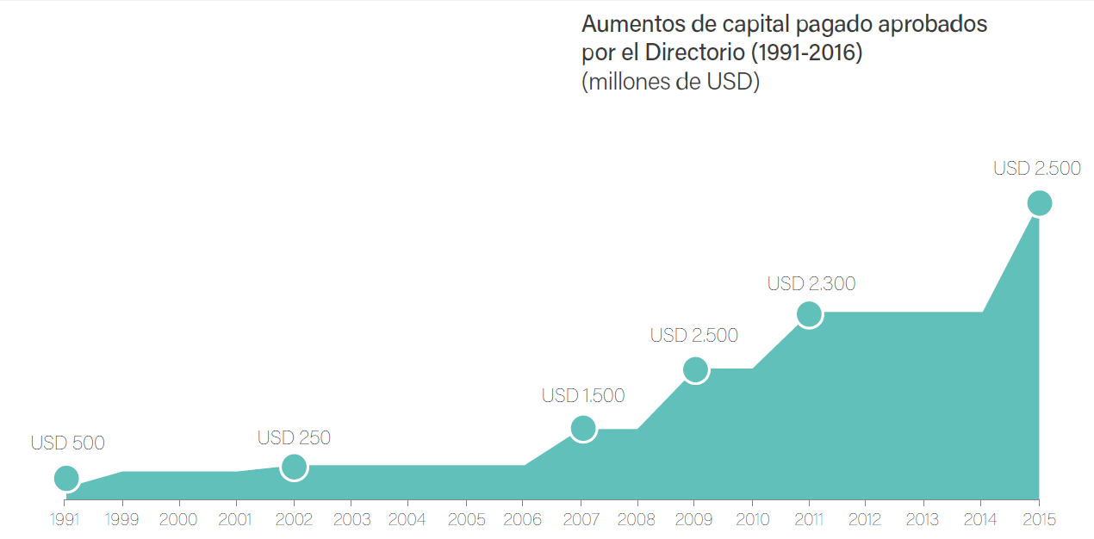
…thanks to confidence of our shareholders…
8
Notes:
On another hand, CAF’s financial strength nurtures from member countries’ commitment and capital markets access, fed by highly satisfactory profitability indicators.

Slide 9
…and the financial markets
1990
1993
2001
2013
Sin Calificación
Categoría BBB
Categoría A
Categoría AA
9
Notes:
These results come from consistent ratings improvements, starting in 1993 with the first BBB investment grade score and winning a AA- or equivalent risk rating by 2013 from S&P's, Moody's and Fitch.

Slide 10
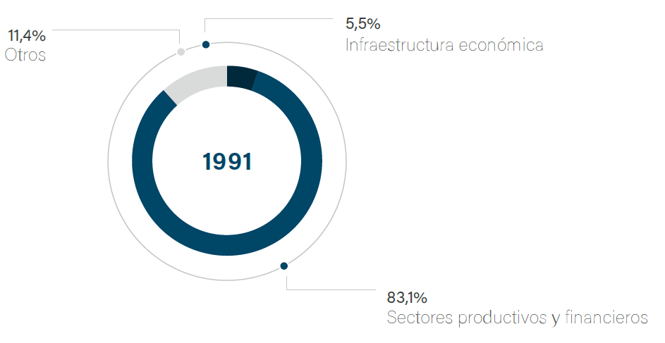
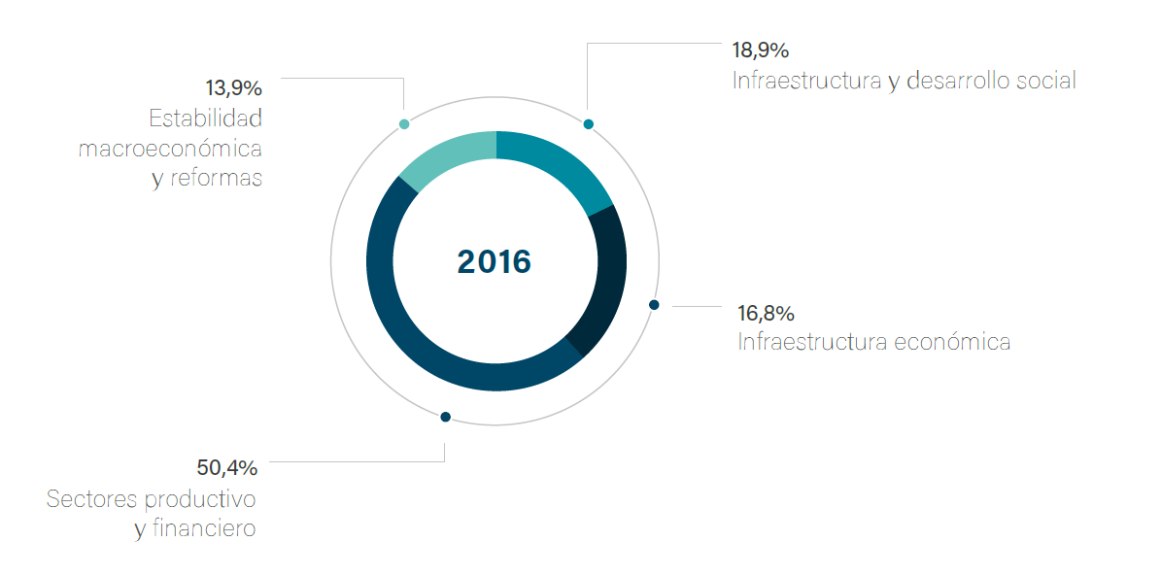

Supporting strategic sectors
10
Notes:
As you can see, in addition to prioritizing financing in the infrastructure sector, CAF has increased its participation in the social sector, in the environment and in the promotion of Medium, Small and Micro enterprises. The support to private firms is done directly and through public and private institutions

Slide 11
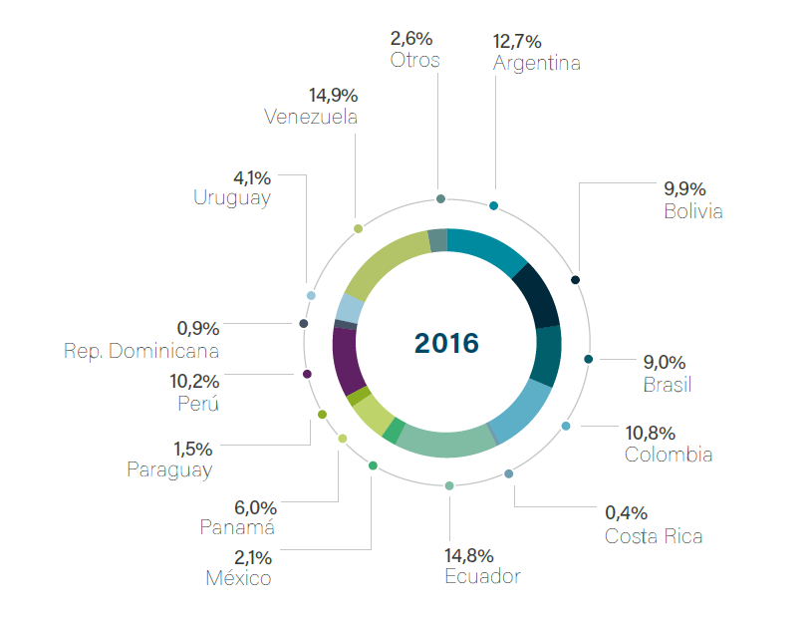
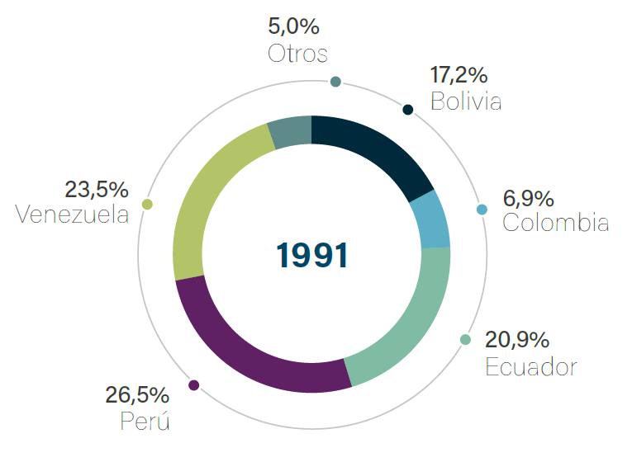
Diversifying the loan portfolio amongst countries
11
Notes:
The bank’s portfolio evolution has gained an important geographical diversification, which reflects CAF’s capital growth and outreach in the region, echoing the mission to promote Latin America’s sustainable development and integration.

Slide 12
And positioning as the largest source of multilateral financing in infrastructure in Latin America
Total Approvals 1990:
USD 10.658 millones
Total Approvals 2015:
USD 34.480 millones
12
Notes:
To this day, CAF represents the main source of infrastructure financing in the region. In addition, as part of the growing commitment with multilateral financing, the bank has gone from approving 8% of total multilateral projects in 1990 to 34% in 2015.

Slide 13
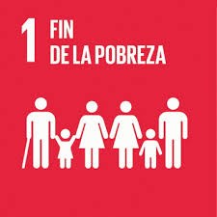
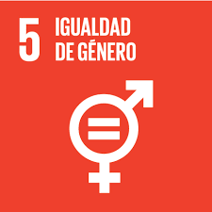
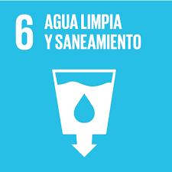
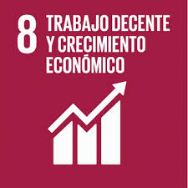
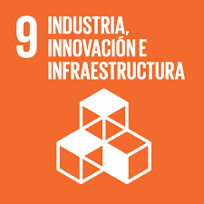
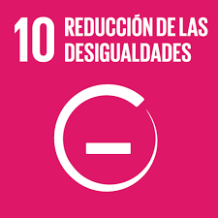
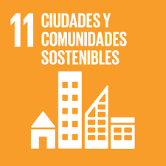
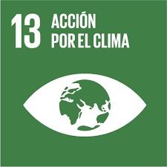
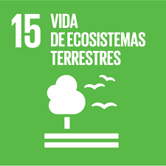
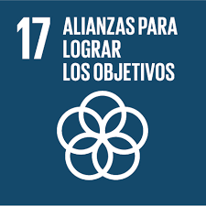
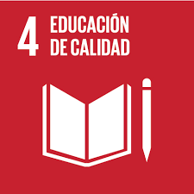
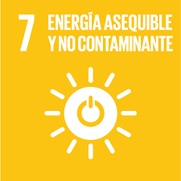
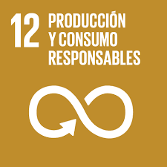


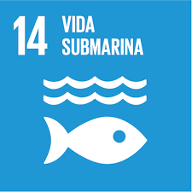
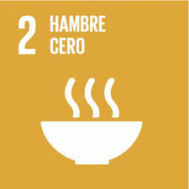
In practice, CAF's strategy is focused on achieving the SDG´s
Infraestructure
Energy
Regional Integration
Social Development
Climate Change
Productive Transformation
Institutional Strengthening
13
Notes:
Hence, we are well satisfied with our financial performance and banking role, however our DNA is intrinsically linked with development, and thanks to CAF’s economical health and optimal resource allocation we have a favorable impact on the region. The primary lines of work and special programs which support CAF’s actions go in hand with our continuous quest for the region’s comprehensive development and fulfillment of Sustainable Development Goals:
Infrastructure
Energy
Regional Integration
Social Development
Environment and Climate Change
Productive Transformation
Institutional Development
Ending poverty in all its shapes and forms represents the first SDG that CAF tackles transversally throughout all its areas, being a crucial element of the Institution’s mission and the ultimate result we aim to achieve in every infrastructure, energy, water, integration, environment, productive transformation and institutional development intervention. Whilst looking to reduce inequality and increase population welfare on those least favored.
In the same light, SDG objectives 7 and 9, focused on ensuring access to affordable, reliable, sustainable and modern energy for all, and building resilient infrastructure, promoting sustainable industrialization and fostering innovation, are two key elements in CAF’s toolkit for interventions in the region. Equally important and prioritized for CAF is goal 11, intimately aligned with our “Cities with a Future” program, which represents a comprehensive approach of development with social inclusion, where we aim to promote cities that are increasingly inclusive, connected and spatially, economically and socially integrated, with universal access to basic and environmentally responsible training opportunities.
Also very clear, is CAF’s commitment with the environment and the objective to take urgent action to combat climate change and its impacts, taking into account that one of our comprehensive agenda’s four main development pillars is environmental sustainability, and that since 1994 a mandatory revision of all social and environmental aspects regarding every CAF intervention has been imposed.

Slide 14
In practice, CAF's strategy is focused on achieving the SDG´s
Infrastructure
Energy
Regional Integration
Social Development
Climate Change
Productive Transformation
Institutional Strengthening
14

Slide 15
Infrastructure
Roads
Urban transport
Logistics
IT Information Technology
Regional Integration
Waterways
USD 30 Billion Invested
Argentina, Barbados, Bolivia, Brasil, Colombia, Costa Rica, Ecuador, México, Panamá, Paraguay, Perú, República Dominicana, Trinidad y Tobago, Uruguay, Venezuela
15
Notes:
Aware of the enormous potential that lies in the provision of adequate physical infrastructure as an instrument of spatial and border articulation of the territory, CAF has prioritized investment in this sector, which also represents a powerful tool for social and economic cohesion. CAF recognizes that effective infrastructure investments raises the beneficiaries quality of life, reducing mobilization and transport costs, facilitating access to new goods and services and closing the inequality gap amongst families. This is why our interventions in roadways, urban mobility, information and communication technology, logistics, regional integration and waterways, go and in hand with SDG linked with the reduction of poverty, inequality and foster of sustainable cities and communities. Just as SDG 13 and 15, having a strict sustainable and green approach to all of CAF’s projects, whereas all works and services must prove their social, environmental and economical sustainability.

Slide 16
Energy
Energy Infrastructure
Regional Integrating Projects
Energy efficiency
Clean and Renewable Energy
Technological innovation
135 Projects
USD 8.6 billion Invested
Argentina, Barbados, Bolivia, Brasil, Chile, Colombia, Costa Rica, Ecuador, Jamaica, México, Panamá, Paraguay, Perú, Uruguay, Venezuela
16
Notes:
In a close second place, CAF has played a pivotal role in the energy sector, approving more than 135 projects for more than USD 8.6 billion, representing 26% of the bank’s portfolio for 2016. Mostly, CAF’s energy interventions focus on structural projects that contribute with the region’s energy integration. Our main goal in the subject, closely allied with the SDG, aims to facilitate the consumption of modern and accessible sources of energy that contribute with our economies’ productive transformation and guarantee better living standards for the population. Moreover, CAF has stimulated knowledge creation in energy matters such as hydroelectricity, energy efficiency, integration and interconnection projects, urban cooling and patentable technological innovation.

Slide 17
Regional Integration
Andean Community
Mercosur
Mesoamerican Project
Unasur
CELAC
Border Development
25 projects in the border area in several countries
60 Bilateral and Multilateral projects
USD 7 MM non refundable support
17
Notes:
Committed with the mission to promote our countries’ regional integration, CAF has identified as a key element in Latin America’s political and economic strategy, the active involvement in Presidential Summits, Ministerial Meetings and Work Groups, as well as the installment of a permanent communication mechanism amongst the Secretariats-General and Pro-Tempore Presidencies of the regions’ main integration schemes. From a multidimensional perspective, it is of paramount importance to encourage the convergence of all social, economic, political, environmental and trade matters, in order to solve collectively the primary obstacles ahead of the region’s sustainable development.

Slide 18
Social Development
• Water and Sanitation
• Education
• Comprehensive Urban Development
• Socio-Productive Inclusion
• Music and Culture
• Social Action for Sport
75 Projects (Water and Sanitation)
USD 12.5 Billion Invested since 2004
Argentina, Bolivia, Brasil, Chile, Colombia, Ecuador, México, Panamá, Perú, República Dominicana, Uruguay, Venezuela
18
Notes:
Furthermore, throughout the past 25 years and within CAF’s comprehensive development agenda, we have emphasized the importance to focus on improving the quality of life of every Latin American citizen, through the implementation of programs and projects that promote social inclusion, the reduction of poverty and access to quality public goods and services for all. Specifically, CAF accompanies all member countries with a social development strategy focused on three key areas: water supply and sanitation, education and comprehensive urban development. Even though they are not the only areas where CAF intervenes with a clear social emphasis, these sectors where prioritized in light of ability to foster minimal and necessary conditions for the construction of cities with equal opportunities, less structural poverty and a more democratic access to quality goods and services.

Slide 19
Environment and Climate Change…
…as a transversal activity in all sectors
43 projects under the Carbon Latin American Program
More than 20 MM Tons of Greenhouse Gas Emissions
Argentina, Bolivia, Brasil, Chile, Colombia, Jamaica, Ecuador, México, Panamá, Paraguay, Perú, República Dominicana, Uruguay
19
Notes:
Moreover, CAF recognizes Latin America as a multi-diverse region with the responsibility to preserve and rationally use its natural capital on one hand, and contribute to mitigate climate change at a global scale on the other hand. However, given the region’s own vulnerabilities, we must promote the adaptation of our economies and societies in consequence to climate change. This is CAF’s environmental framework, with the objective to achieve a better quality of life in the region based on a progressive migration to low carbon and resilient economies to climate volatility, which facilitate the construction of a sustainable development. In regards to climate change, CAF was a pioneer on carbon markets aimed to reduce greenhouse gas emissions in Latin America and the Caribbean with the constitution of the Latin American Carbon Program (PLAC) created in 1999. The program contributed with more than 20 million tons of greenhouse gas emission reductions associated with 43 projects in energy efficiency, renewable energy, biogas, reforestation and massive urban transport.

Slide 20
Productive Transformation: Catalyzing financing and international investment
Productive and Financial sectors
USD 5 Billion invested
Almost all CAF member countries
20
Notes:
In addition, aware of the private sector’s key role in regional integration, sustainable development promotion and specifically, productive transformation, CAF has considered supporting country members’ small, medium and large companies as one of our highest priorities. Nowadays, we aim to reduce productivity gaps in our economies’ productive sectors, widen the export supply of products and services, whilst adding value. With this end, CAF finances growth and competitiveness improvements in private companies, directly and through each one of the countries’ financial systems. CAF’s private sector support is channeled through several mechanisms and focused on areas such as the productive sector, the financial sector, competitiveness, microfinance and venture capital.

Slide 21
Institutional strengthening
Public Management and Institutional Capacity
Young Leadership
Safe Cities
21
Notes:
CAF has recognized that equitable development cannot be achieved in Latin America without solid institutions. In this light, it is imperative to learn from past experiences, lessons, met challenges and most importantly, a strong capacity building process in order to satisfy society’s demands and problem solving. Nevertheless, this task is no longer solely a responsibility of the State, but of society as a whole. Under this premise, CAF has constructed a clear strategy focused on the improvement of the region’s institutional quality based on three pillars: improved governance, strengthening the role of civil society through the encouragement of young leaders, and address public safety challenges.

Slide 22

Detrás de todo lo que hacemos estás tú.
Notes:
In summary, CAF’s actions throughout the years have focused on optimally investing each dollar on the welfare of disadvantaged individuals in the region, with an intrinsically linked strategy with the Sustainable Development Goals.

Slide 23
www.caf.com

