Slide 1


International partners for promoting investment in the SDGs
Regional Seminar on the Promotion of
Bankable Sustainable Development Goal Projects
Mexico City, 7-8 November 2017, BANCOMEXT Headquarters
Annette Mark, 2nd VP, CAIPA
7 November 2017
PROMOTING SUSTAINABLE
NICHE TOURISM IN THE CARIBBEAN
________________________________

Slide 2

About CAIPA
CAIPA was launched on 20th day of November, 2007 in Kingston, Jamaica with funding support from the European Union under a PROINVEST Programme.
The Association was established as an umbrella Association of CARIFORUM Investment Promotion Agencies (IPAs), with the objective of enabling collaboration among Caribbean IPAs.
Under the IDB Programme, CAIPA’s membership stood at 23 IPAs within the region: Anguilla, Antigua & Barbuda, Aruba, Bahamas, Barbados, Belize, the British Virgin Islands, the Cayman Islands, Curacao, Dominica, Dominican Republic, Grenada, Guyana, Haiti, Jamaica, St. Kitts and Nevis, Montserrat, Saint Lucia, Sint Maarten, St. Vincent & the Grenadines, Suriname, Trinidad & Tobago, and the Turks and Caicos Islands.
Caribbean Export Development Agency serves as the CAIPA Secretariat
Diane Edwards, President of JAMPRO
CAIPA President
(2017/2018)

Slide 3
About CAIPA
CAIPA’S VISION
The Caribbean: THE Premier Investment Destination
CAIPA MISSION
To drive sustainable development in the Caribbean through collaboration on investment promotion
CAIPA VALUES
    Impartiality, Transparency, Teamwork, Excellence, Stewardship, Accountability, Passion
CAIPA’s FOCUS AREAS
  Capacity Building, Research & Information, Caribbean Investment Brand Development and Promotion, Investment Climate Advocacy

Slide 4
Sustainable Niche Tourism and the SDGs
In 2015 CAIPA members validated a Regional Investment Promotion Strategy that identified 3 target sectors for proactive promotion as a region:
Sustainable Niche Tourism
Renewable Energy
Business Process Outsourcing

Slide 5
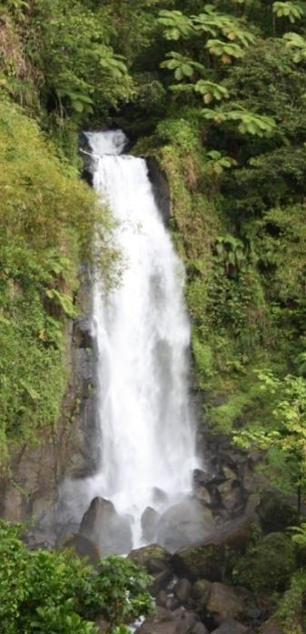
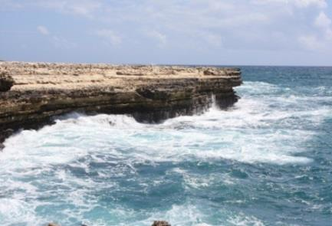
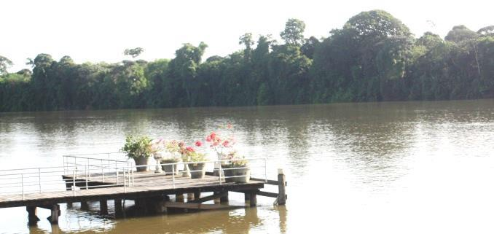
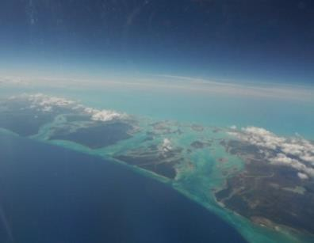

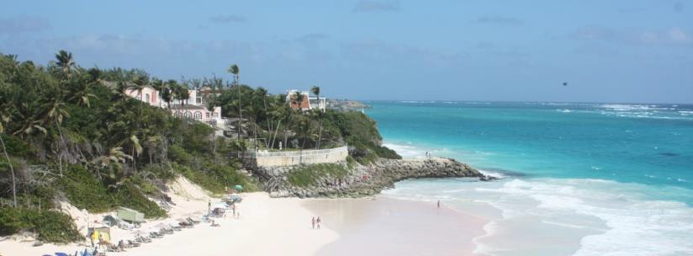
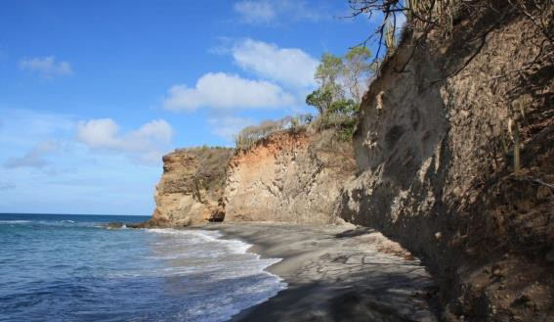
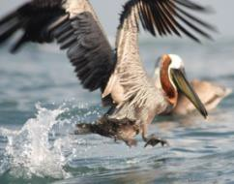
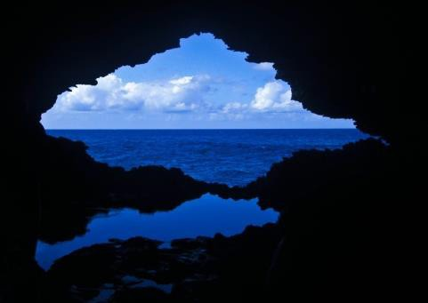
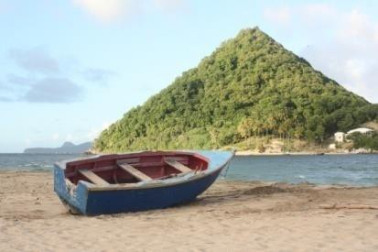
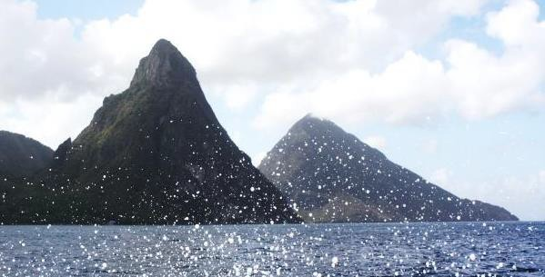
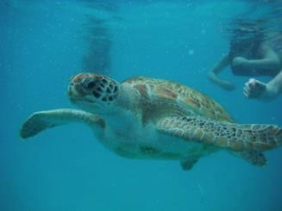
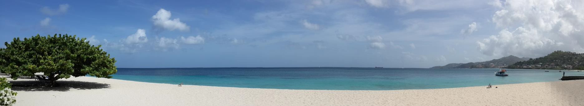
The Caribbean is Paradise

Slide 6
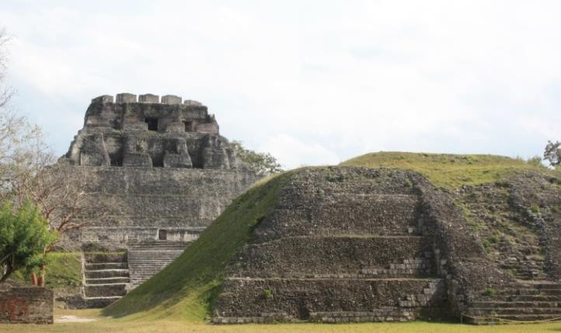
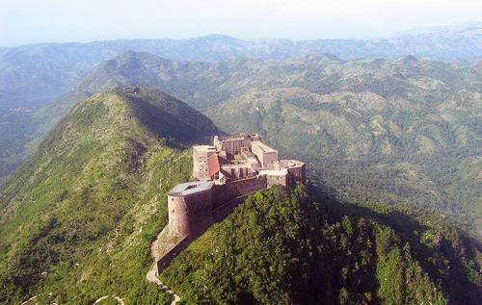
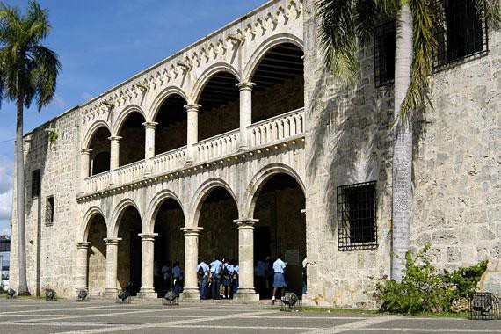
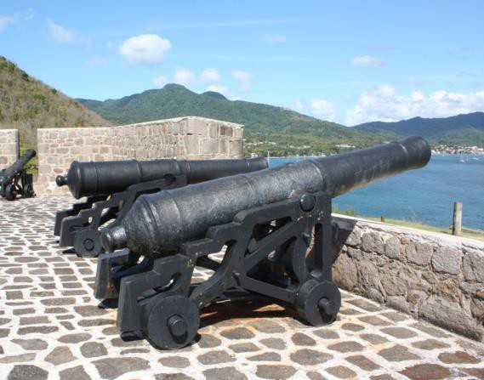
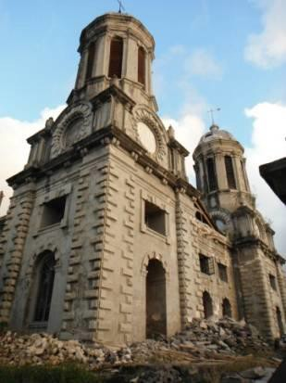
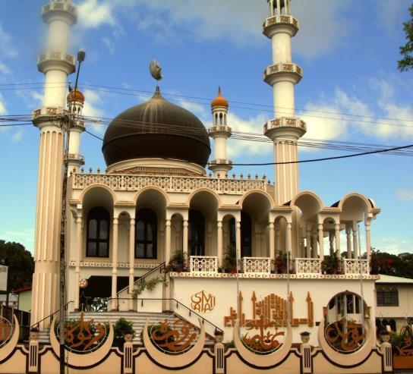
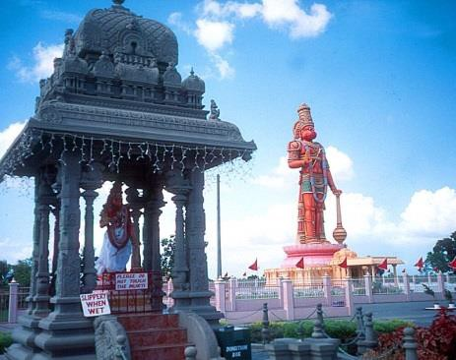
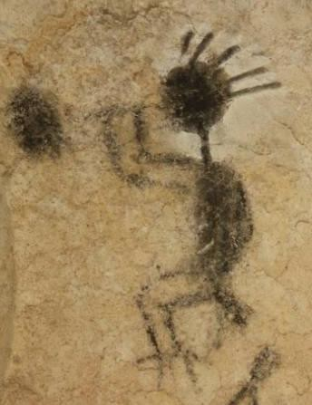
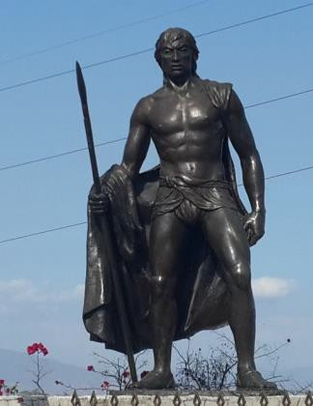
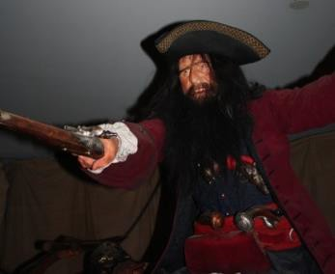

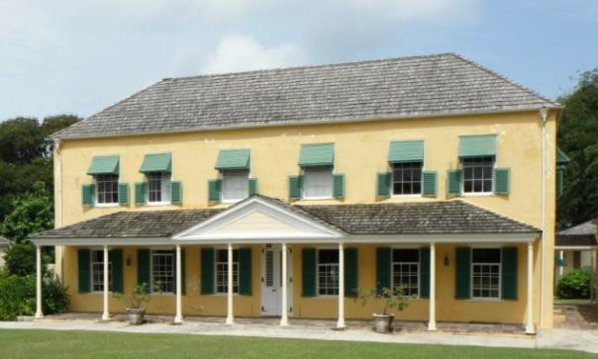
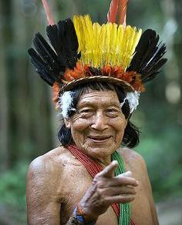
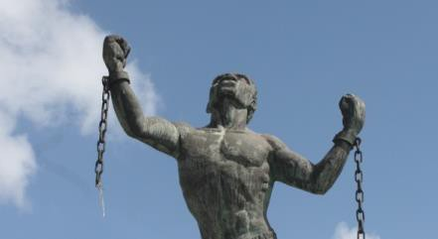
The Caribbean is History

Slide 7











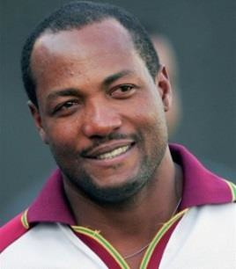
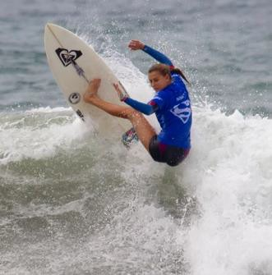


The Caribbean is Passion

Slide 8
Sustainable Niche Tourism Sector Key Drivers
The Caribbean tourism sector presents a prime investment opportunity
✔
Unparalleled market with a continued growth in tourist arrivals and receipts
Geographic location and connectivity
Top performing accommodation sector
Affordable, highly educated and service-oriented workforce
Conducive business environment
✔
✔
✔
✔

Slide 9
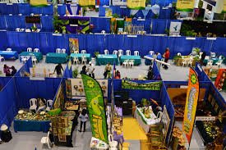
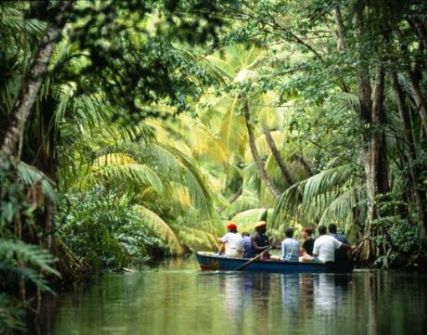

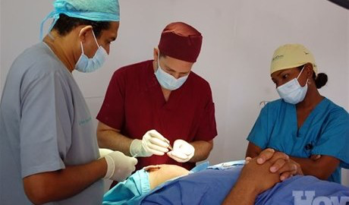
Top destination
The Caribbean is a natural tourism magnet, world widely renowned for its mass “sun-sea-sand” offering, but it also offers exceptional attractions and experiences for niche markets visitors
In the Caribbean the cruise and beach tourism coexists with a wide variety of products
  Countries are tapping in on their cultural and natural resources to develop niche markets such as ecotourism, health, MICE, sports and high-end boutique hotels
  Niche segments are expected to grow at fast pace, between 10%-20% annually, and the Caribbean is well suited to offer customized special interest experiences and services
  The region offers numerous investment opportunities away from beach resorts to seize these fast-growing markets
The Caribbean tourism offering
MICE
Ecotourism
Sports
Health & Wellness

Slide 10
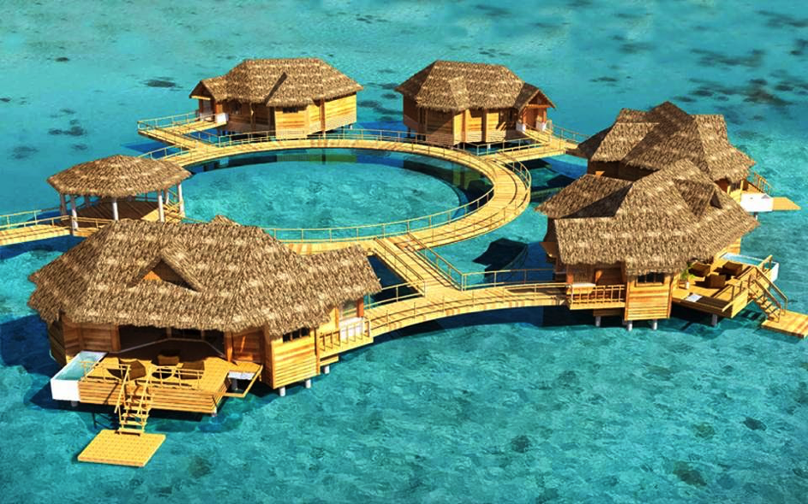

Investment opportunities
High-end boutique hotels
Globally a total of US$200 billion was spent in 2014 on international luxury travel, an increase of 48% in the last five years, two times faster than other types of tourist travel
The Caribbean is showing a positive trend in the high-price market
  The region is one of the most popular destinations for the wealthiest travelers in the U.S., it ranks in the top 10 destinations chosen by the wealthiest 1%
  The Caribbean is a leading high-end destination with over 70 luxury hotels
Demand for high-end boutique hotels and luxury services like on-property golf courses, marinas and high-end culinary experiences open attractive investment opportunities in the region
Notes:
http://www.hotelnewsresource.com/article87500.html

Slide 11
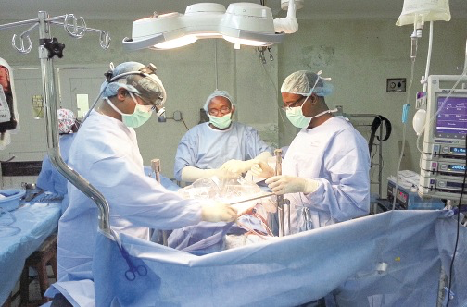
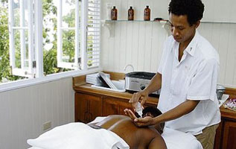
Investment opportunities
Medical, health & wellness
Medical, health and wellness is projected to grow nearly 50% faster than overall global tourism by more than 9% average growth rate annually
  Generally health and wellness tourist spends 65% more per trip than the average international tourist
  The Caribbean offers high-quality and affordable care, patient paying around US$10,000 in cosmetic surgery procedures in the US could pay as little as US$2,000 at Caribbean hospitals
  This niche offers investment opportunities in a range of areas from medical tourism facilities, spas, specialized accommodation and supporting services

Slide 12
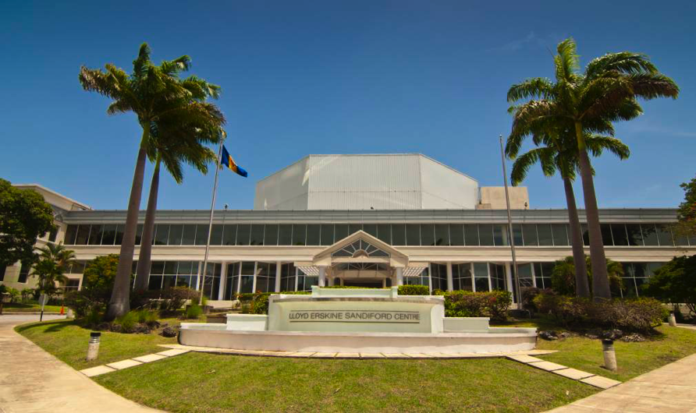
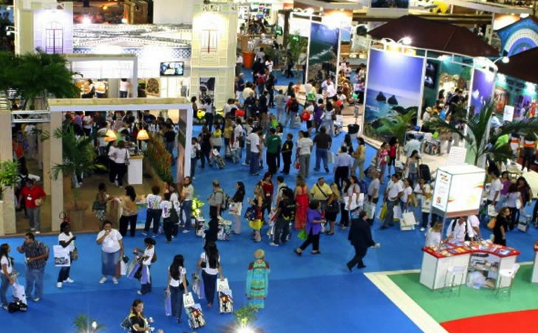
Investment opportunities
Meeting, incentives, conferences & Exhibitions (MICE)
The MICE market is worth around US$30 billion annually and accounts for 50 million trips worldwide each year
The Caribbean has notable facilities, lush resorts and convention centers, with growing numbers of events,
Key advantages the Caribbean offers the MICE market are: good airport infrastructure with high frequency of international flights, flexible visa requirements for meetings and convention delegates, prime quality ICT infrastructure and generally inexpensive services form venue
Investment opportunities exist not only in the area of meeting infrastructure and hotels, but also in specialist related services

Slide 13
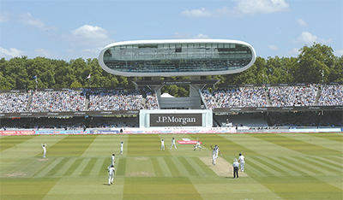

Investment opportunities
Sports tourism
Sport Tourism equates to approximately 12 million trips and US$600 billion a year and it is predicted to grow at a rate of 14%.
The Caribbean has over 50 world-class golf courses and is a leading diving and fishing destination. Water sports, mountain biking and climbing have also huge potential.
Caribbean countries are hosting major sporting events in its top-class venues: cricket, track and field athletic events, baseball and football (soccer) tournaments are positioning well
Supporting investments and therefore investment opportunities, lie in the provision of related enabling infrastructure – golf courses, marinas, tours, cycle shops and services, athletic meets and diving.

Slide 14
Investment Opportunities
Eco-tourism
Protected areas and Biodiversity
Ecotourism has experienced double digit growth in the last decade and is now valued at US$500 billion globally
  The Caribbean has huge potential. 20% of international travellers seek nature experiences
  The Caribbean is home to World Heritage natural sites and has a large share of protected areas and number of known species.
  Several countries are already recognised as leading ecotourism destination such Belize, Guyana Suriname and Trinidad and Tobago
Opportunities to invest are found in providing environmentally certified tourist lodgings and support services, specialty tour operator services, equipment sales, etc.
Word Heritage Natural Sites
1
1
Protected areas as % of total land area
Source: http://data.worldbank.org
Number of known species
Source: WEF Travel & Competitiveness Report 2015

Slide 15
Investors we target and attract
Foreign investors recognize the sector’s potential, a proof is the recently developed projects
Company
Year
Country
Project
Capital Investment
Estimated # of jobs created
H10
2016
Two all-inclusive hotels with a total of 800 sea-view luxury rooms
$200 m
1,000
Jamaica
Decameron
2015
Haiti
Acquisition of the Club Indigo property, establishment of resort with 370 rooms
$15 m
500
2015
Dominican Republic
Urban Hotel under the InterContinental brand with 227 rooms
Grupo Roble
$70 m
400
Blue Diamond Resorts
2014
Dominican Republic
Exclusive resort in Uvero Alto beach with 320 stylish rooms
n/a
500
Hotel Chocolat
Hotel boutique & spa set among cocoa groves on the island of Saint Lucia
2012
St. Lucia
$50 m
100
Source: fDi Markets
Notes:
H10 Quality Excellence Management System
H10 Hotels' own quality and environment system that focuses on the satisfaction and safety of our customers and works towards sustainable development.
Decameron: Recipients of the “Gold Travel life Award”. This prestigious award is given to hotels and lodging facilities certified according to 150 sustainability criteria, including environmental matters as well as the social and economic impact.
Decameron Club Caribbean received this award as a result of taking positive actions such as minimizing waste, a responsible use of water and power and minimizing the use of chemical products, as well as looking out for the wellbeing of our collaborators, the local community, children and human rights
Grupo Roble: Grupo Roble strongly believes in sustainable development, which is why it actively promotes and conveys social welfare, new jobs, health, strengthening of the educational system and environmental sustainability.
Blue Diamond Resorts: Blue Diamond Resorts’ all inclusive hotels in the Dominican Republic, CHIC Punta Cana, Royalton Punta Cana and Memories Splash, have each been recognized by the Dominican Ministry of the Environment and Natural Resources for their implementation of sustainable environmental practices, which have helped further Ministry’s initiatives in waste reduction. This rapidly expanding hotel chain is already the recipient of numerous environmental titles from global organizations, such as the TripAdvisor GreenLeaders program, with Memories Splash Punta Cana at the Gold Level of sustainability, and Royalton Punta Cana as well as CHIC Punta Cana each at the Silver Level. One Link Global and Green Globe also accredited sustainable practices at Royalton White Sands, Memories Grand Bahama, Royalton Punta Cana, Memories Splash Punta Cana, and CHIC Punta Cana. Responsible stewardship by Blue Diamond Resorts include extensive recycling, use of solar energy, a dedicated on-site compost area, donating surplus food peels to local farmers, updating light bulbs to energy saving LED lights, using less paper and corresponding digitally, and more. Each Blue Diamond Resort property will continue to evolve and implement additional conservation programs.
Hotel Chocolat: Combines cocoa production into the luxury hotel experience in Saint Lucia. They employ an Engaged Ethics Programme for Cocoa Farmers where they work with cocoa farmers through sustained investments of know-how, sweat and passion as well as dependable funding to revitalize cocoa-growing communities on the island.

Slide 16
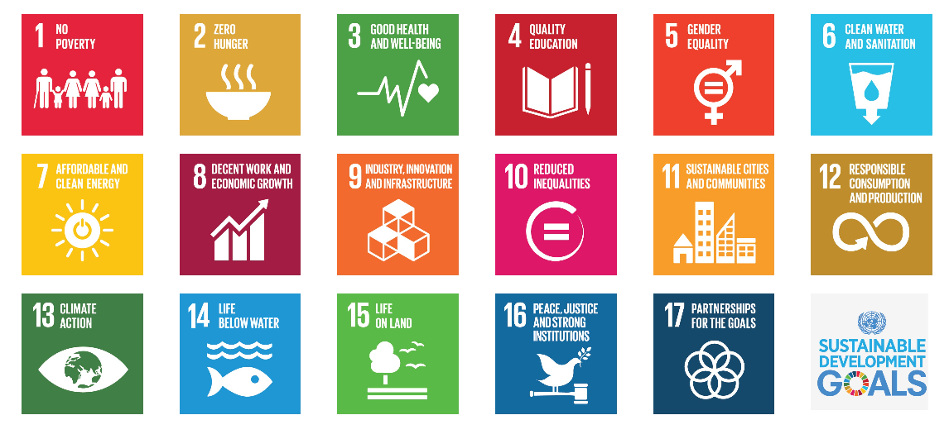
Sustainable Niche Tourism and the SDGs
Impact Points

Slide 17
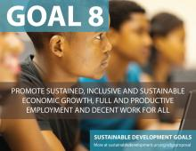
Impact Points
Target 8.9 "By 2030, devise and implement policies to promote sustainable tourism that creates jobs and promotes local culture and products."
Give access to decent work opportunities in the tourism sector;
Provide employment to youth and women
Enhance skills and professional development.
Tourism is one of the driving forces of global economic growth, and currently accounts for 1 in 11 jobs worldwide.

Slide 18
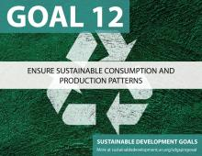
Impact Points
Target 12.b of Goal 12, it is imperative to "Develop and implement tools to monitor sustainable development impacts for sustainable tourism which creates jobs, promotes local culture and products".
Economic impact assessments
Encourage the use of renewable energy by the tourism sector
Encourage linkages to domestic and regional suppliers
A tourism sector that adopts sustainable consumption and production (SCP) practices can play a significant role in accelerating the global shift towards sustainability.

Slide 19
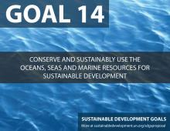
Impact Points
Target 14.7: “By 2030 increase the economic benefits of SIDS and LCDs from the sustainable use of marine resources, including through sustainable management of fisheries, aquaculture and tourism".
Encourage the conservation and preservation of fragile ecosystems promoting the blue economy and incorporating this as a part of our tourism attractions.
As islands in the Caribbean, we rely heavily on healthy marine ecosystems

Slide 20

CAIPA – PARTNERS FOR THE GOALS
CAIPA has grown it’s membership to 23 from 7 when it started
CAIPA recently signed a MOU with IberoNet expanding our reach to cooperate with our partners in the South
Tourism linkages programme in 2018 – private sector collaboration initiative
CAIPA encourages members to adopt best practices at the national level through our annual Ministerial Roundtable on Investment Promotion
The SDGs can only be realized with a strong commitment to global partnership and cooperation.

Slide 21
THANK YOU!
Caribbean Association of Investment Promotion Agencies
CAIPA Secretariat
c/o Caribbean Export Development Agency
Santo Domingo
Dominican Republic
Tel: +1-809-531-2259
Key contact:
Ms. Suzette Hudson
Email: secretariat@caipainvest.org
shudson@carib-export.com
Website: www.caipainvest.org

