Slide 1
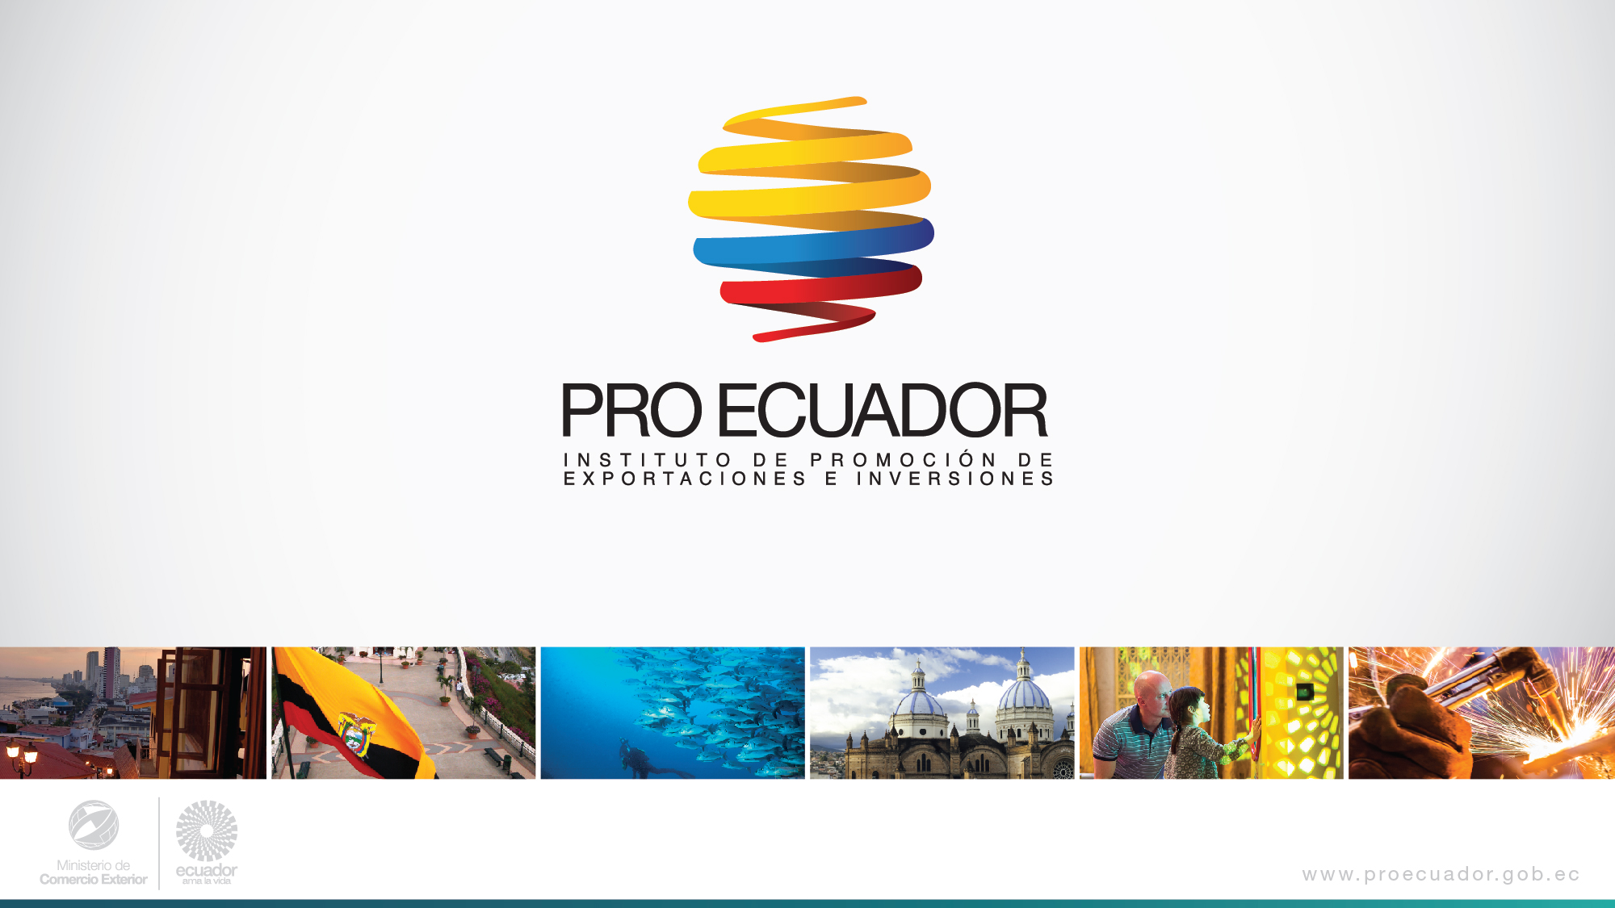
Nathali Vallarino
November 7th, 2017

Slide 2
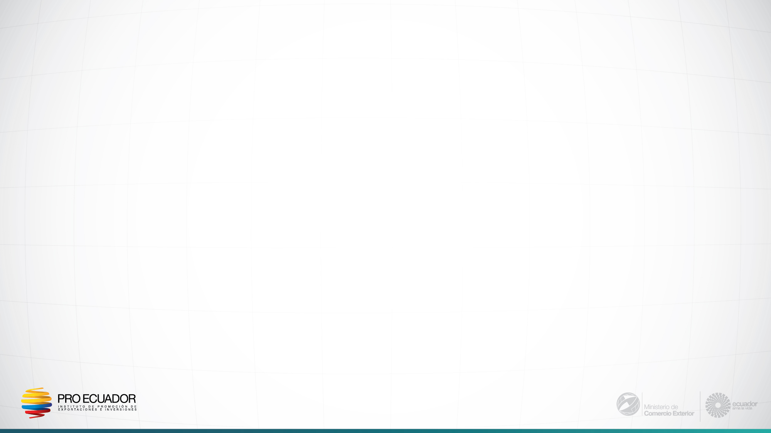


ECUADOR
The center of great opportunities
Capital: Quito
Business Languages: Spanish (official) & English
Area: 257,217 Sq Km
Time Zone: GMT -5 horas
Currency: US Dollar
Population: 16.7 M approx. (14.5 M in census 2010)
Nominal GDP: USD 97,802 M (2016 BCE)
M = millions

Slide 3
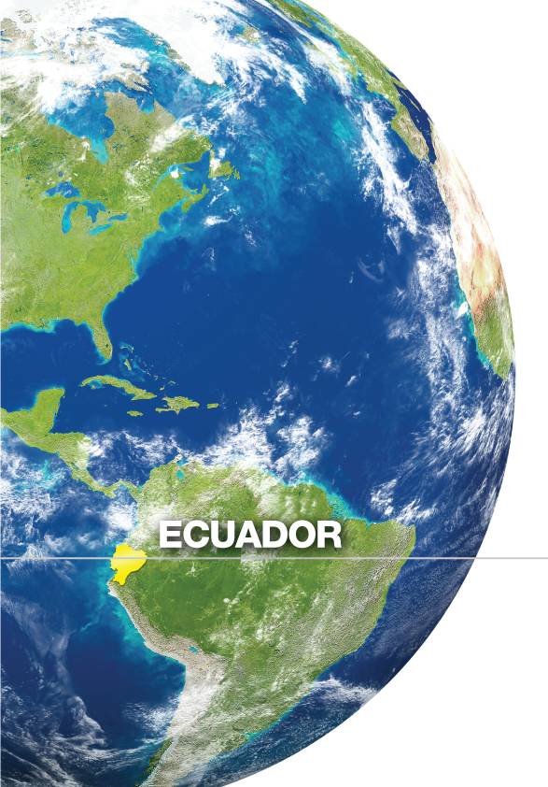
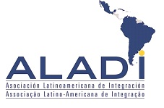


Ecuador
The center of great opportunities
Access to a market of
800 million
people

Slide 4
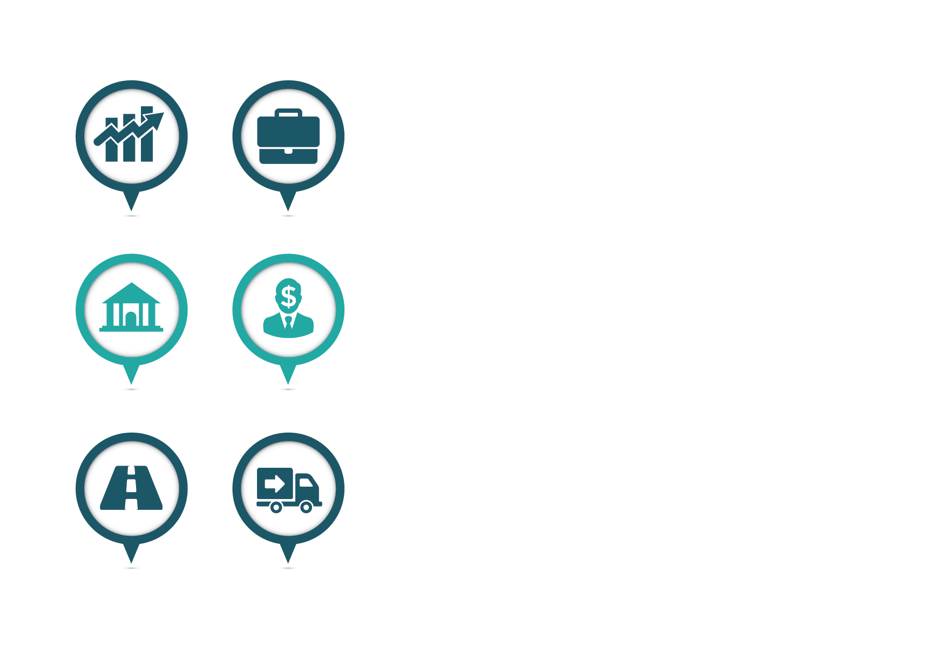


Ecuador has achieved significant growth in the last decade
Economic
Social - Politic
Investment
Low external public
debt / GDP
Political Stability
FDI flows show a growth of 16% up, from 2007 to 2016
28.4% of GDP (June 2017)
Democratic elections ratifications
Upper middle
income country
Social Development
FBKF
Annual average of 25% of GDP (2007-2016)
Gross Net Income per capita on Purchasing Power Parity 2016 $11,000
Improved HDI 0.739, ranking eighty-nine (89) of 188. From 2000 to 2015 Ecuador has climbed 4 positions, which places it in a high human development
*Source: Central Bank of Ecuador
Unemployment
GDP per capita
One of the lowest in South America 4.5% at June 2017
Ecuador GDP per capita in 2016 was $5,966

Slide 5
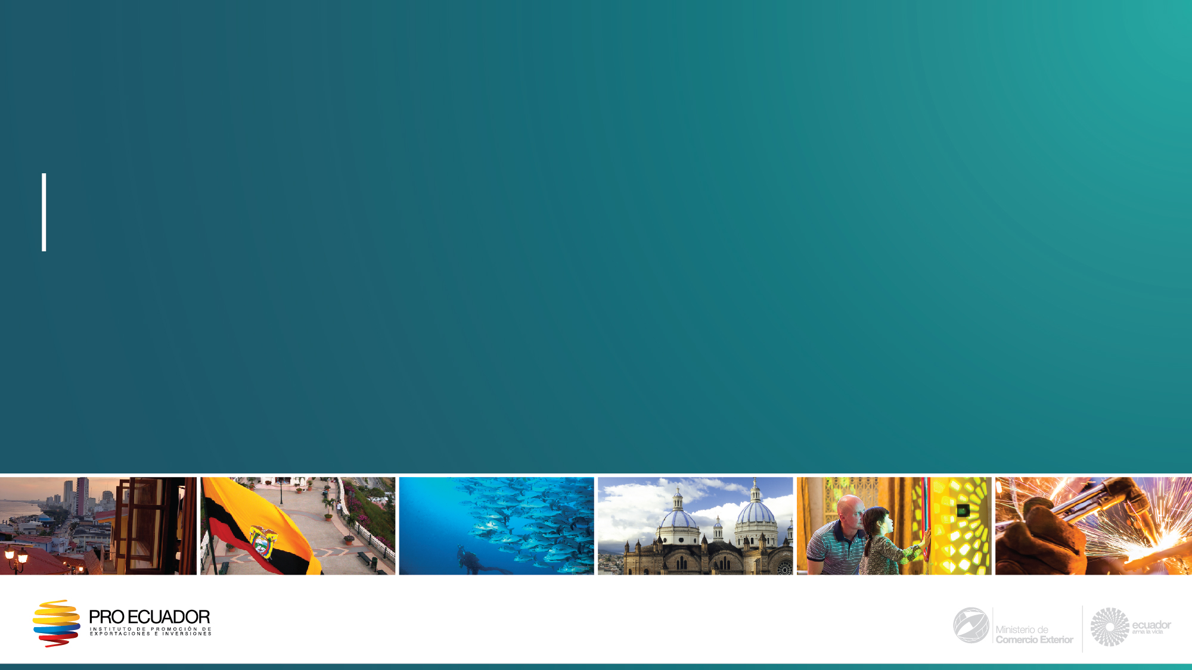
Ecuadorian Government initiatives aligned to SDGs

Slide 6

The National Development Plan 2017- 2021
National Development Goals
The plan includes three main axes:
Rights for all throughout life
2. Economy to the service of society
3. More society,
more state
Guarantee a dignified life with equal opportunities
Affirm interculturality and plurinationality
Guarantee the rights of nature
Consolidate sustainability of the social economic system
Promote a sustainable economic growth
Achieve food sovereignty and an integral rural development.
An active society, with a State oriented to service
Promote transparency and co-responsibility for a new social ethic.
Guarantee sovereignty and peace

Slide 7




Corporate Social Responsibility & The National Development Plan
The government promotes 4 ethics for corporate social responsibility
STATE Ensures that organizations comply with their obligations and participates jointly in the execution of social projects.
HUMAN TALENT Seeks to comply with the principles of Human Rights and with the agreements signed with the ILO.
COMMUNITY Seeks that organizations support the development of society respecting their cultural values ​​and the economic and social inclusion of the poorest.
ENVIRONMENT Ensures that organizations take responsibility for their processes, the impact and waste generated by their actions, minimize the consumption of natural resources and preserve the environment

Slide 8
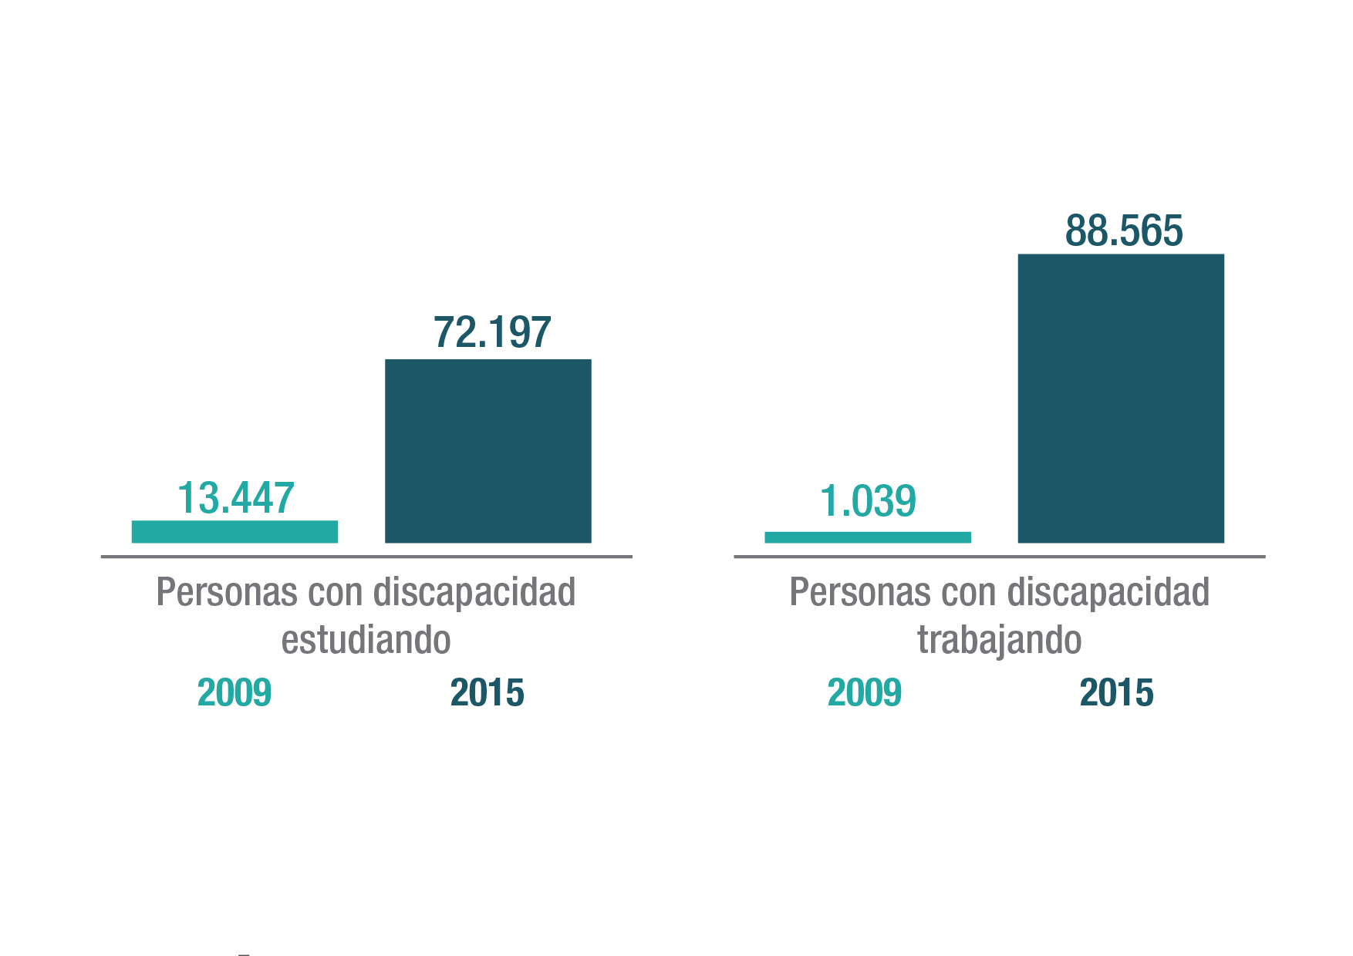

Central government Social Investment
Public expenditure on health per capita quadrupled in the past nine years
We give priority attention to People with special capabilities
87,030
USD
76,158
USD
173
13,447
43
1,039
2007
2016
People with disabilities studying
People with disabilities working
2016
2016
We are the first Latin American country to receive the award for Best Practices in Universal Accessibility 2015

Slide 9


We promote decent work and protect the
workers' rights
Economically Active Population affiliated to social security
32.5%
19.8%
2007
2016
*Source: National Institute of Statistics and Censuses
(*) Note: Information raised with the National Survey of Employment, Unemployment and Underemployment, Urban and Rural (ENEMDU).

Slide 10
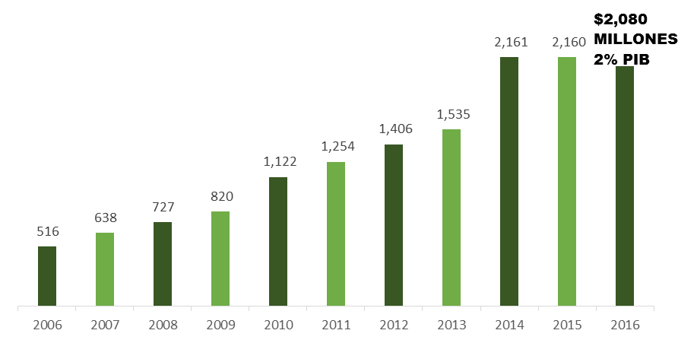
Ecuador invests in Human Talent
EVOLUTION OF PUBLIC EXPENDITURE ON 4th LEVEL EDUCATION
20,000
2% of GDP is earmarked for public expenditure on higher education.
Accumulated
Granted scholarships or high level education from 2007 to 2017
investment
$13.9
Source: SENECYT
BILLION

Slide 11

Ecuador has reduced income inequality
1.5 millions
of Ecuadorians left poverty
*Source: World Bank
54
46.6
2006
2016

Slide 12
Ecuadorian Legal Frameworks aligned to SDGs

Slide 13
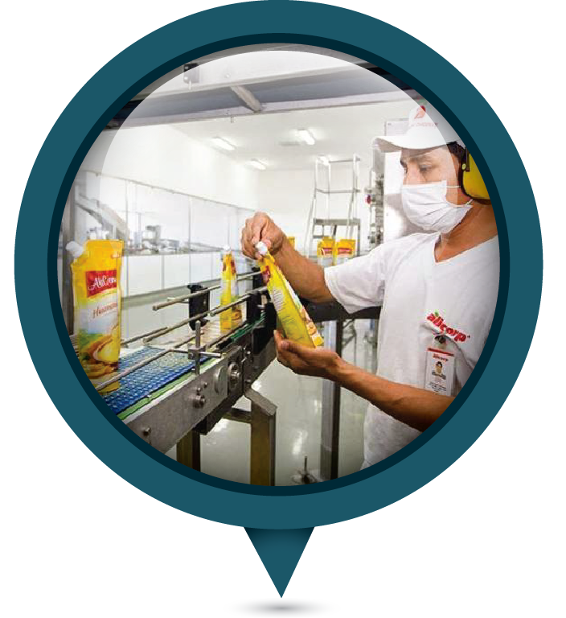
The Organic Code of Production, Commerce and Investment (OCPCI)
December 2010
Objectives
Transformation of the productive matrix based on knowledge, innovation, and sustainable and ecologically efficient practices.
Implementation of instruments for productive, fair, ecologically efficient and sustainable development in the care of Nature.
Foster national production, trade and sustainable spending of goods and services, with social and environmental responsibility.
Foster commercialization and the use of new environmentally clean technologies and alternative energy of national production.
Generation of quality and dignified employment

Slide 14

The Organic Code of Production, Commerce and Investment (OCPCI)
Tax incentives
For the acquisition of machinery, equipment and technologies for cleaner production, mechanisms for the generation of renewable energy (solar, wind or similar) or to the reduction of the environmental impact
1. General
Depreciation and amortization are deductible with an additional 100%
2. Sector and for fair regional development
Priorization of 9 sectors to generate added value and 10 sectors for strategic import substitution
5 year exemption on Income Tax (22%)
Renewable
Energy
Tourism
Agroforestry chain and processed products
An additional 100% deduction on Income Tax for costs of wages, salaries, social benefits and generation of new employment in depressed areas for 5 years.
3. For Economically Depressed Zones
For companies investing in the 89 depressed areas and 60 border cantons
17% Income tax.
Exemption for payment of duties for goods.
VAT tax credit paid on the purchase of goods from national territory.
4. SEZ´s
For companies investing in any of the 4 SEZs: Yachay, Eloy Alfaro, Posorja and Litoral

Slide 15

Forestry sector
Program of Incentives for Reforestation with Commercial Purposes
The sector has a special incentive program, which constitutes an economic transfer of a non-reimbursable nature, given by the Ecuadorian State to disburse and / or reimburse part of the costs of establishment and maintenance of the forest plantation.
The first 4 years
Opportunity of reforestation with
commercial species:
18
Natural and legal persons
Associations, productive cooperatives and communes
Up to 75% of establishment and maintenance costs of plantations
100% of establishment and maintenance costs of plantations
Subject to the % of survival
Pine – Eucalyptus - Melina – Rosewood - Chuncho

Slide 16
Investment project
DP WORLD POSORJA
Ecuador’s First Deep water Gateway
Development, construction, maintenance of facilities; dredging, construction and maintenance of a navigation channel up to Posorja in the province of Guayas; and the operation of the public service of the Deep water Port of Posorja

Slide 17
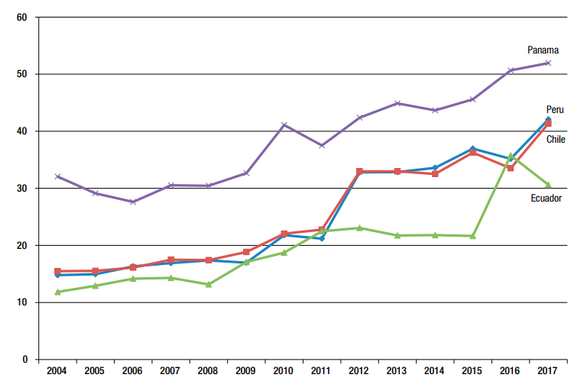
Investment Project DP WORLD POSORJA
Ecuador’s First deep water Gateway
West coast of South America overview
Liner shipping connectivity index
2004–2017
Panama is the best-connected country of the subregion Panama benefits from the Panama Canal.
Chile and Peru have largely the same level of connectivity, as both countries are served by the same companies and ships.
Ecuador was still lagging behind; initially, its main seaport, Guayaquil, was among the last to invest in ship-to-shore container gantry cranes and is hindered by draft restrictions in comparison with the other main.
Source: UNCTAD, REVIEW OF MARITIME TRANSPORT 2017

Slide 18
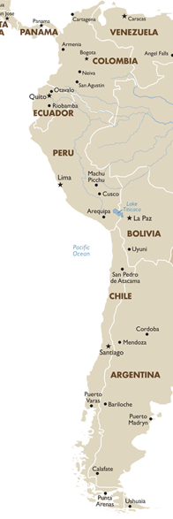

16m
Investment Project DP WORLD POSORJA
15m
Ecuador’s First deep water Gateway
*9.75m
Why Ecuador?
Guayaquil port complex handles more local containers than any other WCSA port
Guayaquil Port is the biggest O/D market in South America
Given its location ships will always have deeper drafts than in Peru and Chile
Ecuador cargo is increasingly dependent on transshipment
Coverage of clients needs - shipping companies – with strategic location
16m
Ecuador’s global trade benefits of the project
16m
Access to more than a 15 meter draft deep water port
Additional capacity for terminals at Guayaquil
Innovative solutions for the world’s largest banana exporting country
Long-term expansion potential
Access to DP World’s world class productivity

Slide 19





Investment Project DP WORLD POSORJA
Ecuador’s First deep water Gateway
Public Private Partnership
Ministry of Transportation and
Public Works
Port Authority of Guayaquil
Private
Public
Development, construction, maintenance and operation of the Deep water Port of Posorja
100% private investment
Over $1 Billion
50 year concession

Slide 20


Investment Project DP WORLD POSORJA
Ecuador’s First deep water Gateway
Local Partnership
78%
22%
One of the largest and most geographically diverse container terminal operators in the world with presence across six continents.
Operates 77 marine and inland terminals, supported by over 50 related businesses in 40 countries.
Maintains approximately 10% of global market share
Nobis S.A. a dynamic real estate developer, with projects ranging from shopping centers, hotels, hospitals, apartment & office buildings
Owns sugar mills, confectionary, power generation and produces alcohol for cosmetics, pharmaceuticals and liquor industries
100% private investment

Slide 21
Investment Project DP WORLD POSORJA
Ecuador’s First deep water Gateway
Financing
Regional
Development Bank
30%
70%

Slide 22




Investment Project DP WORLD POSORJA
Ecuador’s First deep water Gateway
Road
New 20km road providing direct access to the port.
Channel
New and safer access channel to the Guayaquil river with 16 meters draft and 21 nautical miles long.
Terminal
First deep water port in Ecuador able to handle 15,000 TEU ships
16m
50 years Concession (Design, Build, Finance, Own, Operate, Transfer)

Slide 23
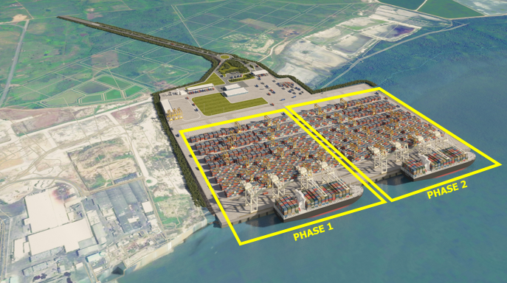
Phase I Phase II
Investment Project DP WORLD POSORJA
Ecuador’s First deep water Gateway
Terminal
Berth: 400 meters
Draft: 16 meters
Capacity: 750,000 TEU
QC: 4 Super Post Panamax
RTG: 12
Delivery date: 2 years after start of construction
Berth: 800 meters
Draft: 16 meters
Capacity: 1,500,000 TEU
QC: 8 Super Post Panamax
RTG: 24
Keeping Ecuador connected to world trade

Slide 24

Investment Project DP WORLD POSORJA
Ecuador’s First deep water Gateway
Economic Benefits for Ecuador
Direct employment of 470 - 600 people in Phase-I, reaching 720 people in Phase-II.
Indirect employment of 2.5 – 3 x (trucking, logistics, services, etc.).
Technology transfer.
Over $1 Billion in planned investment, including about $500 Million in Phase-I.
Approx. $1.7 Billion of direct income taxes payable over the duration of the concession.
Over $1 Billion of concession fees payable over the duration of the concession.

Slide 25
Investment Project DP WORLD POSORJA
Ecuador’s First deep water Gateway
Economic Growth
Jobs creation
New Investment
Commerce
Regional Relevance
Improved Connectivity
Sustainable
Safety
Community Investment
Improved Export Competitiveness
Revitalize Economy
Reduced Pollution

Slide 26
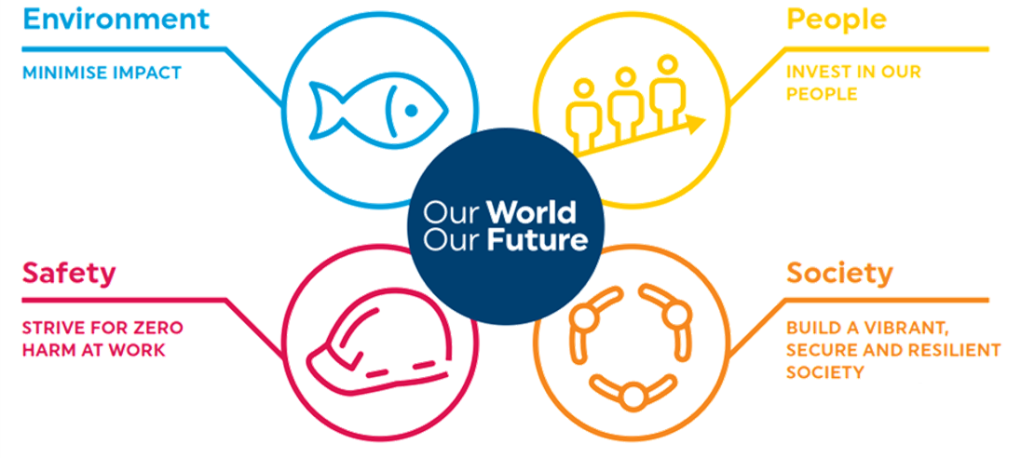
Investment Project DP WORLD POSORJA
Ecuador’s First deep water Gateway
DP World global programme to bring sustainability into every aspect of their work:
on
the environment by better managing natural resources and emissions
by embracing diversity, encouraging personal development and providing them with the tools to drive change
to ensure the safety of the people and surrounding communities
through strategic investment in the issues that affect the people and the industry

Slide 27
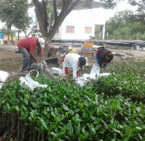
Investment Project DP WORLD POSORJA
Ecuador’s First deep water Gateway
Environmental preservation plan
Restoration of mangrove areas
Area to be affected 10,48 has
Area to be restore 62,88 has
Mangrove seedling in the nursery
Prior to the planting of red mangrove, a garbage collection activity was executed
To date 120,000 red mangrove seedlings planted
Re-sowing is planned for 2018, 2019 and 2020 with at least 48,000 red mangrove seedlings.
In 2020, the forest area with red mangrove will be given to the Ministry of Environment.

Slide 28
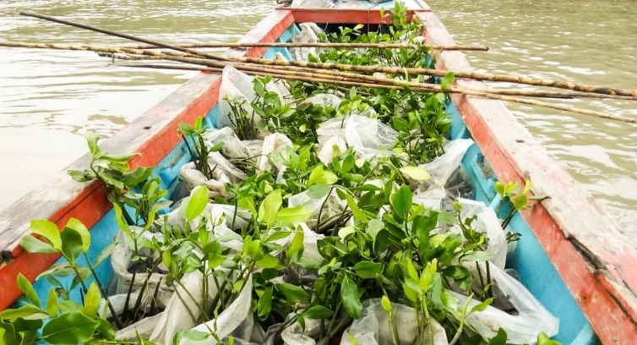
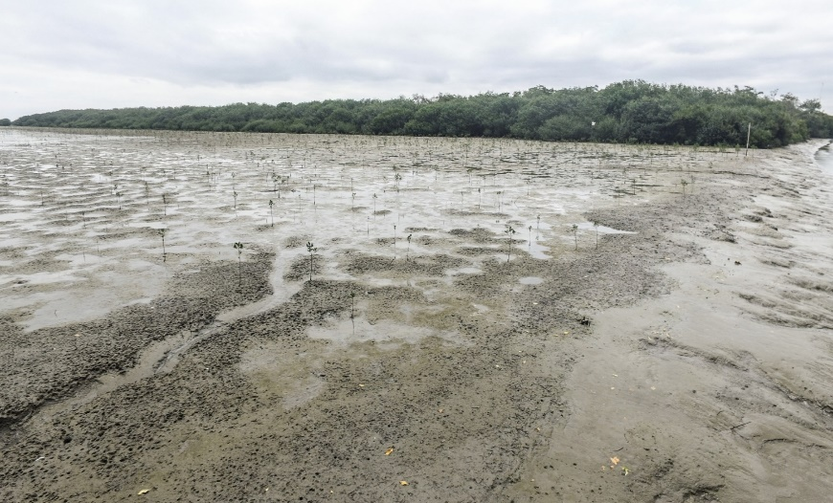
Investment Project DP WORLD POSORJA
Ecuador’s First deep water Gateway
Environmental preservation plan
Restoration of mangrove areas

Slide 29


Investment Project DP WORLD POSORJA
Ecuador’s First deep water Gateway
Inclusion of communities
Community Relations Plan
21 control measures that seek to minimize and mitigate the possible impacts of the project.
Environmental Mitigation and Remediation Program
- Local Labor from the Zapote Commune in Puná Island
* Cleaning the area and mangrove planting.
Local Labor
Construction of the port
- Local labor from communes
* Development and implementation of several activities with social organizations
and local governments.

Slide 30
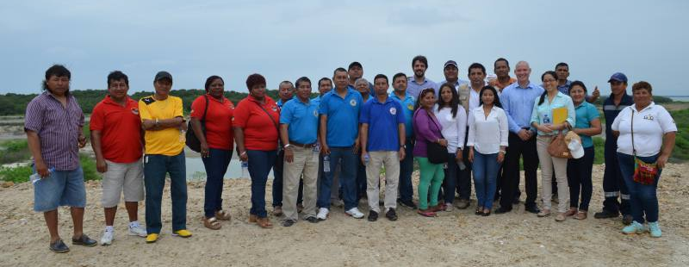
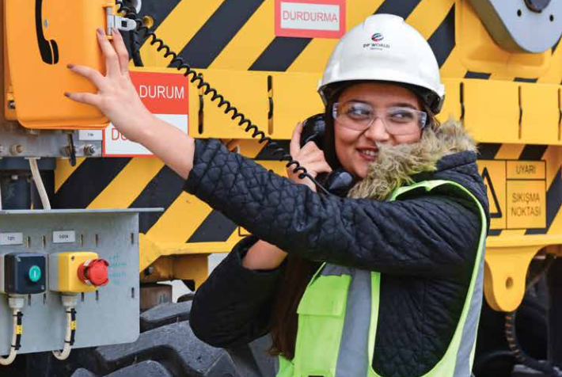
Investment Project DP WORLD POSORJA
Ecuador’s First deep water Gateway
Training and capacity building
Local community engaged in training programs for the Environmental Mitigation and Remediation Program and social responsibility works.
Training programs for employees in specific areas focused safety with the necessary knowledge and the development of critical skills.
In a second phase, employees may have access to DP World Institute. The internationally recognized industry education provider, runs training and development programs globally for employees and industry professionals across the supply chain.

Slide 31
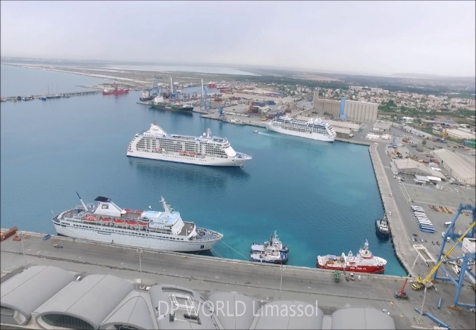
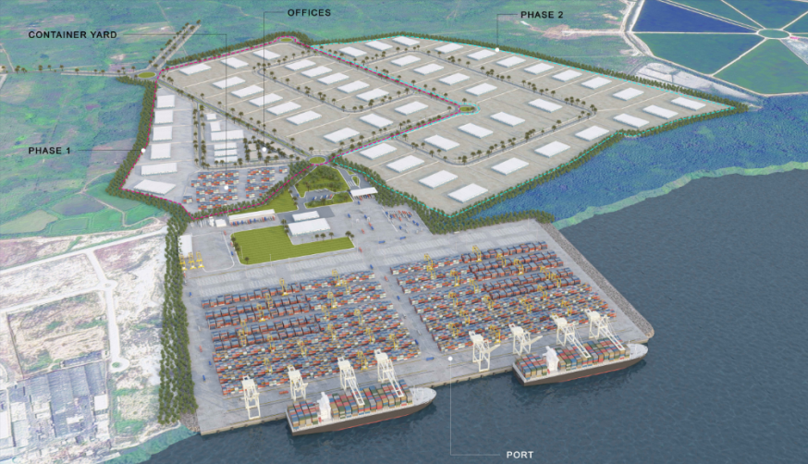
Investment Project DP WORLD POSORJA
Ecuador’s First deep water Gateway
Additional productive linkage
Tourism Sector
The construction of the port and a 22km highway connecting Posorja with Playas will contribute and impulse tourism to the sector.
In a second phase is contemplated the arrival of passenger cruise ships to the port.
Posorja logistic park - Special Economic Zone (SEZ)
Posorja Logistics Park
(SEZ)
Developed by DP World
Approximately 100HA of land available
Direct connectivity with Posorja deep-water port
Tax benefits for resident companies
Dramatically reduced supply chain costs
Special areas for services to transporters (food courts, parkings, gas stations)
Port

Slide 32

Thank you

