Slide 1
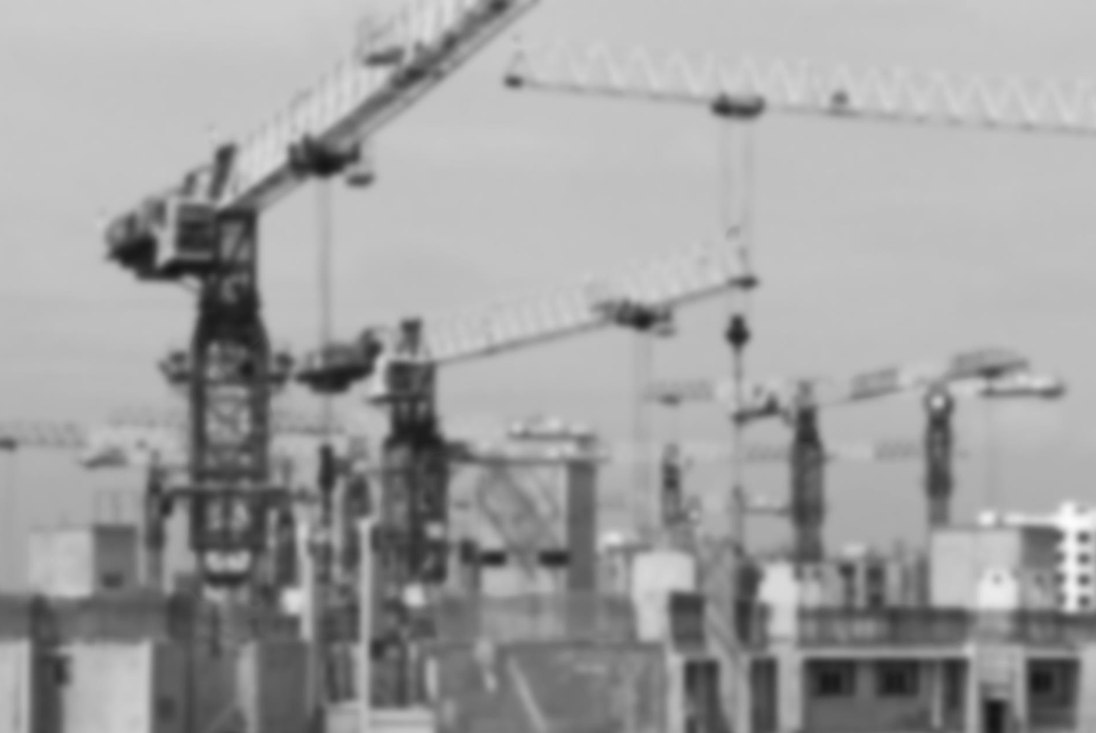
Investment promotion for SDG projects
Regional Seminar on the Promotion of
Bankable Sustainable Development Goal Projects
7-8 November 2017, Mexico City
Carlos Griffin
UNCTAD consultant

Slide 2
Investment promotion best practices: A quick review
Serves development objectives
Hinges on understanding of investor needs
Strategic
Sector-focused
Based on competitiveness
Considers the entire project life
IPA structured and staffed accordingly
Coordinated intra- and inter-governmentally
M&E based on concrete impact indicators
So, how are best practices different for SDGs?
They are not. To be effective, investment promotion for projects that benefit SDGs, must still conform to best practices.
2
Global and Regional Investment Trends

Slide 3
Three ways to incorporate SDGs into our work
Keep doing what you are already doing
Modify what you are already doing
Do something new
3
Global and Regional Investment Trends

Slide 4
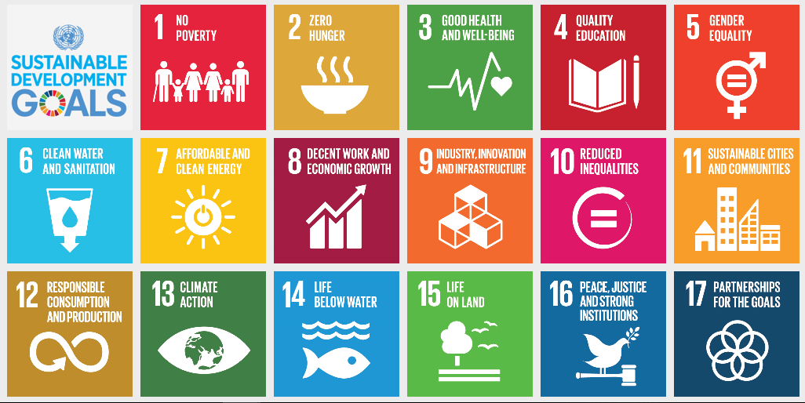
1. Keep doing what you are already doing
Your current work probably serves some SDGs already
  E.g., Mfg employment, mfg value added, R&D expenditure–SDG9
Know where you stand with respect to the SDGs
Adopt SDG-related indicators to make sure this impact is captured
4
Global and Regional Investment Trends

Slide 5
2. Modify what you are already doing
Adjust your normal workflow to mainstream SDG considerations
Apply an SDG lens to all investors
Understand the perspectives of new investor types
  Motives, success metrics, business models
Weigh SDGs in setting sector priorities
  But still based on the two fundamental considerations of anticipated impact and FDI competitiveness
Set appropriate strategic objectives and corresponding KPIs
Partner/divide labor accordingly with relevant public bodies
Structure and staff accordingly
  Sector specialists, institutional partnership managers
Take ownership and plan accordingly for the entire project life
  M&E based on concrete impact indicators
5
Global and Regional Investment Trends

Slide 6
3. Do something new
Develop a database of SDG-oriented investors and financing partners
Firms in relevant sectors
Firms with known CSR programs focused on areas of relevance to SDGs where your country lags
Outward investment promotion agencies
Development finance institutions
Investment guarantee schemes
Build relationships with these organizations
What kind of projects are they interested in investing in?
What do they need from you to consider projects?
What kinds of partners are they looking for?
6
Global and Regional Investment Trends

Slide 7
Examples of SDG-benefiting investment projects
Renewable energy generation, energy efficiency manufacturing/sales–SDG7
Sustainable fishery–SDG14
Industrial infrastructure with affordable, equitable access (e.g., commercial transport/logistics)–SDG9
Technical, vocational, educational, and training institutions, particularly with an ICT focus (e.g., software boot camp)–SDG4
Affordable housing and public transport–SDG11
Any firm that contributes annually to local, SDG-related development initiatives (e.g., CSR program for schools)
7
Global and Regional Investment Trends

Slide 8
3. Do something new (cont.)
Coordinate with partners in your government explicitly on marketing SDG-related projects
Bring promotion expertise and contacts to the government
Establish a division of labour with partners, including leadership, technical expertise, information management, promotional activities, and follow-up
Adjust the IPA’s sector/project-specific strategies, staffing, and M&E accordingly
  Technical expertise, hire or coordinate
Develop a pipeline of bankable SDG-related projects to promote
Implement tools to organize, assess, prioritize, and market the projects in the pipeline
8
Global and Regional Investment Trends

Slide 9
A tool for the promotion of SDG-related projects
Tools and systems are needed to:
Organize highly diverse projects with SDG benefits
Assess competitiveness and, therefore, promotability
Prioritize each project against others. (Comparative info needed)
Market projects by presenting crucial information to potential investors succinctly and persuasively
9
Global and Regional Investment Trends

Slide 10
The tool: An SDG project profile template
 | The generic project template
A. | General information: This section provides overall high-level project information that will enable the investor to position it in terms of scale, scope, resource requirements and outcomes - what is needed to realise the project?
B | More detailed project information: This section provides the “nitty-gritty” project details. It should contain detailed information about the rationale for the project, market to be served, suppliers, competition, costs of inputs and their availability, relevant legislation and institutional arrangements
C | Regulatory requirements: Given the SDG context it is more than likely that important regulatory factors might be involved.
D | Support & incentives: While a financing package may already provide support that could affect the risk-return ratio, it is probably in the interest of the IPA to develop a tailored support package.
E | Contacts: The importance of providing project-related contacts for the promoters/ investors is often underestimated.
10
Global and Regional Investment Trends

Slide 11
Systems
Effectively implementing of the tool requires a system that includes
Assigned staff for management of individual projects and the pipeline overall
IT systems
Standard operating procedures for who does what when, regarding collecting information, updating profiles, staff training, etc.
M&E framework and procedures
11
Global and Regional Investment Trends

Slide 12
Obstacles
Possible bias against efficiency-seeking/export-oriented industries
Technical capacity to understand and promote the sector/project
Overstretching
  Too many “focuses”
  Stepping into projects that are already being promoted, without coordination
Conflict with and/or lack of support from partners
Lack of ownership and A-to-Z project management for complex, multi-stakeholder projects
12
Global and Regional Investment Trends

Slide 13
Follow-up, facilitate, and provide aftercare
Follow-up on a successful investment is critical. It s the first step to the next successful investment.
Effective aftercare may identify and support further additional investments - investors may already have some intended investments in mind – create an environment where that can happen sooner rather than later
OIAs undertake increasingly rigorous project evaluation exercises to assess if targeted outcomes that they have to report on to their shareholders or stakeholders have been achieved.
OIAs also learn from such exercises - it will have an influence on future investment in the territory.
The IPA must stay close to the project to safeguard its reputation as a good partner to do business with.
In addition, follow-up by the IPA with the investor and OIA will provide an opportunity for sharing knowledge that could have a positive influence on future project flows and cement a good long-term relationship.
13
Global and Regional Investment Trends

Slide 14
Provide feedback to SDG stakeholders
Providing regular feedback to the IPA stakeholders is essential so that lessons learnt can be built into future activities.
This will ensure that that processes are continually fine-tuned or abandoned as required; or drive the development of new approaches.
This feedback is the last element of the management cycle and critical to ensure continuous improvement.
14
Global and Regional Investment Trends

Slide 15
A note on policy advocacy
Many IPAs already play the role of advocate for investment climate reform and champion of sectoral development
Mainstream SDGs in policy advocacy
Do not advocate measures in contravention of SDGs
15
Global and Regional Investment Trends

Slide 16


UNCTAD’s
Investment Promotion Programme
Thank you!
Questions & discussion.
Paul Wessendorp
Chief, Investment Promotion Section
UNCTAD
Carlos Griffin
UNCTAD consultant
8 December 2015, Geneva
Carlos.Griffin@yahoo.com

