Slide 1
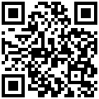

The Consolidated Report Initiative

Slide 2
Contents
“Valle Por y Para Todos”
The Consolidated Report
The voice of the private sector
Results Showcase
What is the follow-up?

Slide 3
Contents
“Valle Por y Para Todos”
The Consolidated Report
The voice of the private sector
Results Showcase
What is the follow-up?

Slide 4
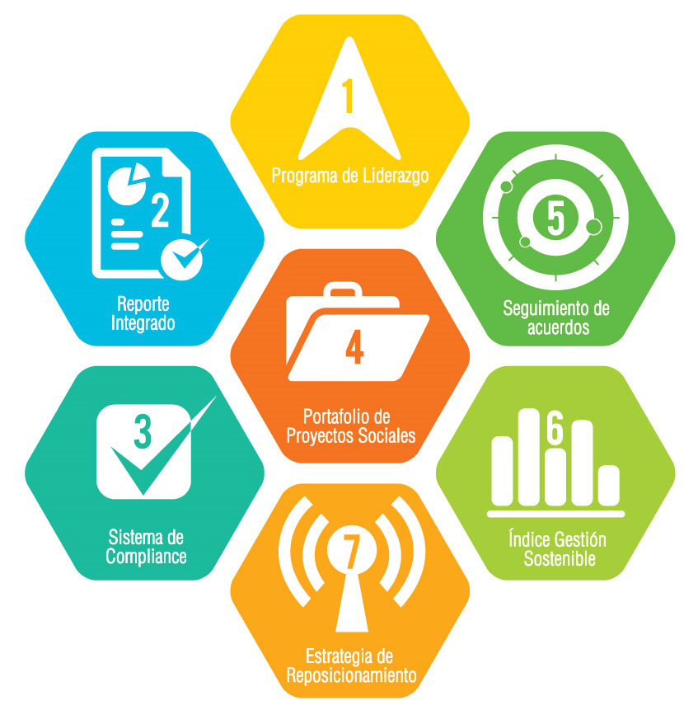
Valle Por y Para Todos
Business Alliance that boosts sustainable development in the region of Valle del Cauca, Colombia.

Slide 5
Contents
“Valle Por y Para Todos”
The Consolidated Report
The voice of the private sector
Results Showcase
What is the follow-up?

Slide 6
The Consolidated Report
The initiative is an instrument that creates the baseline of sustainable activities of businesses in the region, in light of the SDG.
Is the first investment companies should make towards sustainable development.

Slide 7




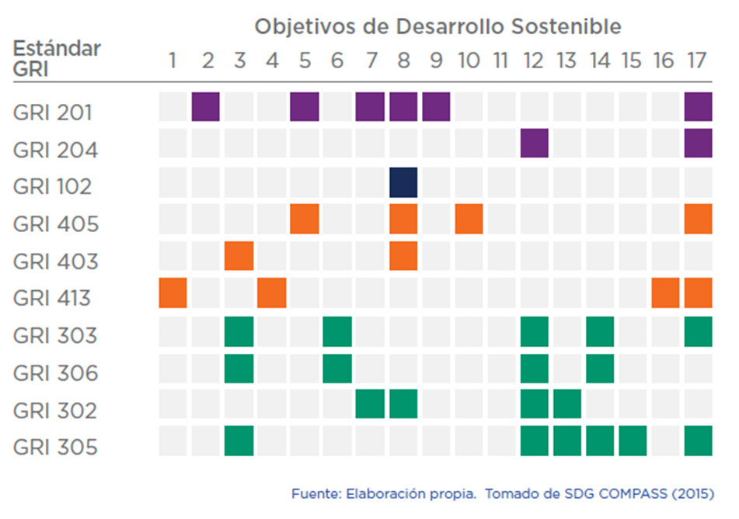

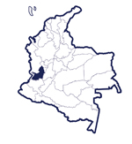

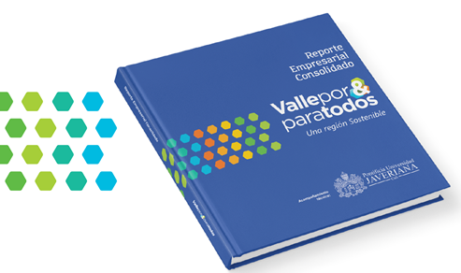

Slide 8
Contents
“Valle Por y Para Todos”
The Consolidated Report
The voice of the private sector
Results Showcase
What is the follow-up?

Slide 9
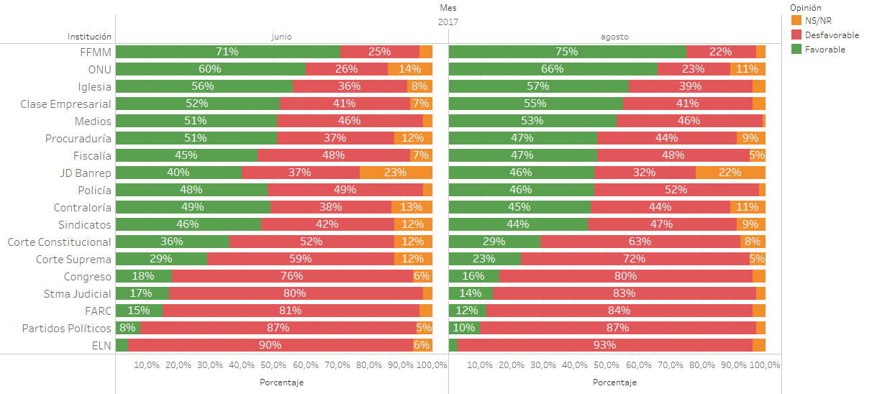
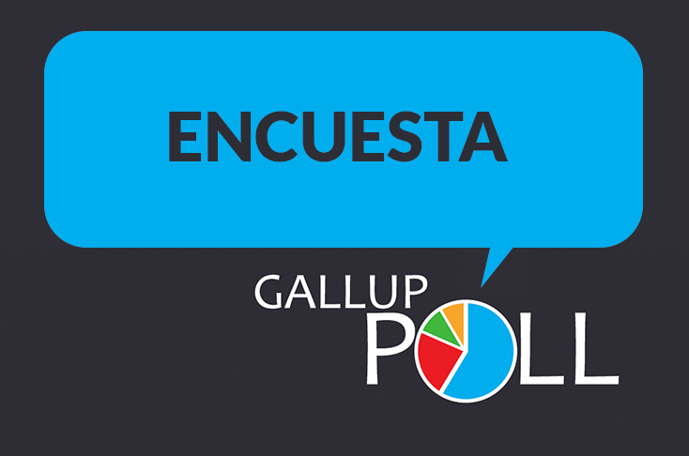
Growing favorable opinion of the business class
Citizen perception of different groups in Colombia:

Slide 10
Contents
“Valle Por y Para Todos”
The Consolidated Report
The voice of the private sector
Results Showcase
What is the follow-up?

Slide 11
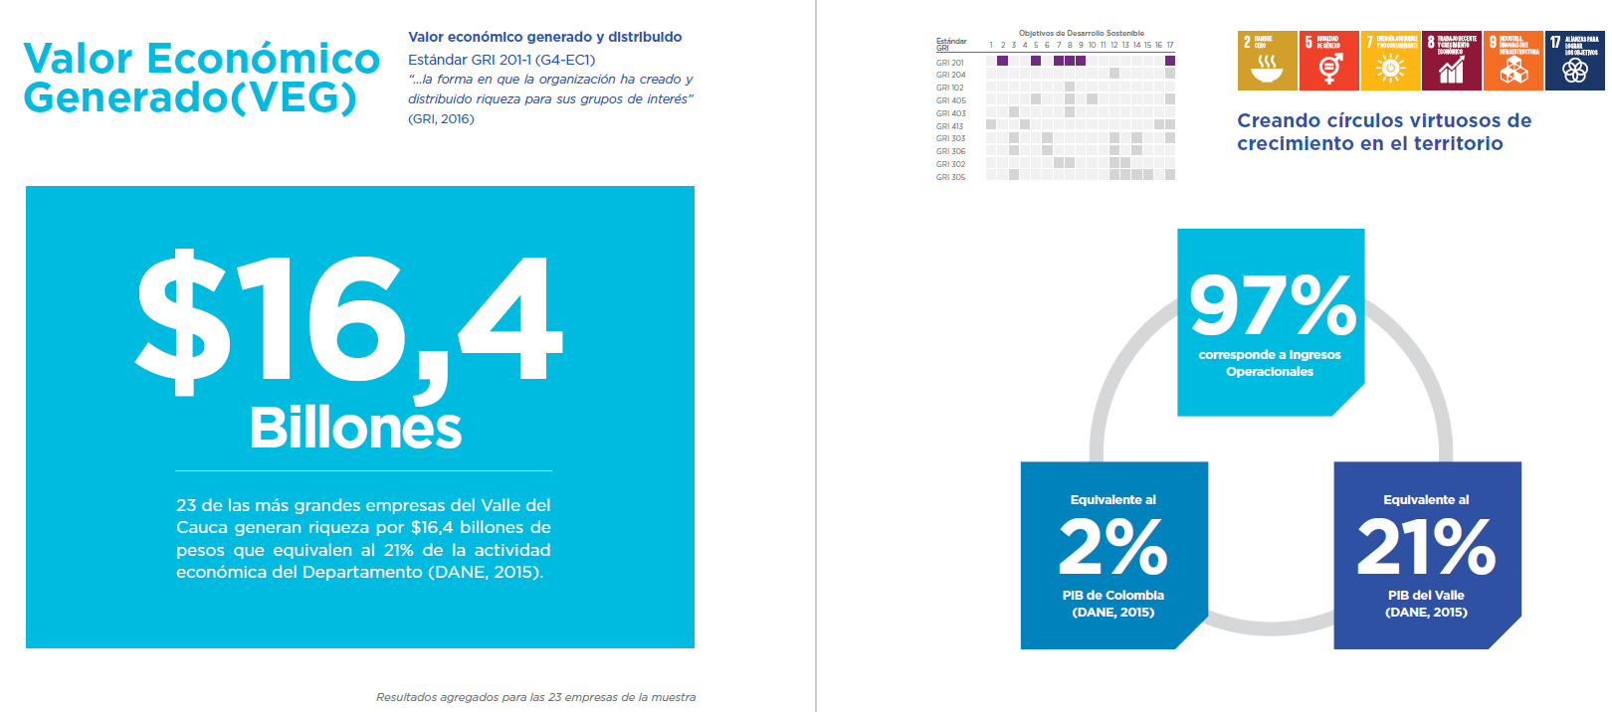

Slide 12
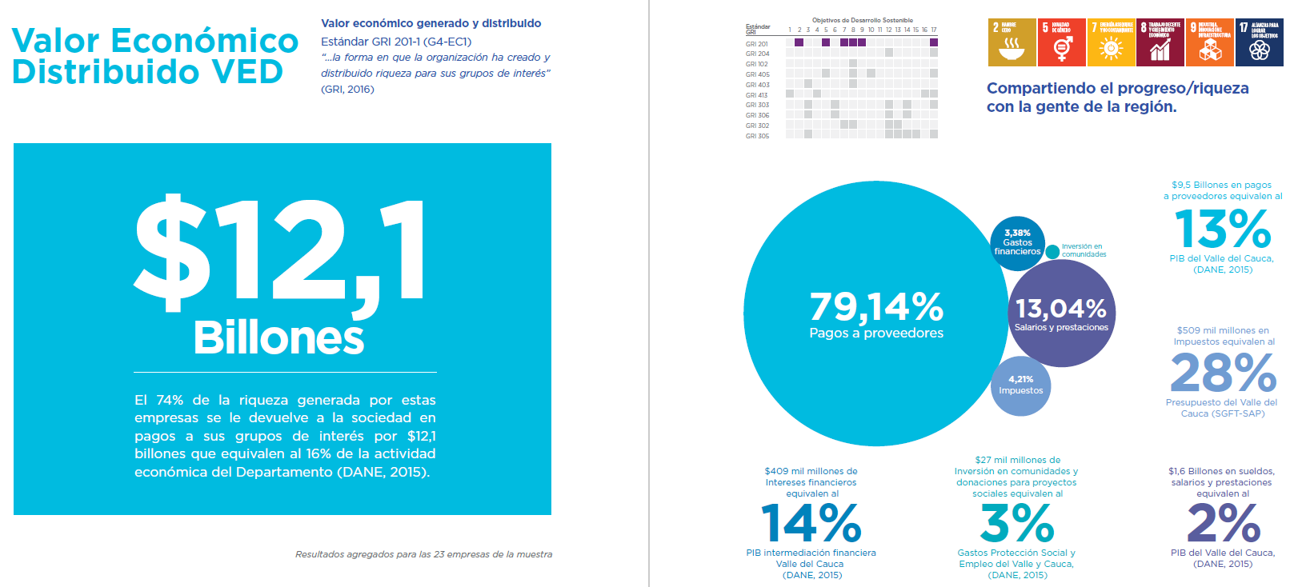

Slide 13
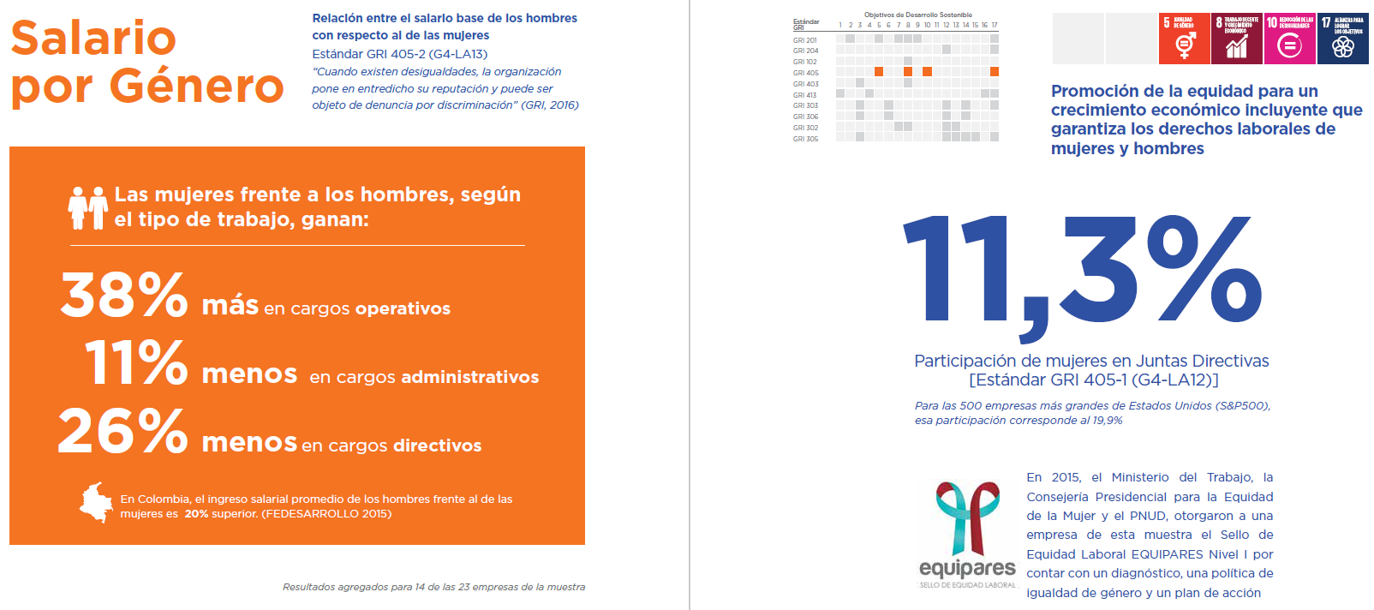

Slide 14
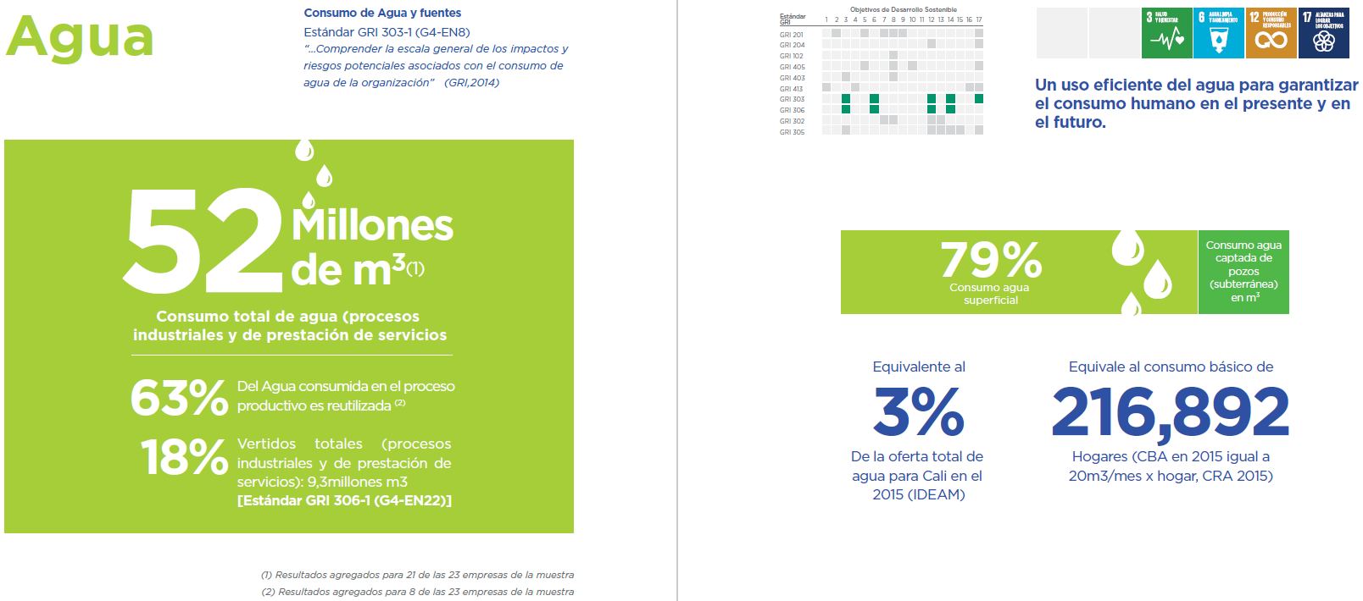

Slide 15
Contents
“Valle Por y Para Todos”
The Consolidated Report
The voice of the private sector
Results Showcase
What is the follow-up?

Slide 16
What is the follow-up?
The value of a base line
Enforce Sustainable Companies
Vision of the Region we dream of
Collective leadership

Slide 17


Acompañamiento
Técnico
Alexei Arbona Ph.D. (c)
Associate Professor
Department of Economics
aarbona@javerianacali.edu.co
Notes:
Emails y contacto

