Slide 1
OPIC at UNCTAD
Promotion of Bankable Sustainable Development Goal Projects

Slide 2
Helping to Catalyze the Private Sector for Development
OPIC’s financial support helps businesses and investors gain entry to Emerging Markets
OPIC works with the private sector to stimulate investment by providing solutions to common problems such as lack of financing, and political and regulatory risk.
The Northern Triangle (TNT) has been identified by OPIC and the administration as a critical region of focus.
Agency Profile
Current Portfolio: $22.2 billion
$15.6B Investment Finance
$2.8B Investment Funds
$3.8B Political Risk Insurance
Active Projects in more than 100 countries
Management: Ray Washburne, President & CEO
Based on Fiscal Year 2017 data

Slide 3
Our Products
OPIC offers innovative financial solutions to support private investors including debt financing, insurance, and support for private equity investment funds.
Products
Current* Portfolio
Based on a $29B Statutory Capacity
$22.2 BILLION
Debt Finance
Political Risk Insurance
Investment Funds
Political Risk Insurance
Investment Funds
Debt Finance
*December 21, 2016

Slide 4
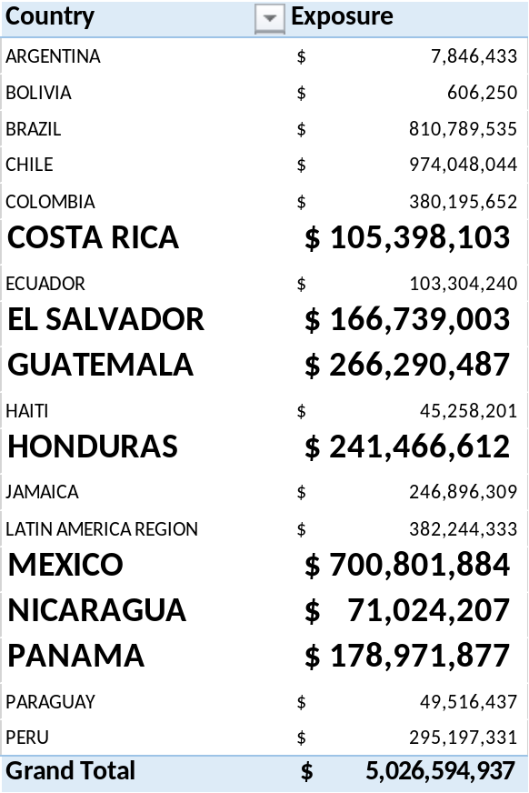
OPIC in Latin America
The US has a long history of involvement in Central and Latin America, and OPIC has a large presence in the region
Country Breakdown
Key Projects
Over $1.7B portfolio in Central America & Mexico
Solar power in El Salvador
Geothermal power in Honduras
Microlending in El Salvador

Slide 5
Investment Standards and Policies
Investors and project proposals must satisfy certain policy criteria to receive
OPIC financing and insurance.
Eligibility Criteria for Investors
Policy Standards for Projects
To be eligible for OPIC financing and insurance, applicants must:
Have a commercially viable business plan and successful track record
Involve the U.S. private sector in a meaningful way in the project seeking OPIC support
Confirm that commercially viable private sector financing or insurance is not already available for the project
OPIC supported projects must:
Cause no loss of U.S. jobs or adverse impact on the U.S. economy
Contribute to sustainable development
Be located in one of our approximately 160 eligible countries
Comply with international best practices regarding environmental and social impact
Support internationally recognized worker rights

Slide 6
Our Impact Overseas
Projects that OPIC currently supports are producing significant sustainable economic development results across a number of sectors.
Housing projects have constructed more than 60,000 affordable homes and have provided more than 200,000 home mortgages, the majority of which are for first-time homeowners.
Water infrastructure projects are producing over 150 billion liters of water each year, the equivalent of more than 260 billion bottles.
SME and microfinance clients are providing access to finance to over 10 million SME and microfinance borrowers.
Agriculture projects are sustaining livelihoods for nearly one million small holder farmers.
Energy projects are expected to generate more than 3.5 gigawatts of electricity in the developing world – enough to power roughly three million U.S. homes.
Healthcare projects are treating patients at a rate of more than seven million patient visits per year – in both small clinics and large hospitals.
Education projects are educating more than 120,000 students in primary and secondary schools, and more than 25,000 students in higher education.

Slide 7
OPIC Project Lifecycle
SOURCING
PRESCREENING
APPLICATION
DUE DILIGENCE &
POLICY REVIEW
APPROVAL
PROJECT CLOSE
PORTFOLIO MONITORING
Clients and Partners; Interagency; Business Development
Statutory and Policy Eligibility; Additionality; Development Impact; Financial Viability
Business plan; Eligibility of investor/project; Creditworthiness; Developmental Return; Investor/Management Experience/Track Record
Credit and Risk Underwriting; Policy Review; Legal Review; Character Risk Due Diligence (CRDD)
Vice President; Credit Committee/Evaluation Committee; Investment Committee and President & CEO; Board of Directors
Finish CRDD, Legal and Policy Review; Negotiation and Execution of Commitment and Insurance/Financing Agreements; First Closing on Equity Raising (Funds); First Disbursement
Ongoing monitoring of financial health, policy compliance, and development impact; Loan Repayment; Restructuring or Write-Off; Insurance Modifications and Claims;

Slide 8





www.opic.gov

