Slide 1
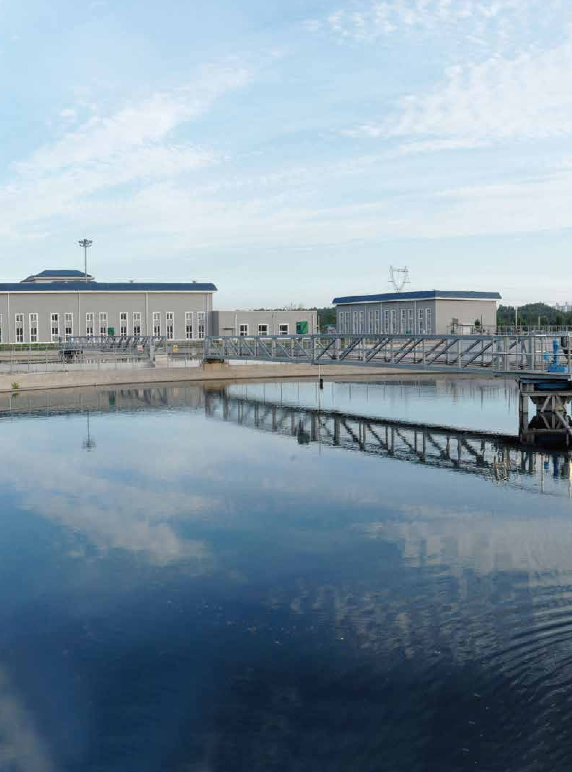
Infrastructure investment:
The role of private capital in the delivery of essential assets

Slide 2
Global Infrastructure Investment
Transformation in the ownership of the world’s economic infrastructure.
Strong supply of assets and a need for governments and companies to reduce debt.
Investors appreciate the needs and public status of their assets and are committed long term stewards.
Private investors, working alongside governments, can play a positive role in the delivery of world class infrastructure.
.
Source: PwC GIIA, Global Infrastructure Investment 2017
Notes:
The idea would be to start the presentation by providing insights on the findings of the PwC infra investment report.
The real aim of the report is to provide evidence base of the contribution of private capital in providing assets for the daily usage of infrastructure. The findings are across the globe, there is a very long term mindset related to the projects, there is a strong desire to deploy more capital, investments with the assets, more asset management focus. The challenges for the industry are related to new capital and new investors but make sure they work right on asset management, secondly the essential services of high public interests can generate scrutiny from governments, and third there is a need to create new innovative structure for investment. Around the world the government are focusing on better developing its infrastructure investment.
https://www.pwc.com/gx/en/industries/capital-projects-infrastructure/publications/global-infrastructure-investment.html
https://www.pwc.com/gx/en/ceo-agenda/ceosurvey/2017/gx/industries/capital-projects-and-infrastructure.html
http://www.bancomundial.org/es/news/feature/2017/05/05/america-latina-crear-infraestructura-sin-costo-contribuyentes
https://openknowledge.worldbank.org/bitstream/handle/10986/26406/114418-WP-LACRegionalInfrastructureFinanceReportFINALFINAL-PUBLIC.pdf?sequence=8&isAllowed=y
https://elpais.com/internacional/2017/04/24/america/1493062663_312614.html
http://inicio.infralatam.info/
https://www.americaeconomia.com/negocios-industrias/conozca-los-principales-proyectos-estrategicos-de-infraestructura-de-america-lat

Slide 3
Public Private Partnerships
LatAm should invest at least 5% of GDP yearly in infrastructure to have a leap in competitiveness
LatAm governments today face higher debt levels (% of GDP) than at the beginning of the commodity super-cycle.
Figure 1: Annual Avg. Public Infrastructure Investments (% GDP) in Selected LaTam Countries, 2008–2015
* Uruguay: 2008 – 2013
* Chile: 2008 - 2014
Source: Infra Latam, WorldBank, BN Americas, Ami Perspectiva, CAF Development Bank of Latin America
Notes:
El promedio de la inversión en infraestructura como porcentaje del PIB en la región fue de 2.8% entre 2008 y 2015, según las cifras de www.infralatam.info, iniciativa de CAF, BID y CEPAL, que cuenta con la más completa base de datos sobre inversiones en sectores como agua y saneamiento, energía, telecomunicaciones y transporte, de 18 países de América Latina y el Caribe. El aumento de la inversión en infraestructura en América Latina requerirá un sustancial aporte del sector privado para alcanzar al menos junto con el sector público 5% anual como porcentaje del PIB, según análisis de CAF -Banco de Desarrollo de América Latina. En los últimos años la inversión promedio en infraestructura osciló entre 2,4 y 3,2 % del PIB y esto incluye más de 30% de inversiones privadas y programas de asociaciones público-privadas. The next generation of infrastructure will be financed by the private sector, including yield-seeking commercial banks, growing Latin American pension funds as well as international equity investors and non-bank lenders.
Mexico's national infrastructure program through 2018 includes 223 transport projects requiring investment of nearly US$100bn. Argentina presented in 2016 a US$35bn national transport infrastructure plan. And Colombia is plowing ahead with its transport infrastructure program, focused mainly on US$17.4bn in 4G highways.
Governments in the LAC region have been using PPPs as a procurement method since the late 1980s, but the evolution and level of sophistication of the various PPP markets have not been uniform
https://www.bnamericas.com/en/news/privatization/the-biggest-hurdles-for-infrastructure-development-in-2017/
http://amiperspectiva.americasmi.com/the-future-of-infrastructure-investment-in-latin-america/
https://openknowledge.worldbank.org/bitstream/handle/10986/26406/114418-WP-LACRegionalInfrastructureFinanceReportFINALFINAL-PUBLIC.pdf?sequence=8&isAllowed=y
https://ppi.worldbank.org/snapshots/region/latin-america-and-the-caribbean

Slide 4




Public Private Partnerships in Selected LatAm Countries
Brazil put in place a regulatory framework in 2004. Concessions are awarded from 5 to 35 years and private investment represent at least 30% of the consolidated project’s cost.
Chile made an infrastructure program (Chile 2020) – with investments of up to US$28 billion in 25 PPP-based projects, tackling impacts from massive earthquake in 2010
PPP projects reaching an investment amount of close to US$16 billion have been awarded in last five years. The “Proinversion” is the central institutional body to structure PPPs.
Colombia has enjoyed recent success at attracting infrastructure investment through PPPs. Key projects have recently been launched such as related to the 4G roads.
Source: Ami Perspectiva, World Bank Group
Notes:
http://amiperspectiva.americasmi.com/the-future-of-infrastructure-investment-in-latin-america/
As often is the case in Latin America, Brazil and Chile are the two countries who set early standards for regulatory frameworks, in this case Public Private Partnerships. Mexico has also a good framework and more advanced compared to others.

Slide 5
Financing infrastructure projects
Financing options
Venture capital
Debt
Listed
Non listed
Capital markets
Commercial banks
Development banks
Stocks
Investment Funds
Direct
Indirect
Govt.
Bonds
Corporative Bonds
Project Bonds
Securiti
– zation
Companies
Projects
Projects
Investment in project
Investment in private equity
Source: OECD, Consorcio, PwC Analysis
Notes:
In terms of financing for the sector, it first can be considered that there are several financing options that can be used as related to infrastructure and most of them have been used as well in Mexico, as from development banks and commercial banks. On an overview, from the Government side, to finance infrastructure projects, four sources can be highlighted:
Budgetary resources
Resources generated from the own infrastructure projects development
The banking and stock indebtedness/capitalization, as through banks and stock market
The participation of the private sector through PPPs and concessions
The following diagram, elaborated by the “Consorcio” from information of the Organization for Economic Co-Operation and Development (OECD), presents the financing options for infrastructure projects in Mexico, considering options for either public or private entities. In terms of projects development to access the financing options, the PPPs in all of its modalities are a current well used model. Overall, aspects that must be considered for the investment evaluation is related to the economic and social environment either local, national or international, a feasibility study, the correlation with the business plan and growth strategy, as well as defining best and most convenient financing source to gather the economic resources to place on investments.

Slide 6
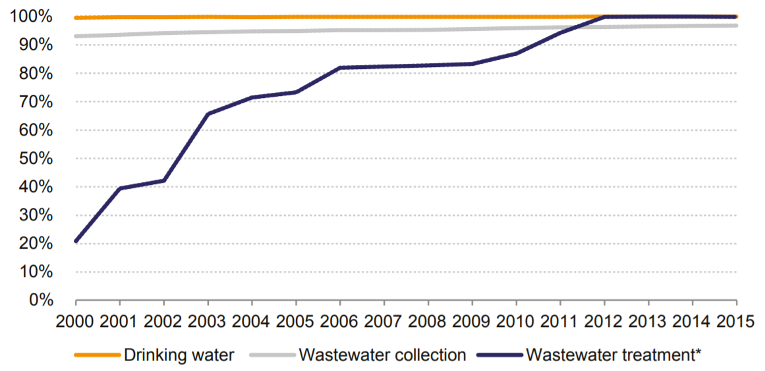
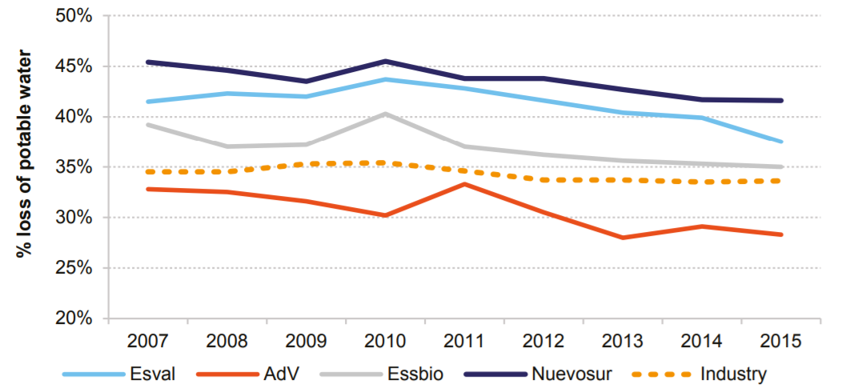
Chilean water project
Driving wealth improvements through infrastructure privatization
By 1998, even after a program of investment, the country had just 24 wastewater treatment plants, while just 15% of urban coverage was for sewage treatment.
Set a goal to treat 90+% of the sewage in Chile by 2010 and meet world-class standards. The country faced investing an estimated US$4bn to meet this target.
Between 1998 and 2004, the government sold strategic interests in 13 water companies to the private sector, with five being perpetual concessions and the remainder 30 year concessions.
Figure 2: Chile – urban coverage of drinking and wastewater
Figure 3: Chile – water losses per industry, selected companies
Source: PwC Global Infrastructure Investment 2017, SISS (Superintendence of Sanitary Services)
Notes:
Chile has gone from one of the poorest performed to be one of the global leaders in water sewage treatment. Between 2000 and 2010, coverage levels for potable water, sewage collection and sewage treatment approached 100%.
As recently as the early 1990s, cities in Chile were unloading untreated sewage into the sea or rivers. The goal set for 2010 was related an undertaking the government-owned water companies in Chile were neither able to self-finance nor had the necessary experience to implement. With a sophisticated international investor as majority owner, OTPP’s Chilean water companies have enjoyed a wide range of advantages. These include access to insight from a network of world class commercial operators to help drive innovation and leading edge thinking on financing.
Alongside these gains, one of the clearest benefits OTPP brings as a long term investor without immediate cash requirements is the ability to maintain required investment plans, irrespective of shocks in the macro environment. While privatisation of the Chilean water industry has objectively been highly successful, inevitably some challenges remain. One is the need to handle the growing impact of climate change on the security of the water supply, including a recent severe drought that lasted about five years, whilst simultaneously keeping customers’ bills at affordable levels.
En el caso de PPPs, Chile posee las mejores condiciones de financiamiento, en comparación con los demás países de América Latina. Principal fuente en esos casos son los fondos de pensiones chilenos, que invierten, en promedio, 20% en sectores de infraestructura (http://www.portaldaindustria.com.br/publicacoes/2016/7/o-financiamento-do-investimento-em-infraestrutura-no-brasil-uma-agenda-para-sua-expansao-sustentada/)

Slide 7
Peruvian subway development
Major projects for transportation association public and private investment
Peru is in the process of rolling out its planned six-line metro transit system for the City of Lima, seeking to better establish its transport system to ease people’s access in the country.
Lines 3 and 4 of the Basic Network of the Metro of Lima and Callao will be operational before the year 2025, as they will be tendered in 2018 and their construction will begin in 2019.
The socioeconomic benefit that will be obtained should be related to savings in travel time, savings in vehicle operation cost, reduction of traffic accidents, reduction of pollution, less effects to health etc.
ProInversión (Peru’s private investment promotion agency) conducted technical studies and promotion of private investment around the concession of the design, funding, construction, operation and maintenance of Lima Metro’s Line 2; and was commissioned for Lines 3 and 4 as well, besides the responsibility to handle the promotion of private investment.
Source: El Comercio Peru, Andina, La Republica Peru, Norton Rose, Gestión Peru
Notes:
Las líneas 3 y 4 de la Red Básica del Metro de Lima y Callao demandarán una inversión de más de 10,000 millones de dólares, y serían licitadas el próximo año, según el Ministerio de Transportes y Comunicaciones (MTC).
http://www.nortonrosefulbright.com/knowledge/publications/127577/the-latin-american-infrastructure-pipeline
https://elcomercio.pe/economia/peru/lineas-3-4-metro-lima-estaran-operativas-ano-2025-438073
http://larepublica.pe/economia/768655-inversion-de-linea-2-del-metro-llegara-1120-millones-de-dolares-en-2016
http://www.andina.com.pe/agencia/noticia-linea-2-del-metro-lima-primer-tramo-estara-listo-entre-2019-y-2020-678182.aspx
https://gestion.pe/economia/proinversion-consorcio-nuevo-metro-lima-gano-concesion-linea-2-metro-lima-2093067
For example, in case we decide to give a broader perspective instead on renewable energies: http://www.ren21.net/wp-content/uploads/2017/06/17-8399_GSR_2017_Full_Report_0621_Opt.pdf

Slide 8
Biofuel as renewable energy example
Investment toward clean energy
By 2050, of all the energy produced in Latin America, approximately 20% should come from clean sources (now ~6%).
Brazil is the second largest producer of biofuels in the world.
Over 80% of the biomass-based electricity generation is fueled by bagasse, produced in sugar production.
Among world’s most advanced green transport programs.
Among world’s largest fleet of flex-fuel cars.
Continuous support from Government on promoting internationally.
Brazil’s first corn ethanol plant, FS Bioenergia, recently began production. It will help meet that nation’s growing ethanol needs and introduces new feed options for Brazil’s livestock industry.
A few years ago, Boeing and Embraer opened a joint sustainable aviation biofuel research center in a collaborative effort to further establish the aviation biofuel industry in Brazil.
Source: REN 21: Renewables 2017 Global Status Report, BBC, Reuters, Biomass Magazine, Oil Price – Alternative Energy
Notes:
http://www.bbc.com/news/business-33114119
http://www.wallacesfarmer.com/energy/brazil-s-first-corn-ethanol-plant-starts-production
https://www.reuters.com/article/us-brazil-ethanol-policy-analysis/new-brazil-ethanol-policy-should-boost-demand-ma-idUSKBN1AR22Q
http://biomassmagazine.com/articles/11431/boeing-embraer-open-aviation-biofuel-research-center-in-brazil
https://oilprice.com/Alternative-Energy/Biofuels/Biofuels-May-Be-The-Future-Of-The-Aviation-Industry.html
Puse el ejemplo de Embraer y Boeing para caracterizar la importancia de la iniciativa independiente privada, por un ser un sector fuerte (debido a Embraer)

Slide 9
Focus on sustainability-related projects through infrastructure
Infrastructure investment
Investment multiplier
Impact on services, network accesssibility
Quality of life gains
Primary benefits in quality and quantity of services
Economic Development
Developing markets
Shortening gaps
Preparing for future
Externalities
Spatial redistribution of activity
Pecuniary externalities
Allocate externalities
Network
of services
Labor
market
Company consolidation,
reduction of production costs
Foreign markets:
imports and exports
Productivity and competitiveness gains
Source: World Bank Group
Notes:
Fuente para el diagrama: https://openknowledge.worldbank.org/bitstream/handle/10986/26406/114418-WP-LACRegionalInfrastructureFinanceReportFINALFINAL-PUBLIC.pdf?sequence=8&isAllowed=y
Aquí sería el momento de explicar sobre el desarrollo de la inversión en infraestructura como beneficio para sostenibilidad, puse algo muy general para que tengan la oportunidad de explicar lo que sea que prefieran. Si quieren hablar sobre proyectos específicos en la región, podría ser aquí también, así que pongo ligas de noticias relacionadas a proyectos:
https://blogs.iadb.org/energia_es/2016/07/07/america-latina-y-el-caribe-son-lideres-en-energia-renovable/
http://www.elfinanciero.com.mx/opinion/las-energias-renovables-en-america-latina.html
- Actualmente es un 5/6% y la expectativa es que hacia el 2050 de toda la energía producida en América Latina, el 20%, aproximadamente, provenga de fuentes renovables y limpias
Brasil es el segundo mayor productor de biocombustibles en el mundo
Across Latin America, renewable energy supplies 35% of heat demand, nearly one-quarter of which is met with traditional biomass (concentrated mainly in Bolivia, Colombia, El Salvador, Guatemala, Honduras, Nicaragua, Paraguay and Peru), with significant variations across countries
Brazil is the largest overall consumer of electricity and bio-power in Latin America. Over 80% of the biomass-based electricity generation in Brazil is fuelled by bagasse, which is produced in large quantities in sugar production
Solar PV is playing an important role in providing energy access in Latin America and the Caribbean, although the vast majority of capacity installed to date has been in large-scale projects
Related to wind power, Brazil continued to lead the region and to rank among the global top 10. Other countries in the region to add capacity included Chile (0.5 GW), which had a record year; Mexico (0.5 GW), which held its first auction in 2016; Uruguay (0.4 GW); and Peru (0.1 GW). 57 Both Chile and Uruguay passed the 1 GW mark for total capacity
In 2016, Chile announced that Santiago’s subway system (the second largest in Latin America, following Mexico City's) will be powered mostly by solar PV (42%) and wind energy (18%) as of 2018
A

Slide 10
Infrastructure Investment Trends
Broaden Horizons Developing markets
and greenfield projects
Political Leadership More social infrastructure for people
Future-proofing Impact of global megatrends on assets
Commodity-regions Governments with private financing options
Sustainability Make cities ecologically sustainable and smart
Source: PwC – The future of infrastructure spending,
Notes:
Then the idea would to finish the presentation by associating the investment trends of PwC with the megatrends for the future changes as well.
Over $4.5 trillion a year will be spent on infrastructure between now and 2020, and we expect that figure to increase in the decade after. These five themes all have rapid change in common. Yesterday’s strategies are no longer enough to tackle tomorrow’s challenges. But with the right mix of agile strategies, investors and governments can together meet the needs for affordable, sustainable infrastructure. The world is changing at a breathtaking pace. Never before has (r)evolution occurred in such short periods of time. In 2011— attributed to social media— the Egyptian government fell in 17 days; market dominance can be lost to completely new entrants; leaders who do not understand and listen to their stakeholders and who lack the willingness and ability to change will be passed by, as their markets and customers move without them.
https://www.pwc.com/gx/en/industries/capital-projects-infrastructure/publications/the-future-of-infrastructure-spending.html
https://www.pwc.com/gx/en/industries/capital-projects-infrastructure/publications/cpi-spending-outlook.html
http://blogs.worldbank.org/ppps/what-are-new-trends-driving-private-infrastructure-investment-emerging-markets?CID=PPP_TT_PPP_EN_EXT
https://www.pwc.com/us/en/faculty-resource/assets/symposium/2014-megatrends-overview.pdf
https://www.caf.com/es/actualidad/noticias/2017/05/america-latina-debe-invertir-al-menos-5-en-infraestructura-al-ano-para-dar-el-salto-en-competitividad/
http://amiperspectiva.americasmi.com/the-future-of-infrastructure-investment-in-latin-america/
http://repositorio.cepal.org/bitstream/handle/11362/40849/1/S1600759_en.pdf

Slide 11
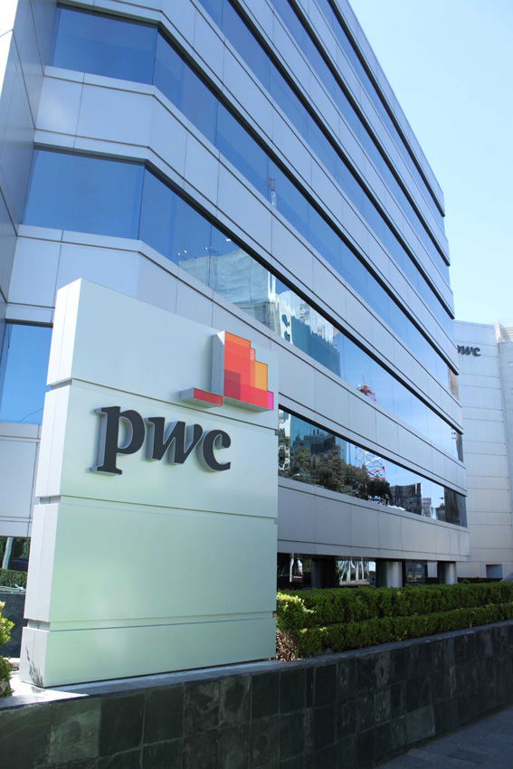
PwC Mexico
How can each country’s agency enhance the deployment of more infrastructure investment?
Antonio Correa
Director, Management Consulting – PwC Mexico
antionio.correa@mx.pwc.com
+52 (55) 5263 8903
Luca Torosani
Leader, International Business Centre – PwC Mexico
luca.torosani@mx.pwc.com
+52 (55) 5263 6674
Allan Souza
Innovation Consultant – PwC Mexico
allan.souza@mx.pwc.com
+52 (55) 5263 6000 ext.: 7339
This content is for general information purposes only, and should not be used as a substitute for consultation with professional advisors.© 2017 PricewaterhouseCoopers, S.C. All rights reserved. PwC refers to the PwC network and/or one or more of its member firms, each of which is a separate legal entity. Please see www.pwc.com/mx for further details.
Notes:
La idea aquí es poner una pregunta que va ser la finalización de la presentación, mientras ya se dejan los contactos de ustedes para que la audiencia se fije en esto
Es importante asociar con los Sustainable Development Goals, ya que se asociada al tema del evento:
http://www.un.org/sustainabledevelopment/infrastructure-industrialization/

