Slide 1
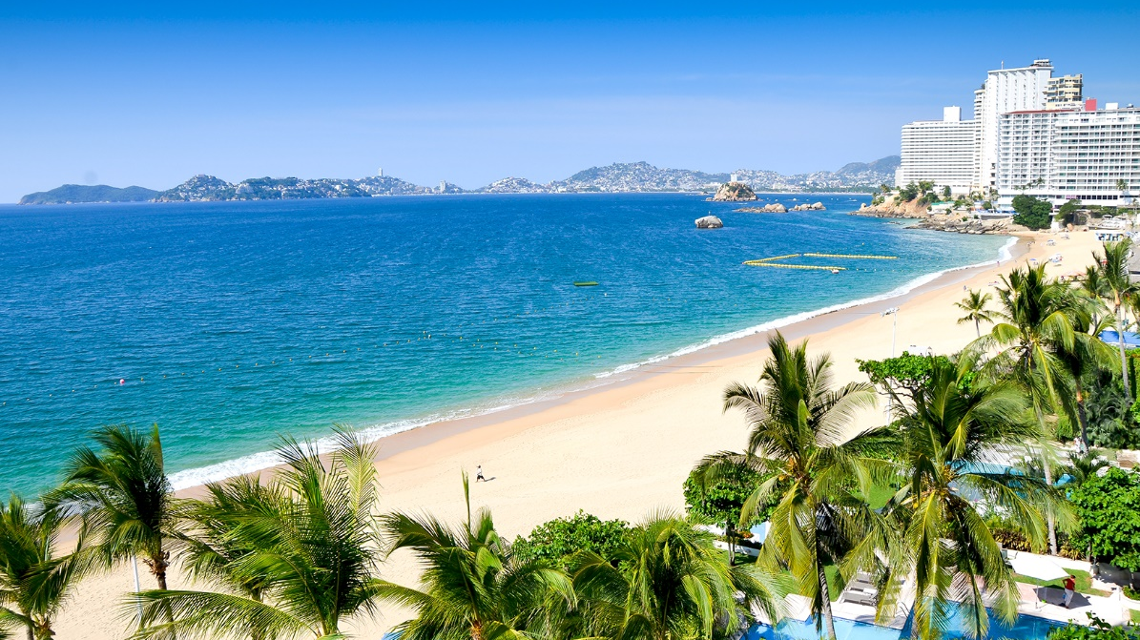

Bancomext role to support the Tourism Sector through
Sustainable Mechanisms

Slide 2

CONTENT
Bancomext
Tourism as a Strategic Sector
Comprehensive Finance Program
Bancomext Sustainability Initiatives
SARAS
KfW-DEG Technical Cooperation
IDB (BID) Technical Cooperation
Solar Walter Heaters Project / Peninsula of Yucatan

Slide 3
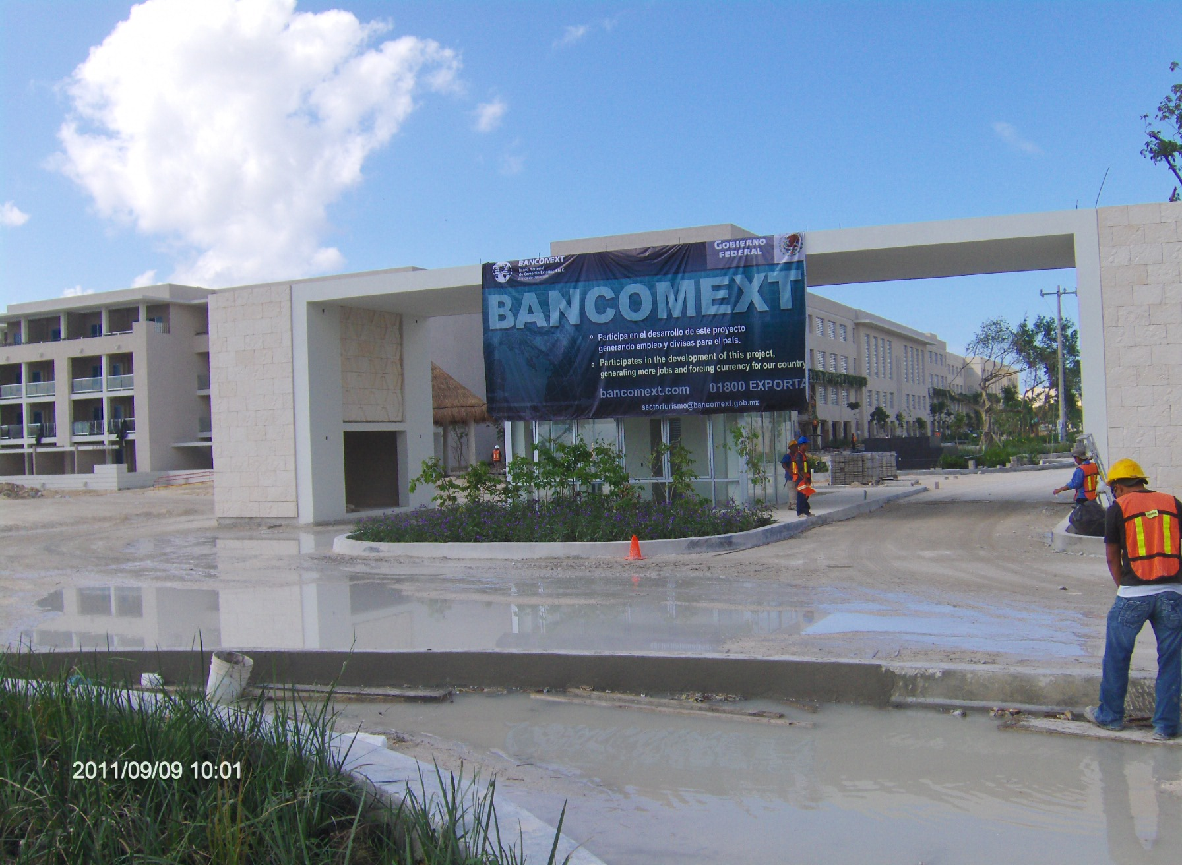
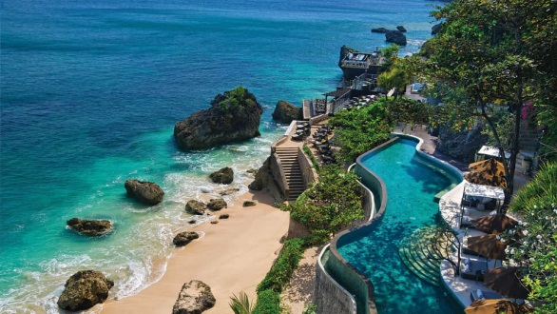
I. BANCOMEXT
Development Bank in charge of increasing the competitiveness of Mexican companies in the global markets.
Founded 80 years ago.
Belongs to the Federal Government.
Specialized in the attention of priority sectors, highlighting the Tourism Sector.
Bancomext supports Mexican and foreign companies that want to invest in Mexico, through direct loans (first tier) and / or through a wide network of comercial Banks (second tier).

Slide 4



Estrategia de atención a empresas
II. Tourism as a Strategic Sector
The tourism industry plays one of the most important roles in the world economy, contributing directly to the development of México.
Hotel infrastructure development is key player in the generation of foreign currency and foreign direct investment.
Tourism in Mexico 2016
World Tourism2016
  8.7% of the national GDP.
  More than 18 thousand hotels and 692 thousand hotel keys.
  More than 19,600 MDD in foreign currency in 2016
  Generates 9 million jobs (8.1%).
  First employer of young people, and the second employer of women
  8th position worldwide in the arrival of international tourists.
7.6
USD billions contribute to world GDP
10%
of world GDP
1,235
Millions of international tourist
1 de cada 10
Jobs is linked to the sector

Slide 5
II. Tourism as a Strategic Sector
Tourism links several sectors of the economy, including construction sector, transport, logistics, among others.
Tourism Sector Financing supports the strengthening of value chains:
Direct contribution
Indirect contribution
Induced contribution
TOTAL contribution
Supplier development.
Entertainment.
Transport.
Attractions
Congresses
Conventions
Investment in Tourism & Travel.
Government:
Impact of supplier purchases.
Food and drinks.
Clothing.
Lodgings
Recreation.
Food and drinks.
Clothing.
Lodgings
Recreation.
Direct Credit
Guarantee Programs
Factoring or
Productive Chains

Slide 6
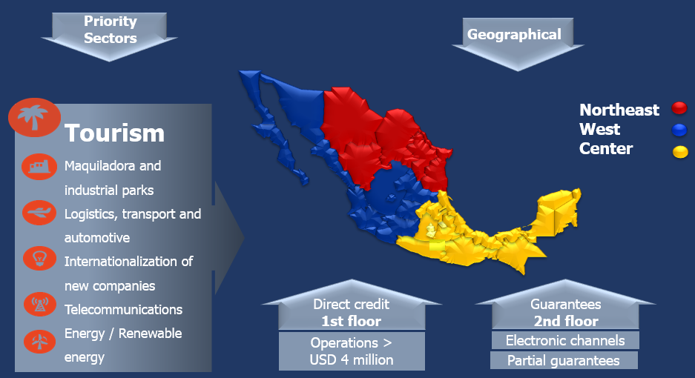
III. Comprehensive Finance Program
Bancomext Business Model

Slide 7
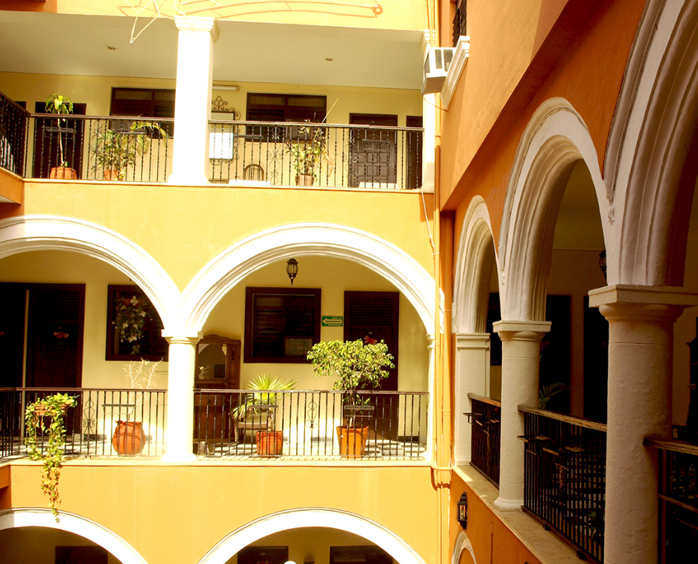

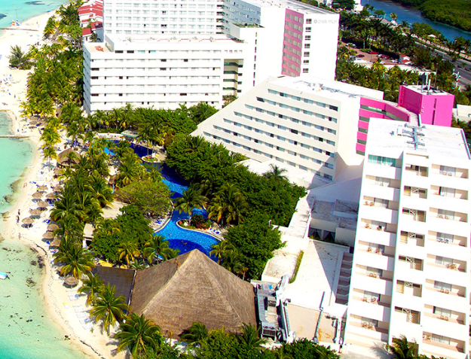
III. Comprehensive Finance Program
Business Strategy
  Micro, Small and medium-sized companies in the sector
National providers of tourism companies
Hotels and Tourist Projects
  …Bancomext Direct Credit (1st Tier Loans)
  …Through Commercial Banks (2nd. Tier Loans)
  ...To foster national suppliers participation
LARGE HOTELS AND TOURIST PROJECTS
SME´s
FINANCING A
SUPPLIERS
FROM THE SECTOR
CREDIT TO
SMALL AND MEDIUM
HOTELS (MTH)

Slide 8
III. Comprehensive Finance Program
COMPREHENSIVE ANALYSIS
Developer experience
Operator experience (flag)
Destination
Segment: Sun and beach, business
health, retirement community
Follow-up to the construction plan
Financial evaluation
Constructor licenses, permissions
Structure
(% participation)
First Tier Financial Program
Structuring of projects taylor-made.
Credits in USD / MXN.
Loan amounts starting at 4 MDD.
Maturity term of up to 15 years with grace period, amortizable during the term.
Syndicated or Club Deals with commercial banking.
MODALITIES
SEGMENTS
  Investment projects
  Working capital
  Expansion – Add on
  Remodeling
  Long Term Sales
  Sun and beach
  Business
  Luxury Tourism
  Megadevelopment
  Sports Tourism
  Health tourism
  Marinas and Golf Courses

Slide 9




III. Comprehensive Finance Program
First Tier Financial Program: IMPACT
New built hotel keys
Hotel Keys
11,690
*/ A junio
+11,600 hotel keys financed during the present administration (2013-June 2017) with Bancomext funds.
5,000 MDP annual average in the last ten years, of direct credits granted to the tourism sector,
50% y 41% of the projects focused on business tourism and sun and beach, respectively.
18 states of the country detonated new investment.

Slide 10


III. Comprehensive Finance Program
First Tier Financial Program: IMPACT
Perspective of Hotel keys
funded with Bancomext
Equals to 1.7x hotel keys in Querétaro.
Equals to 1.5x hotel keys in Puebla.
Equals to 2.1x hotel keys in León.
Hotel Keys
11,690
(In the last 4 and a half years)
95% of the offer in Los Cabos.
2 times Ixtapa
4 times La Paz
3 times Huatulco
97% of the offer in Puerto Vallarta.

Slide 11
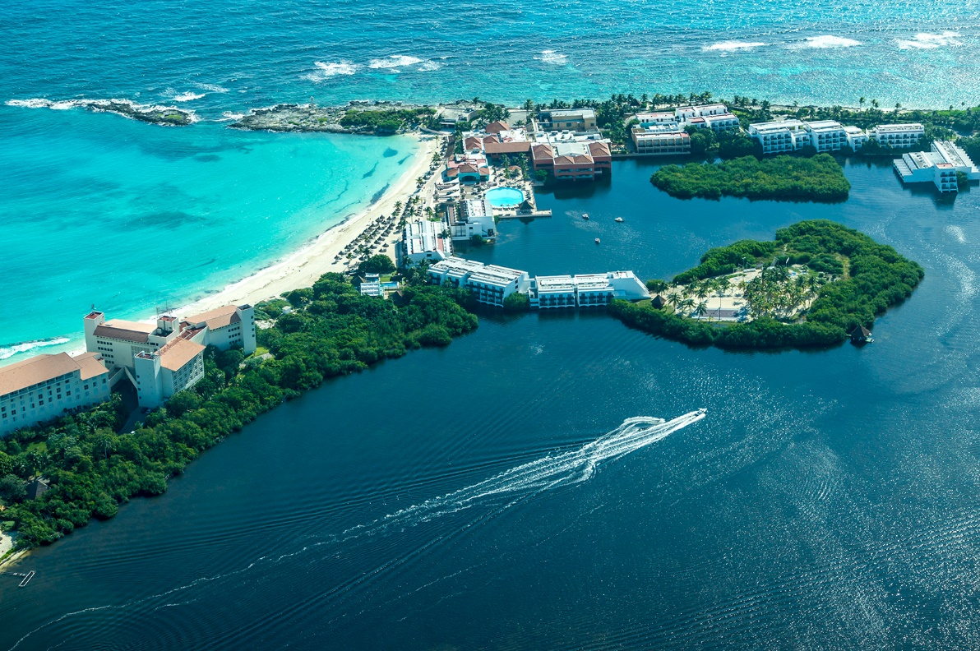
III. Comprehensive Finance Program
Second Tier Financial Program
“Mejora tu Hotel”
Background
Bancomext and commercial banks in a coordination effort with the Ministry of Tourism; are linked in a strategic alliance for the benefit of a priority sector and highly job-creating
The program seeks to finance hotels (small and medium, mainly) in projects for the construction, equipment, expansion, remodeling, technological improvements, environmental, energy savings, fuel and water of the hotel. Any integral improvement of the facilities and / or services offered by the hotel.

Slide 12
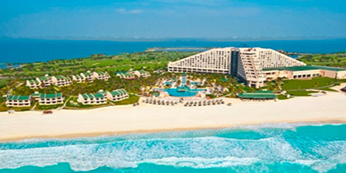

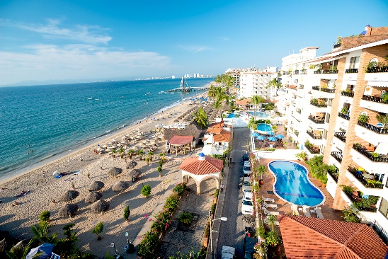
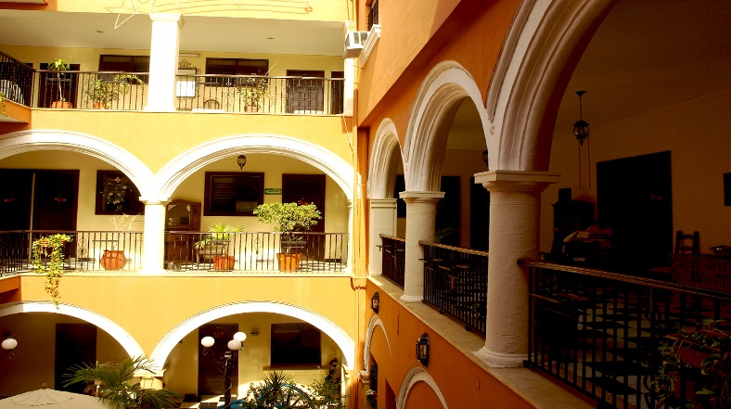
III. Comprehensive Finance Program
Second Tier Financial Program: “Mejora tu Hotel”
What is it?
Support to the hotel sector and to the companies providing lodging services through commercial banks with Bancomext guarantee, or Bancomext directly to large projects
Applicable to all lodging services formally constituted: hotels, motels, and inns. Mainly small and medium properties.
Includes the construction of new hotels.
The program seeks to support the hotel sector, its growth and its needs to renew equipment and investment.
Commercial Banking is expected to offer a competitive financial package, considering the investment needs of hotels.

Slide 13
IV. Bancomext Sustainability Initiatives
SARAS
KfW - DEG
Solar Water Heaters Project
Bancomext financing scheme to promote the use of solar water heating systems (SCSA) within the tourism sector in Mexico
Lines of Financing
Environmental and Social Risk Management System (named SARAS after its initials in Spanish).
IDB-BID
Market Study that provides inputs for the structuring of financial instruments, to fund projects alligned with climate change mitigation.
Technical Cooperation for SARAS implementation
.

Slide 14
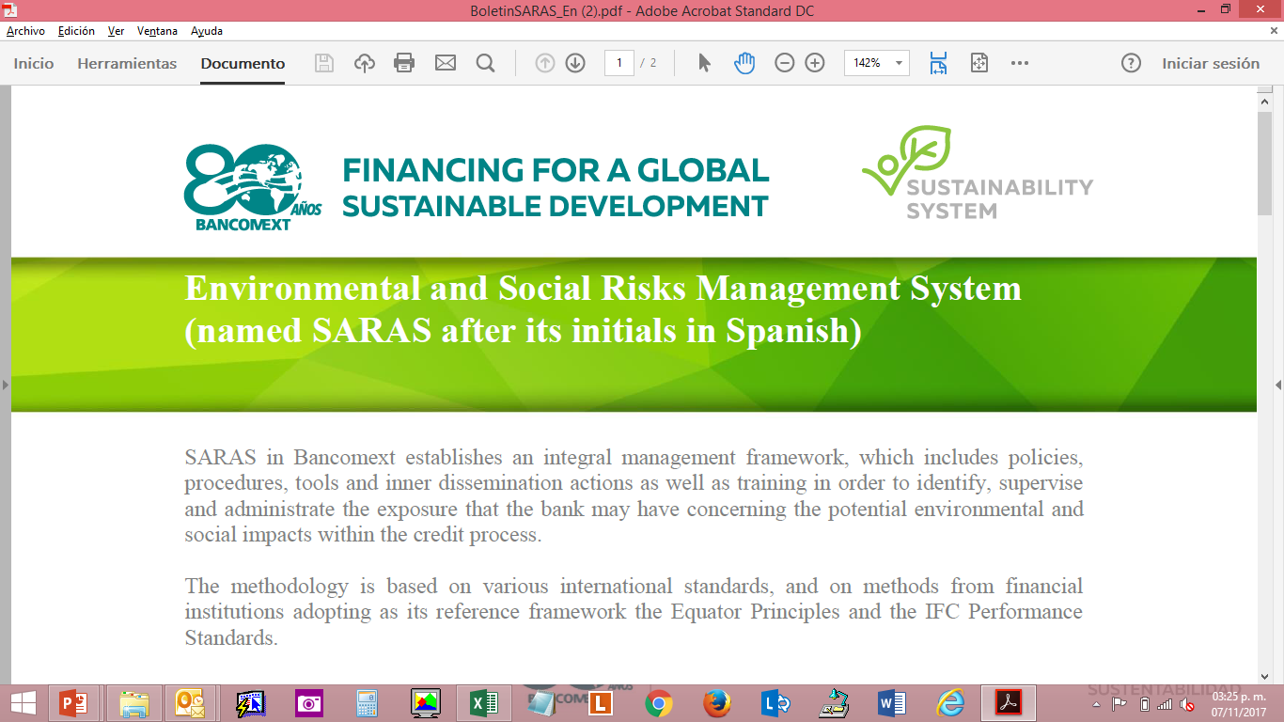


IV. Bancomext Sustainability Initiatives
SARAS
Financing For a Global Sustainable Development
Bancomext, establishes an Enviromental and Social Risks Management System (named SARAS after its initials in Spanish).
SARAS includes: policies, procedures, tools and inner dissemination actions as well as training…
Identify
Supervise
Manage
MINIMIZE
EXPOSURE TO
POTENTIAL ENVIROMENTAL AND
SOCIAL IMPACTS WITHIN THE CREDIT PROCESS
Methodology based:
The Equator Principles and
The IFC Performance Standards.

Slide 15

IV. Bancomext Sustainability Initiatives
SARAS
Financing For a Global Sustainable Development
Objective: Categorizing projects based on its environmental and social risk in order to manage the potential impacts that influence the credit and the reputational risk.
A
Projects with probable adverse and sensitive effects on the enviroment that can be irreversible, varied, or unprecedented.
CATEGORIZING
B
Projects with posible adverse effects on the enviroment within human populations or important ecological areas such as wetlands, forests, and other natural habitats.
C
A proposed Project is classified in this category if the probability of causing adverse effects on the enviroment is minimum or null.

Slide 16
IV. Bancomext Sustainability Initiatives
SARAS
CREDIT PROCESS IN BANCOMEXT
Business
development
Analysis and decision
Intrumentation and development
Monitoring and Recovery
WHAT IS INCORPORATED FOR SARAS?
BUSINESS DEPARTMENT
ANALYSIS AND CATEGORIZATION
FEASIBILITY, DECISION AND RELEASE
PORTFOLIO MONITORING
Evaluation questionnaire
Get information to be analyzed vy the UGAS
Contractual obligations
Identification of A&S elements to monitor
Initial categorization
Validation of categorization
Weighting matrix A&S
Follow-up report
Exclusion list

Slide 17


IV. Bancomext Sustainability Initiatives
KfW and DEG Technical Cooperation
Cooperation in sustainable energy projects with different lines of financing since 2001.
Strengthening the promotion of sustainability and socially responsible projects in Mexico through the actions of Bancomext.
Strengthening the implementation of social and environmental standards SARAS.

Slide 18


IV. Bancomext Sustainability Initiatives
IDB (BID) Technical Cooperación
Project: Energy efficiency study
The IDB and Bancomext have agreed to promote energy efficiency in the tourism sector towards mitigation of climate change.
Aim of the project: to carry out a market study on the potential of energy efficiency projects and programs in the hotel sector in Mexico.
Market study benefits: This market study will serve as a basis for discussion, design and structuring of effective financing strategies for Bancomext for climate change mitigation.
Outcome: Development of financial and guarantee instruments, technical advisory, consultancy and training support to financial intermediaries and final beneficiaries, who can promote and execute financing programs for energy efficiency projects and mitigation of climate change.

Slide 19
IV. Bancomext Sustainability Initiatives
IDB (BID) Technical Cooperation
Energy efficiency study
  To define target hotel segments
  To evaluate potential in Energy Efficiency
  To identify technology and offer
  To define Financial Institutions
Program Design
  Promotion Strategy
  Pilot projects
  Call for Suppliers
  To define financial offer
  To identify adjustments to instruments
  To develop missing technologies
  To design program operation
Market Study
Program Implementation

Slide 20




IV. Bancomext Sustainability Initiatives
Solar Water Heaters Project / Peninsula of Yucatan
Purpose
Financing for the Installation of Solar Water Heating Systems (CSA) in Hotels, supporting the reduction of greenhouse gas emissions in Mexico.
Pilot project in Quintana Roo, Campeche and Yucatán.
Program of the Federal Government with the Secretary of Energy, the National Commission for the Efficient Use of Energy (CONUEE), the United Nations Development Program (UNDP) and Bancomext.
To support small, medium and large hotels, with technical advice, training and financing for the acquisition and installation of CSA systems, with a model based on the savings generated by the reduction in gas consumption.

Slide 21


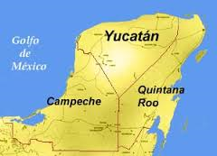

IV. Bancomext Sustainability Initiatives
Solar Water Heaters Project / Peninsula of Yucatan
CONUEE
Project promotion and management coordination including equipment specifications
SENER
Contribution of resources for the program
BANCOMEXT
Guarantees the credits granted by commercial banks for the installation of CSAs in hotels.
Commercial Banks
They grant preferential financing to hotels based on the savings generated
Hotels
Equipment and improvement of processes and costs
Specialized
Consultants
Technical advice and feasibility study

Slide 22

GRACIAS!!!!!!!
Ms. Yvette Valenzuela Becerra
Director of Tourism Project Financing turismo@bancomext.gob.mx
+52 (55) 5449-9000

