Slide 1
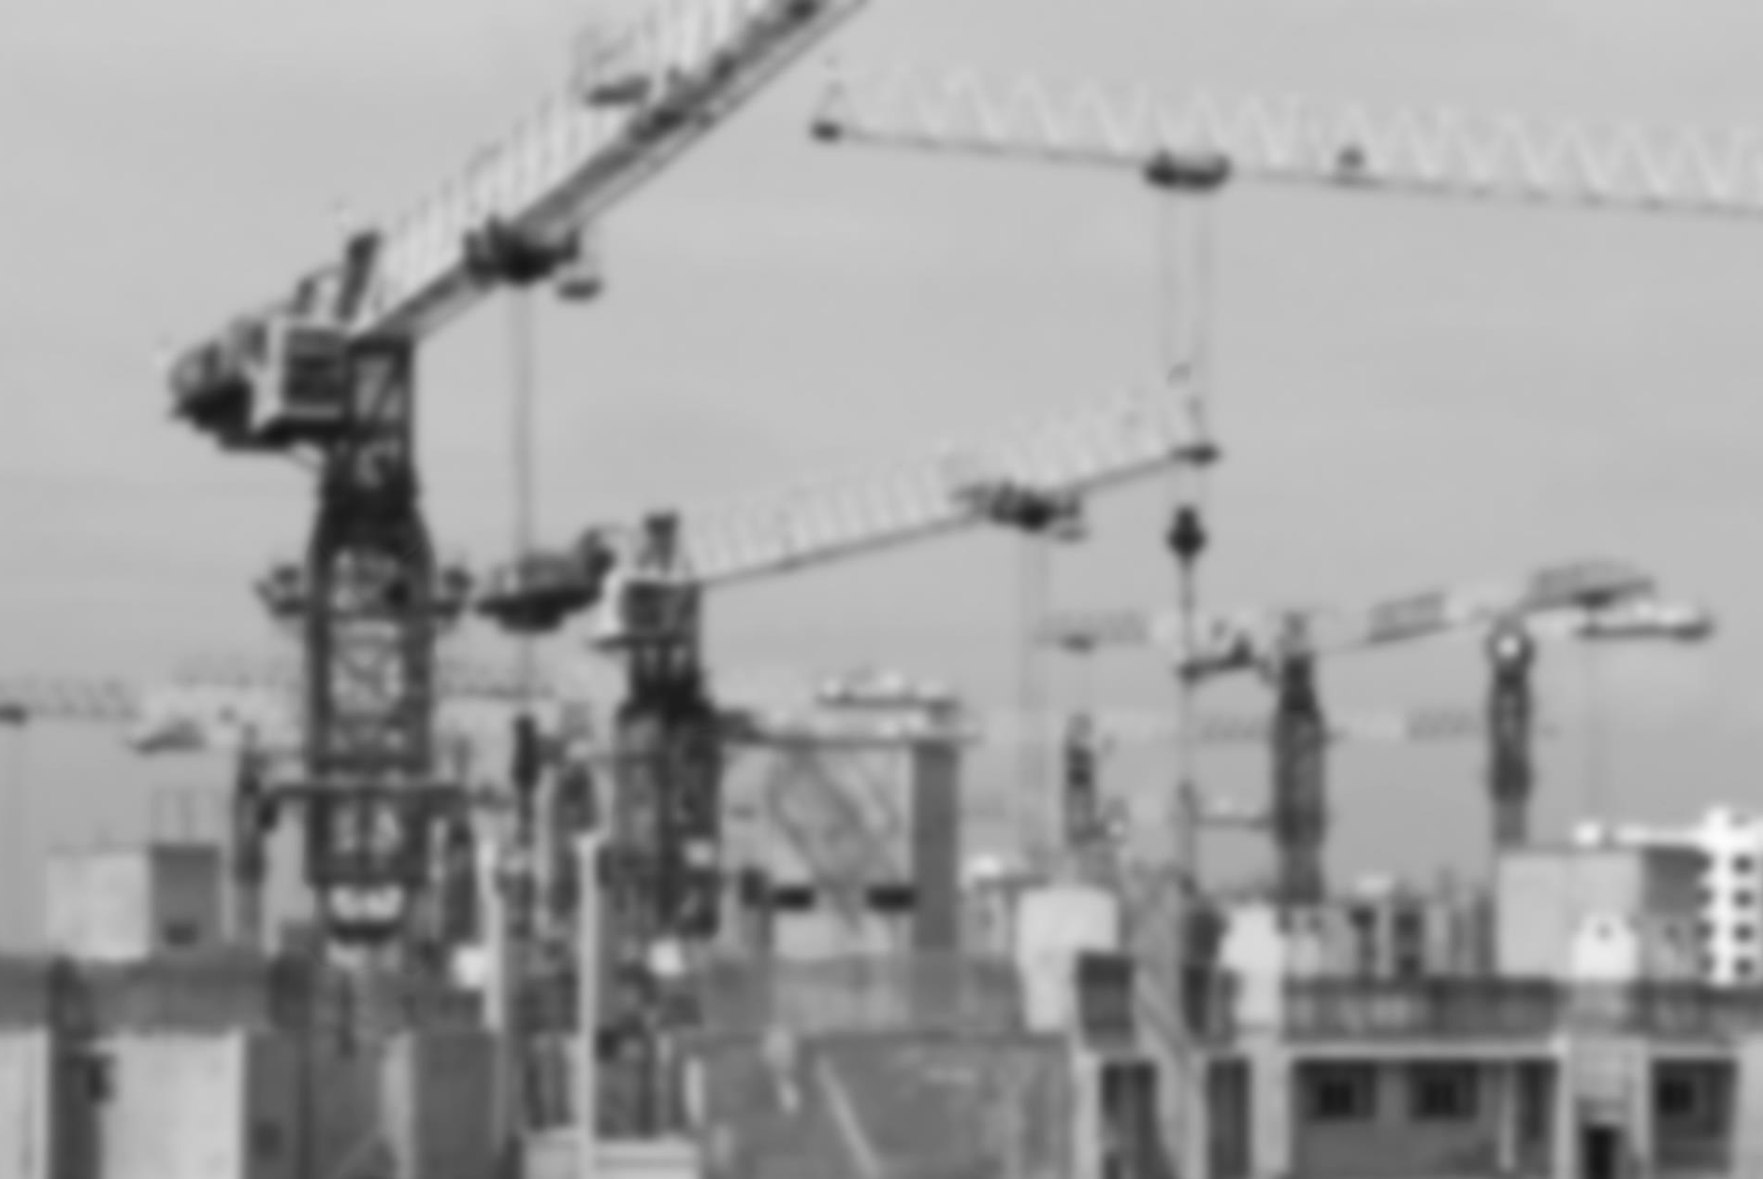
FDI trends and the
Sustainable Development Goals (SDGs)
Regional Seminar on the Promotion of Bankable SDG Projects
7-8 November 2017, Mexico City
Paul Wessendorp
Chief, Investment Promotion Section
United Nations Conference on Trade and Development (UNCTAD)

Slide 2
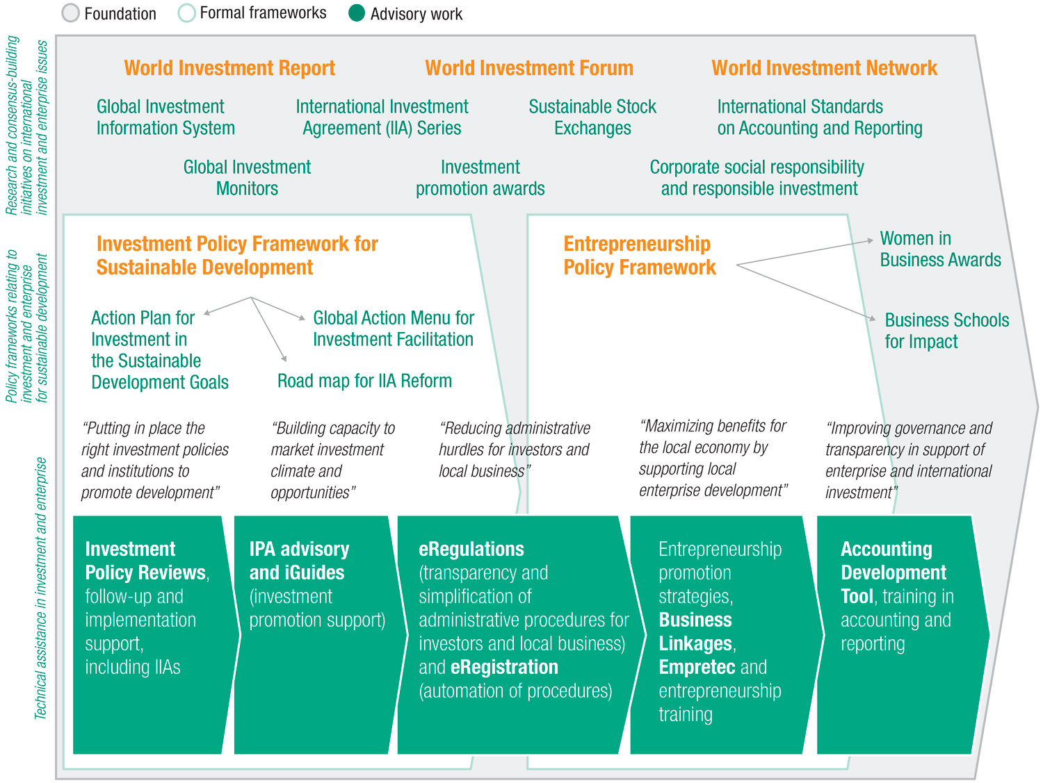
Value Chain of UNCTAD’s products and services in Investment and Enterprise
2

Slide 3
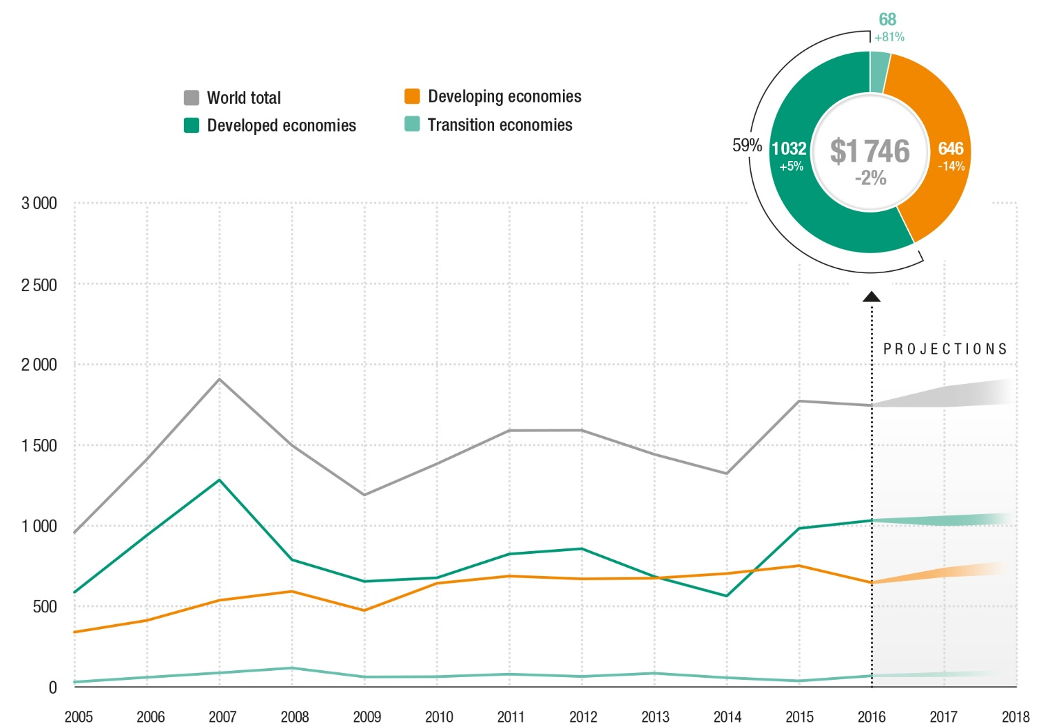
Global FDI down 2% in 2016,
but projections cautiously optimistic
FDI inflows, global and by group of economies, 2005–2016,
and projections, 2017–2018
(Billions of dollars and per cent)
Source: ©UNCTAD WIR 2017.
3

Slide 4
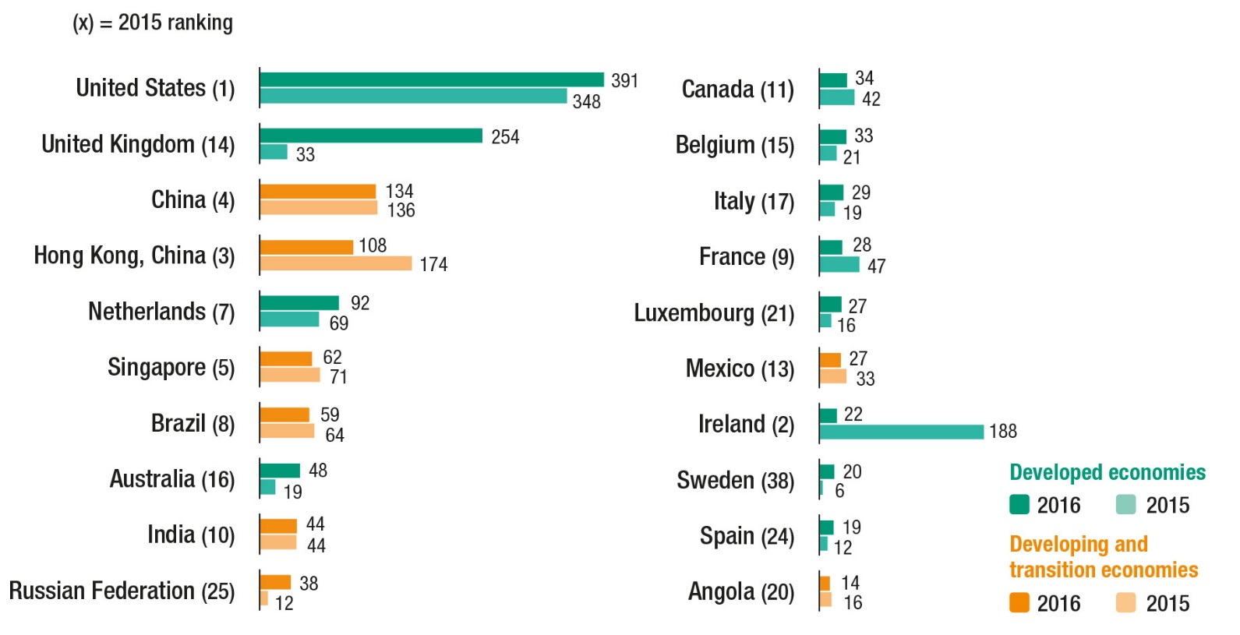
Eight developing and transition
economies rank among top 20 FDI hosts
FDI inflows, top 20 host economies, 2015 and 2016 (Billions of dollars)
Source: ©UNCTAD WIR 2017.
4

Slide 5
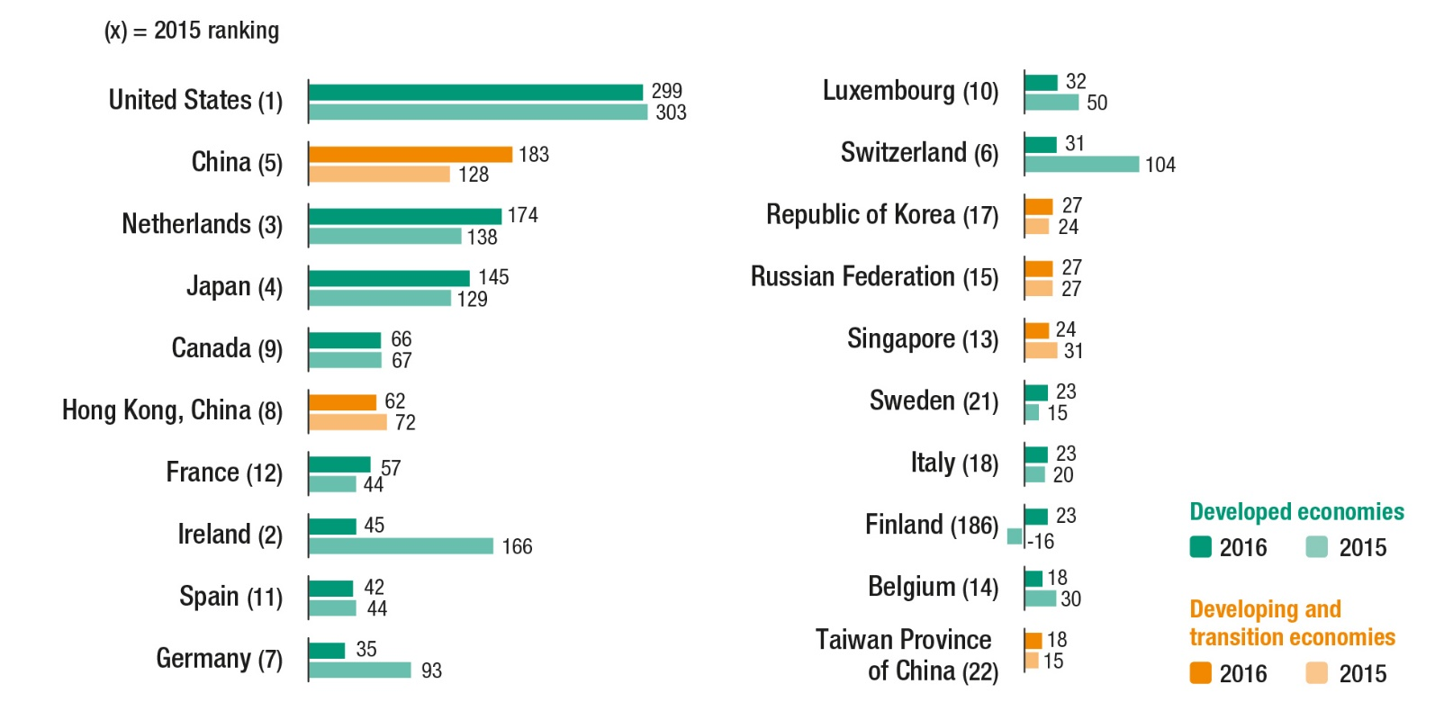
FDI outflows, top 20 investor economies, 2015 and 2016
(Billions of dollars)
Overall FDI outflows decline, with few exceptions
Source: ©UNCTAD WIR 2017.
5

Slide 6
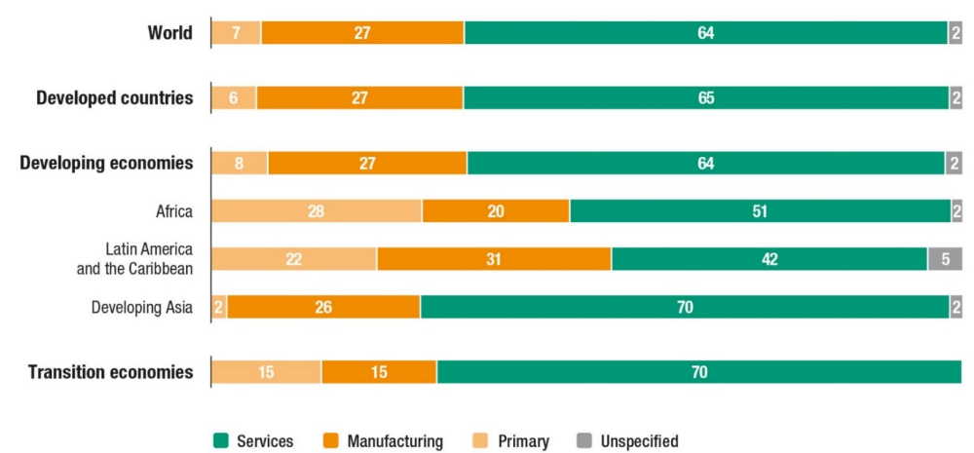
The services sector accounts for almost two
thirds of global FDI stock
Global inward FDI stock, sectoral distribution by grouping and region, 2014
(Per cent)
Source: ©UNCTAD WIR 2016.
6

Slide 7
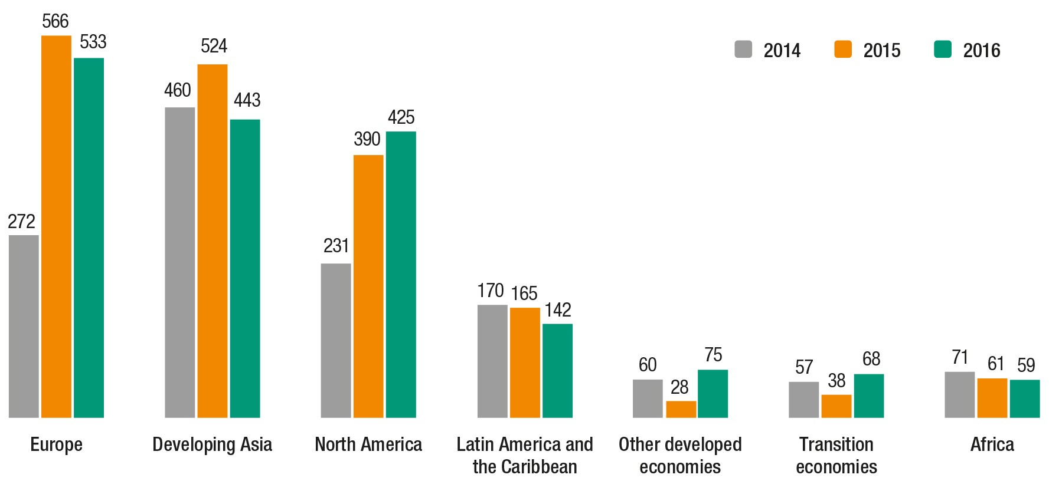
Flows to developing regions shrunk
by 14% to $646 billion
FDI inflows by region, 2014–2016 (Billions of dollars)
Source: ©UNCTAD WIR 2017.
7

Slide 8
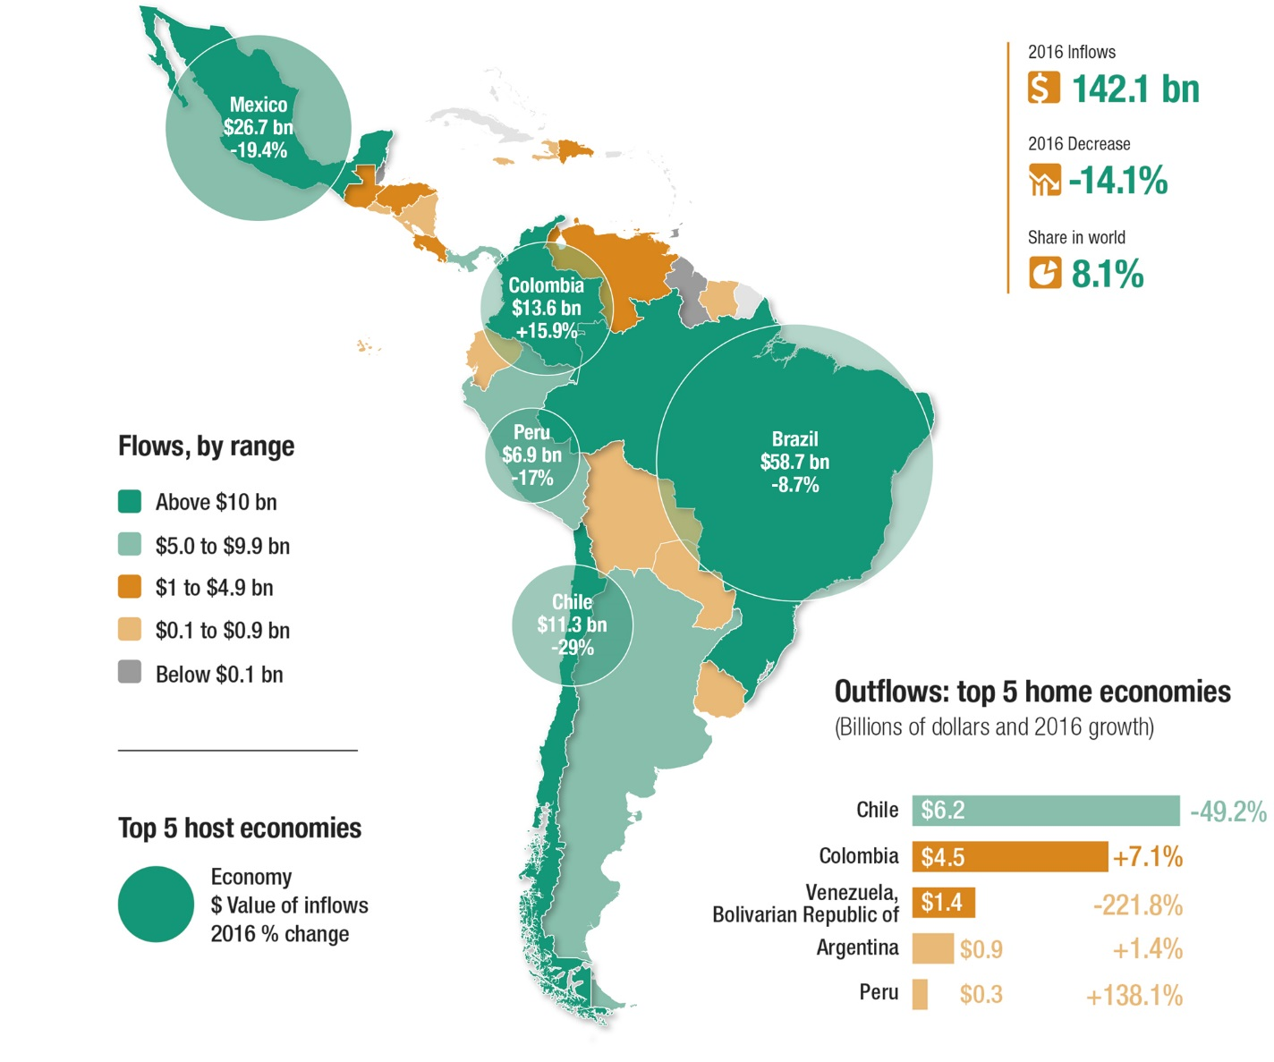
Latin America & the Caribbean
FDI flows, top host and home economies
Source: ©UNCTAD WIR 2017.
8

Slide 9
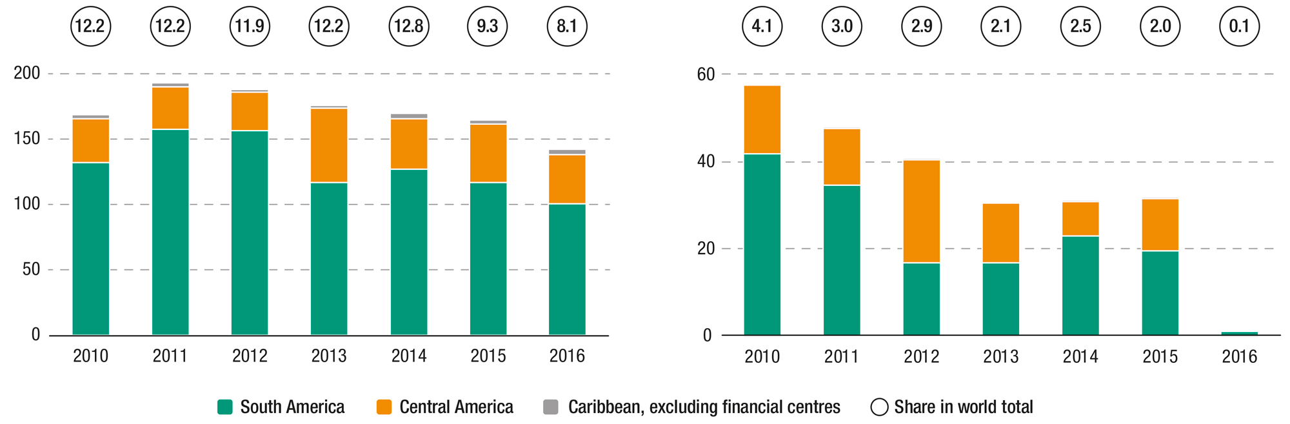
Latin America & the Caribbean
FDI inflows and outflows
FDI inflows, 2010–2016
(Billions of dollars and per cent)
FDI outflows, 2010–2016
(Billions of dollars and per cent)
Source: ©UNCTAD WIR 2017.
9

Slide 10
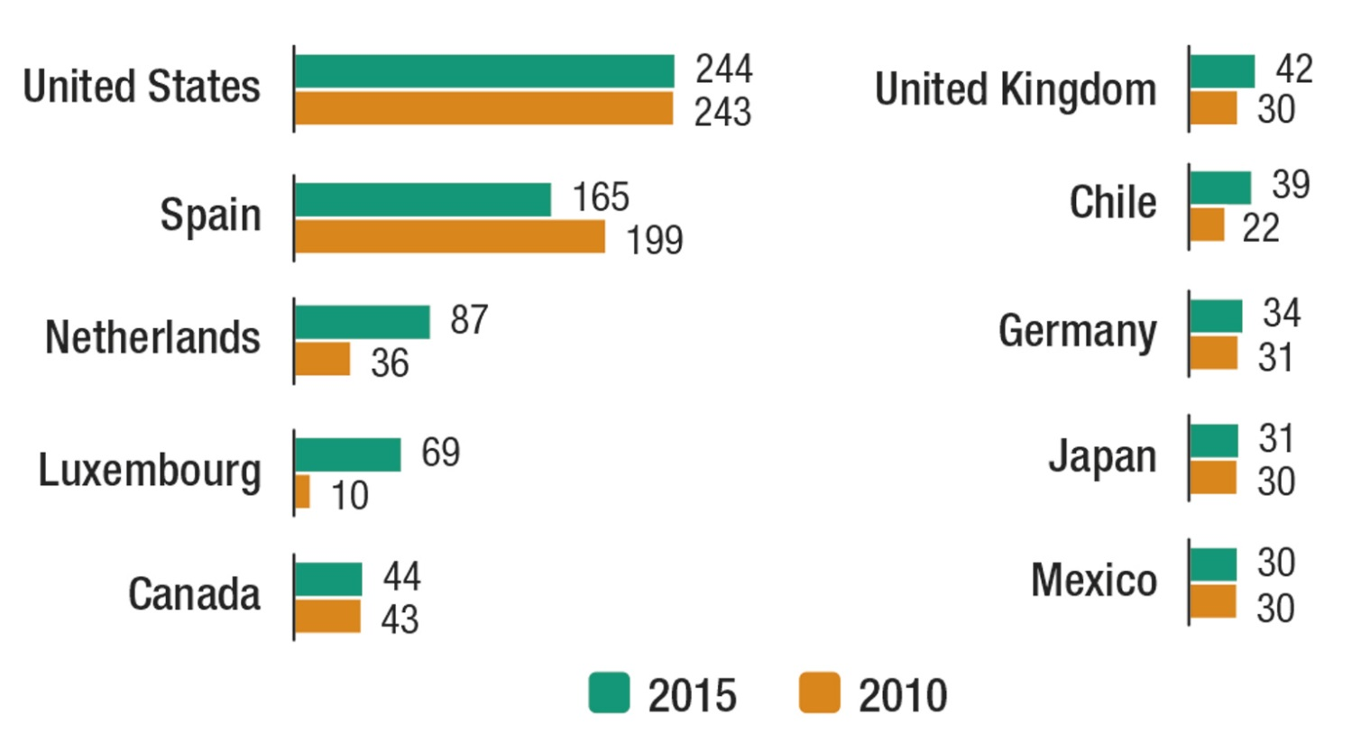
Top 10 investor economies in LAC by FDI stock
FDI outflows, top 10 investor economies in LAC by FDI stock, 2015 and 2016
(Billions of dollars)
Source: ©UNCTAD WIR 2017.
10

Slide 11
Prospects: FDI flows expected to increase
by 5 % in 2017
Accelerated global economic growth to 2.7%
Expected easing of fiscal policy and rise in business confidence in the United States
Growth in China and expansion in natural-resources- exporting countries (expected increase of commodities prices)
World trade expansion forecast to be 3.8%
However, rising interest rates may restrict financing for investment and national currencies depreciation in some developing and transition economies would make corporate debt more expensive
Source: ©UNCTAD WIR 2017.
11

Slide 12
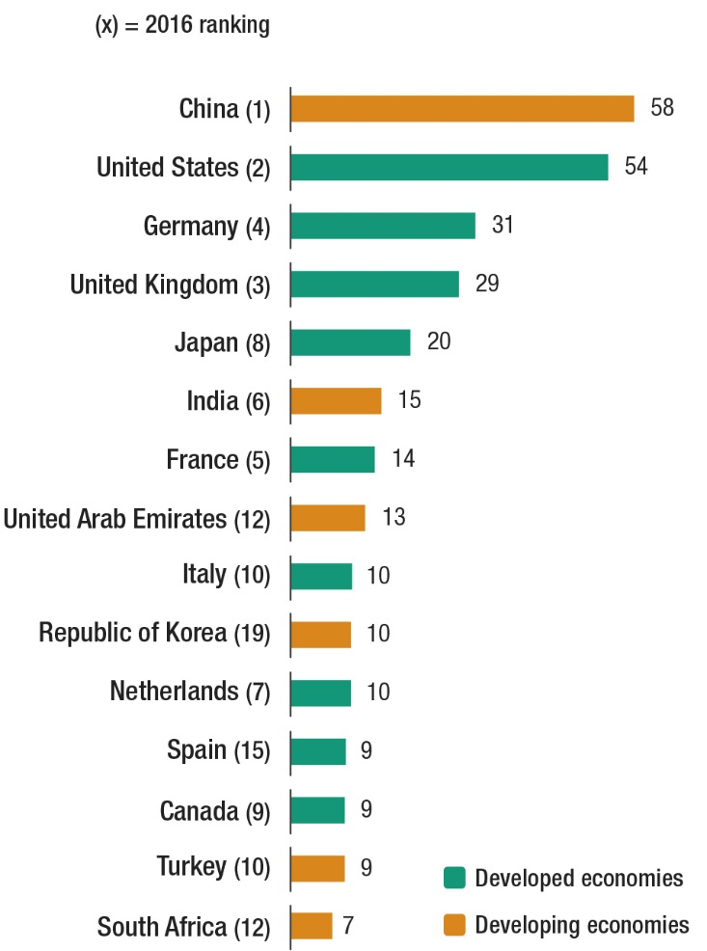
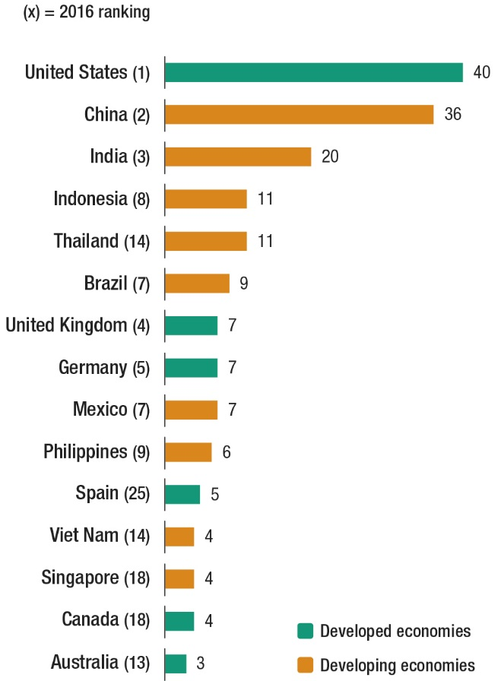
Most promising home countries and top prospective destinations
IPAs’ selection of most promising home countries for 2017–2019
(Per cent of IPAs responding)
MNEs’ top prospective host economies for 2017–2019
(Per cent of executives responding)
Source: ©UNCTAD WIR 2017.
12

Slide 13
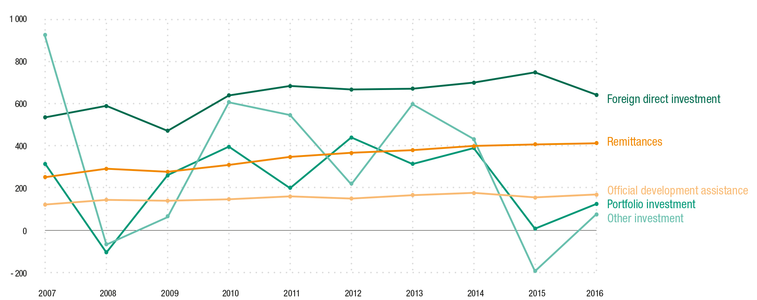
FDI remains a key source of finance for
developing economies
External sources of finance for developing economies,
2007–2016 (Billions of dollars)
Source: ©UNCTAD WIR 2017.
13

Slide 14
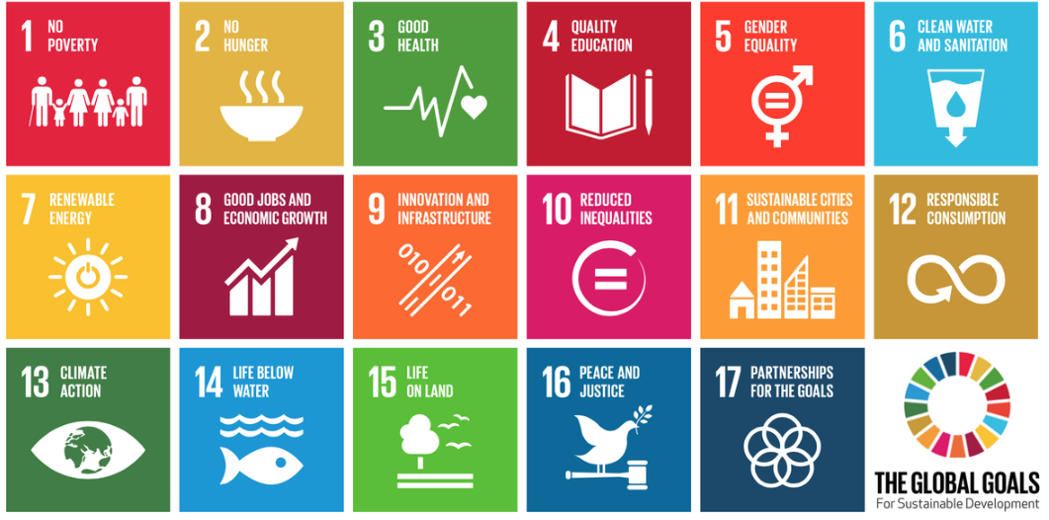
What to promote and facilitate?
UN SDGs for 2030 focus efforts on fighting poverty and addressing
global development and environmental challenges
Source: United Nations
14

Slide 15
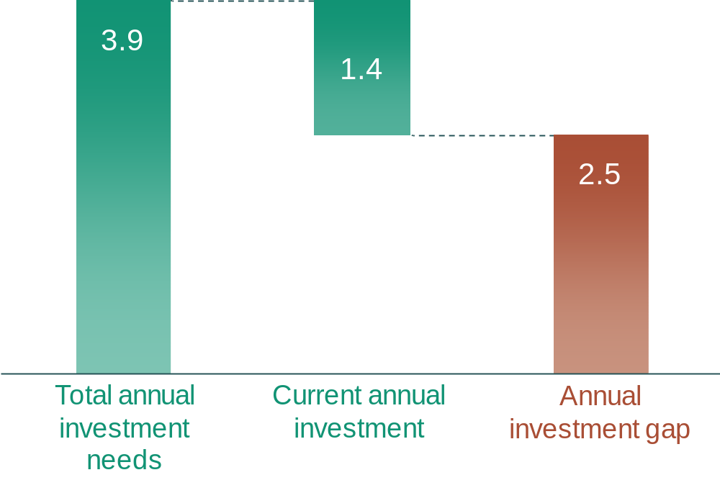
SDG investment gap
Estimated annual investment needs in key SDG sectors in developing countries, 2015–2030
(Trillions of US dollars, annual average)
Source: ©UNCTAD WIR 2014.
15

Slide 16
Key Sustainable Development Goal sectors
Sector | Description
Power | Investment in generation, transmission, and distribution of electricity
Transport | Investment in roads, airports, ports and rail
Telecommunications | Investment in infrastructure (fixed lines, mobile and Internet)
Water and sanitation | Provision of water and sanitation to industry and households
Food security and agriculture | Investment in agriculture, research, rural development, safety nets, etc.
Climate change mitigation | Investment in relevant infrastructure, renewable energy generation, research and deployment of climate-friendly technologies, etc.
Climate change adaptation | Investment to cope with impact of climate change in agriculture, infrastructure, water management, coastal zones, etc.
Eco-systems/ biodiversity | Investment in conservation and safeguarding ecosystems, marine resource management, sustainable forestry, etc.
Health | Infrastructural investment, e.g. new hospitals
Education | Infrastructural investment, e.g. new schools
Source: ©UNCTAD WIR 2014.
16

Slide 17
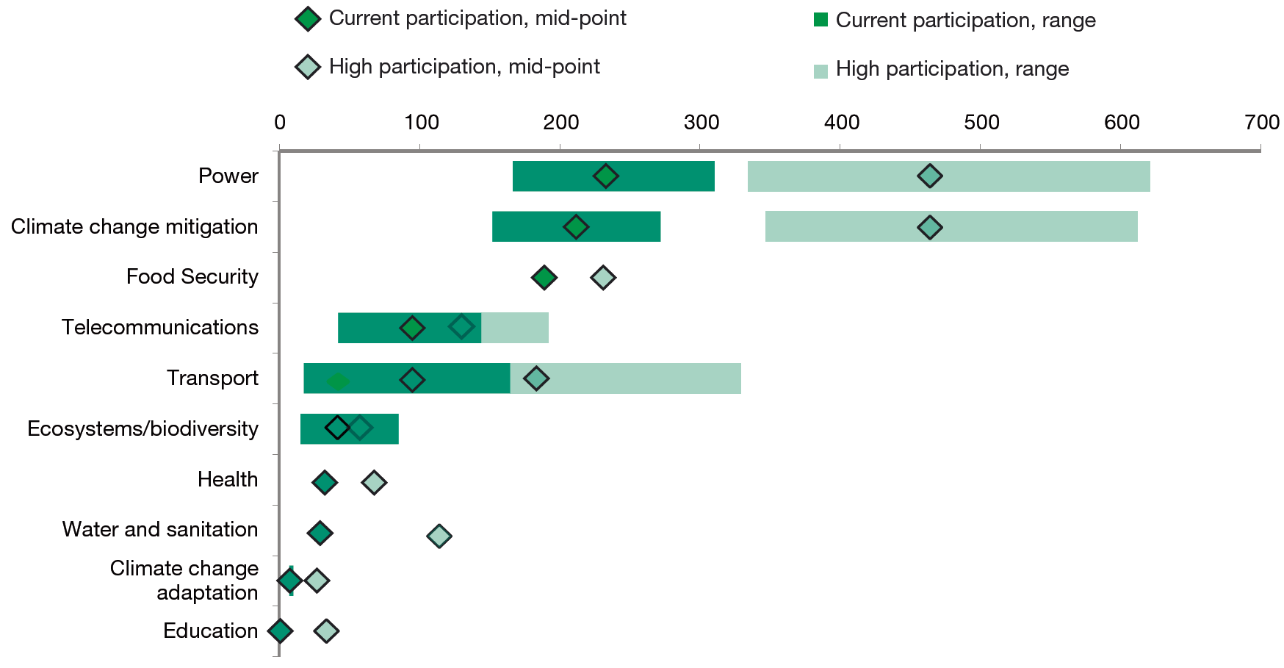
The potential for private sector investment in SDG sectors is significant
Potential private-sector contribution to investment gaps at current and high participation levels (Billions of US dollars)
Source: ©UNCTAD WIR 2014.
17

Slide 18
Investments in the SDGs require
a new generation of investment promotion policies
First generation: Liberalization of FDI regimes
Second generation: Marketing of countries and locations
Third generation: Investor targeting
New generation: Focus on SDG sectors and projects
18

Slide 19
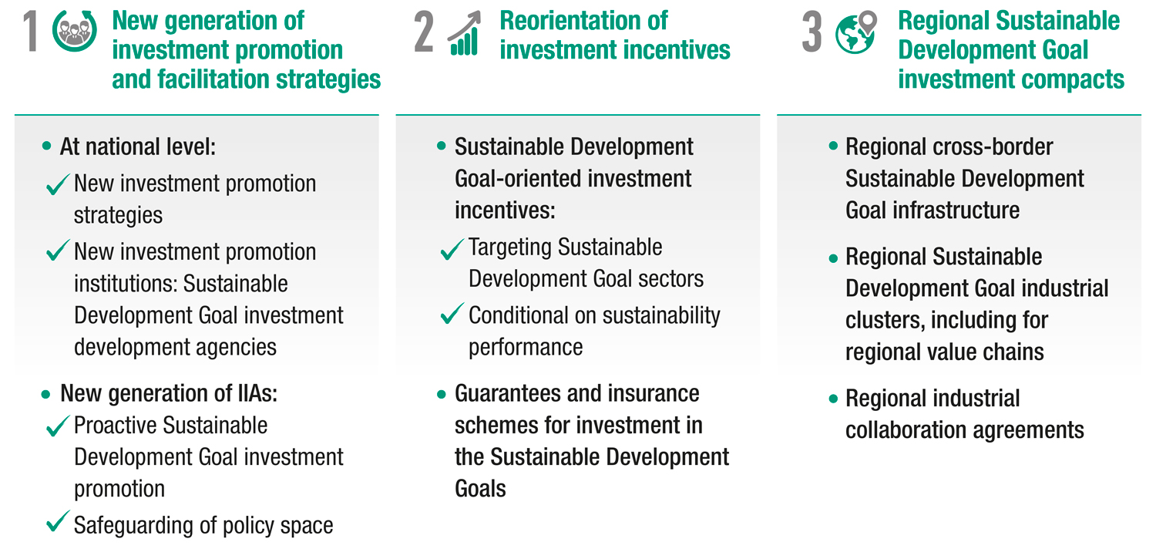
A Big Push for private investment in the SDGs:
Action Packages (1/2)
Source: ©UNCTAD WIR 2014.
19

Slide 20
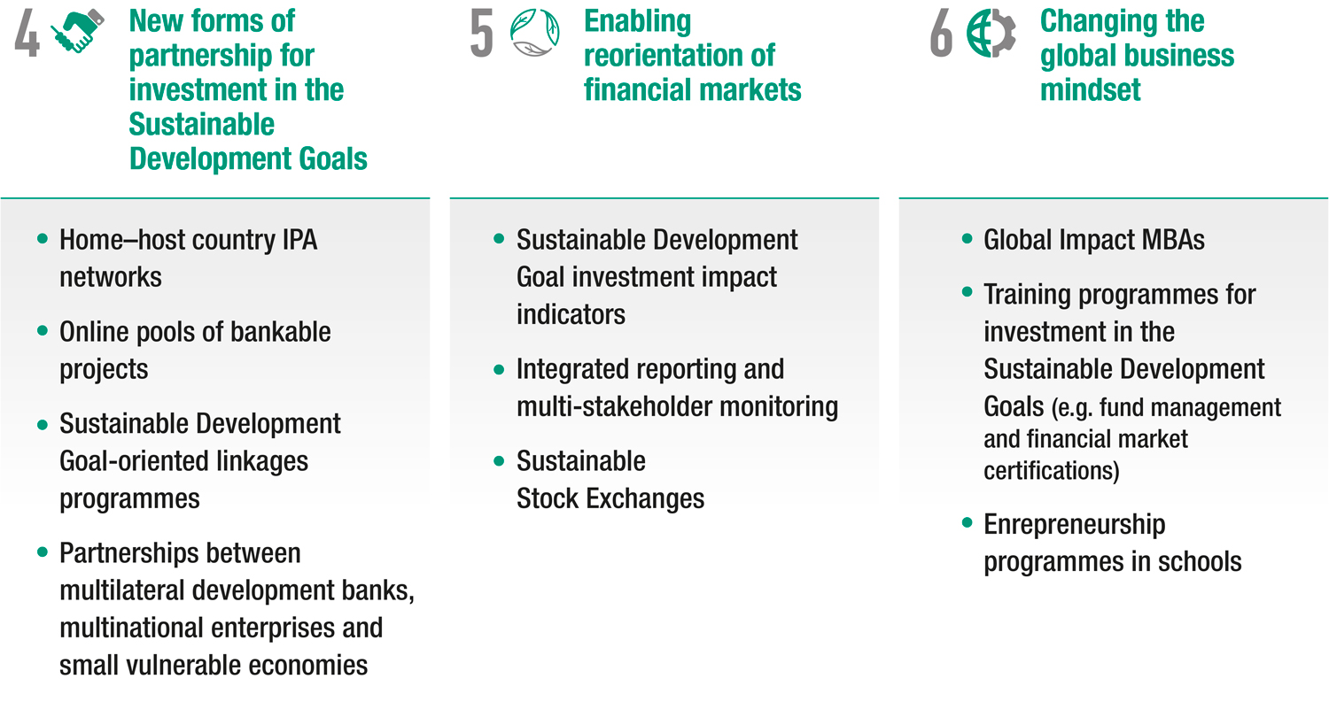
A Big Push for private investment in the SDGs:
Action Packages (2/2)
Source: ©UNCTAD WIR 2014.
20

Slide 21
How to promote and facilitate SDG projects?
SDG project targeting and facilitation
Broaden contacts with potential investors
Regional cooperation
Partnerships with OIAs
Build in-country partnerships
Source: UNCTAD
21

Slide 22
Investment promotion: targeting SDG projects
Create dedicated units for the preparation of SDG projects
Develop in-house expertise for each of these units
Prepare pipelines of bankable SDG investment project proposals
Use new marketing skills in SDG project promotion and facilitate implementation
Mainstream SDG investment promotion and agree on SDG priority sectors
Source: UNCTAD
22

Slide 23
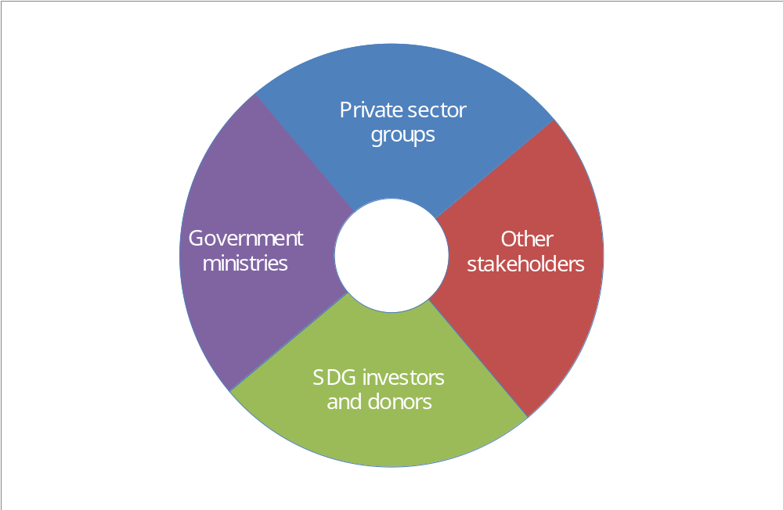
Building in-country multi-stakeholder partnerships
Traditional partners:
Ministries of industry, trade, investment and foreign affairs
TPOs, EDAs, industrial zones, SEZs
Chambers of commerce, manufacturing associations
Goals-related support partners:
Ministries of energy, health, education, agriculture and labour
Local governments
NGOs and informal sector representatives
OIAs and donor agencies
IPA
Source: UNCTAD
23

Slide 24
Broaden contact with potential investors
Relative sizes of selected potential sources of investment, 2012
(Value of assets, stocks and loans in trillions of US dollars)
Bank assets
121
Pension funds
34
Insurance companies
26
TNCs
25
SWFs
6.3
Source: ©UNCTAD WIR 2014
24

Slide 25


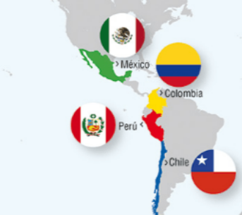
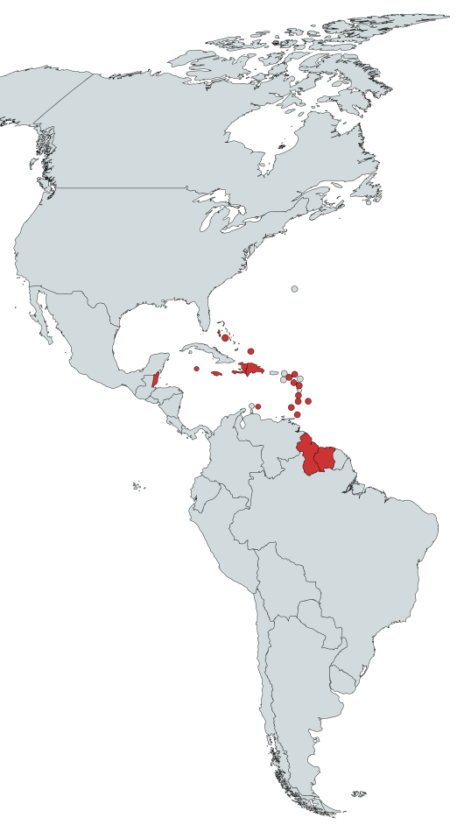
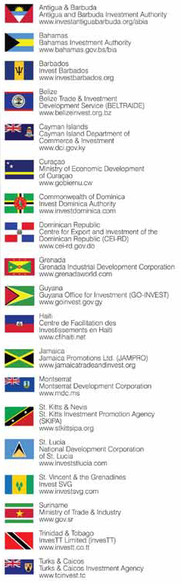
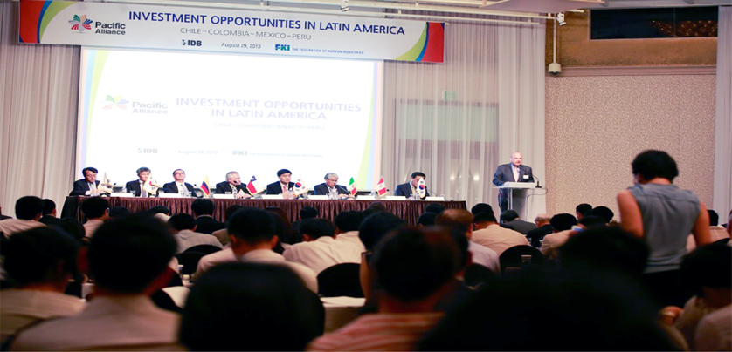
Regional cooperation between governments
and their IPAs
Caribbean Association of Investment Promotion Agencies
Pacific Alliance
25

Slide 26
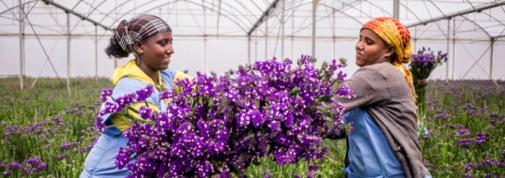
Partnerships with outward investment agencies
Outward investment agencies (OIAs)
Information sharing
Technical cooperation
Foreign enterprise
Investment opportunities marketing
Inward investment promotion agencies (IPAs)
Photo: Dutch Good Growth Fund
26

Slide 27
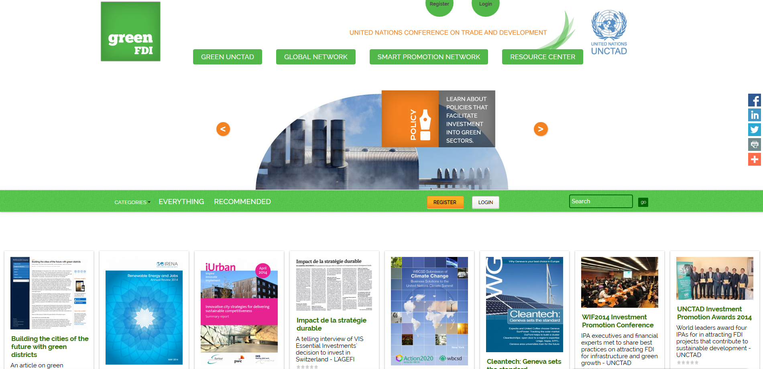
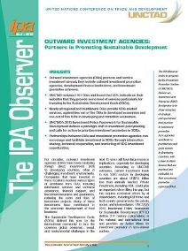
GreenFDI.org
a tool for promoting green investment
27

Slide 28


UNCTAD’s
Investment Promotion Programme
Thank you!
Paul Wessendorp
Chief, Investment Promotion Section
UNCTAD
Paul Wessendorp
Chief, Investment Promotion Section
UNCTAD
8 December 2015, Geneva
paul.wessendorp@unctad.org

